Slide 1
Researching History
1-3

Slide 2
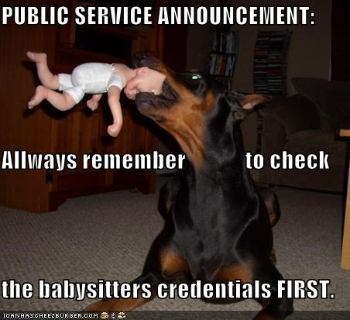
Authorship
Make sure articles from the internet are signed and the author is an expert
Credentials – something that gives confidence that a person is qualified

Slide 3
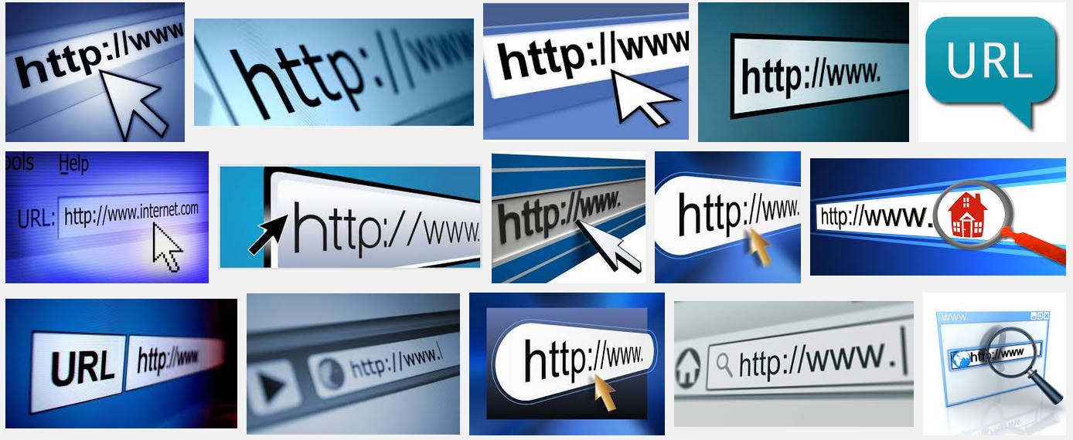
Web URLs
URL - Uniform resource locator
Address of an online resource

Slide 4
.gov – government site
Usually accurate
.edu – educational site
Usually accurate
.org - nonprofit
May be accurate but also bias
Tax exempt or charitable, meaning they do not pay income tax on the money that they receive for their organization

Slide 5
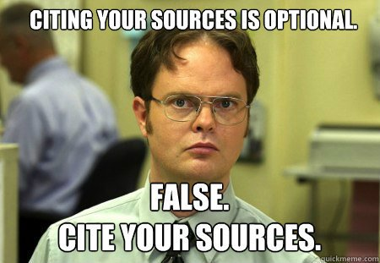
Plagiarism
Plagiarize – to present someone’s work as your own with giving credit

