Slide 1
How Does a Historian Work?
1-2

Slide 2
What is Evidence?
Something that shows proof that something is true
Material object
Documents
Sources – document or reference work

Slide 3
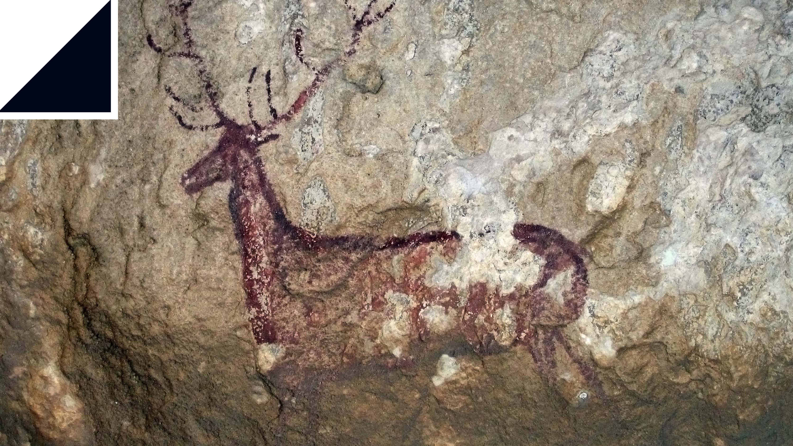
Primary Sources
First hand evidence of an event in history
Written or created by the people who saw the evidence
Letters
Diaries
Government records
Art
Maps
Interviews

Slide 4
Secondary Sources
Document or written work created after an event
Created by people who are not part of an event
Biographies
History books

Slide 5
Reliable Sources
Historians analyze and interpret primary sources
When was it created?
When?
Why?

Slide 6
Point of View
A personal attitude about people or life
Is it a trustworthy viewpoint?

Slide 7
Bias
Unreasoned, emotional judgement about people and events

Slide 8
Looking at History
Scholarly – concerned with academic learning or research

Slide 9
Drawing Conclusions
A decision reached after examining evidence
What can you conclude about these soldiers?

Slide 10
Historical Interpretation
Genghis Khan –
Violent warrior
Generous Mongol leader
Which was he?
Can he be both?

