Slide 1
Chapter 9
Balancing Chemical Reactions

Slide 2
Chemical Reaction
Chemical reaction - change in which one or more substances are converted into new substances
Example – baking a cake

Slide 3
Chemical Reactions
Reactant – substance or molecule that participates in a reaction
Product – substance that forms in reaction

Slide 4
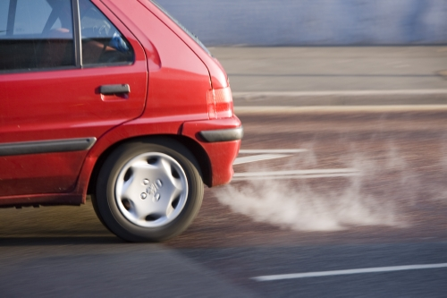
Chemical Reaction
Gas in a car
Reactants:
Isooctane C₈H₁₈
Oxygen O₂
Products:
Carbon dioxide CO₂
Water H₂0

Slide 5
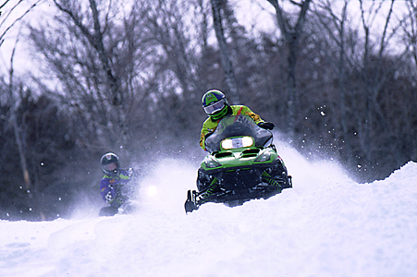
Chemical Reactions
The products and reactants contain the same types of atoms.
Rearranged as bonds are broken and formed.
Mass is always conserved

Slide 6
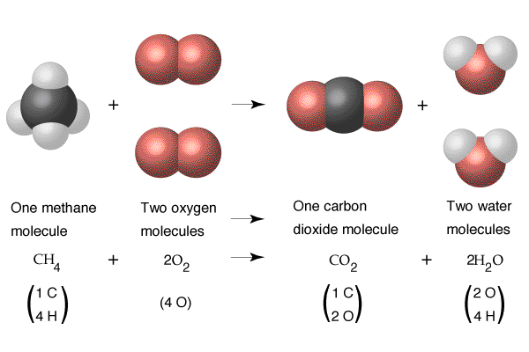

Slide 7
Conservation of Mass
The mass of the candles and oxygen before burning is exactly equal to the mass of the remaining candle and gaseous products.

Slide 8
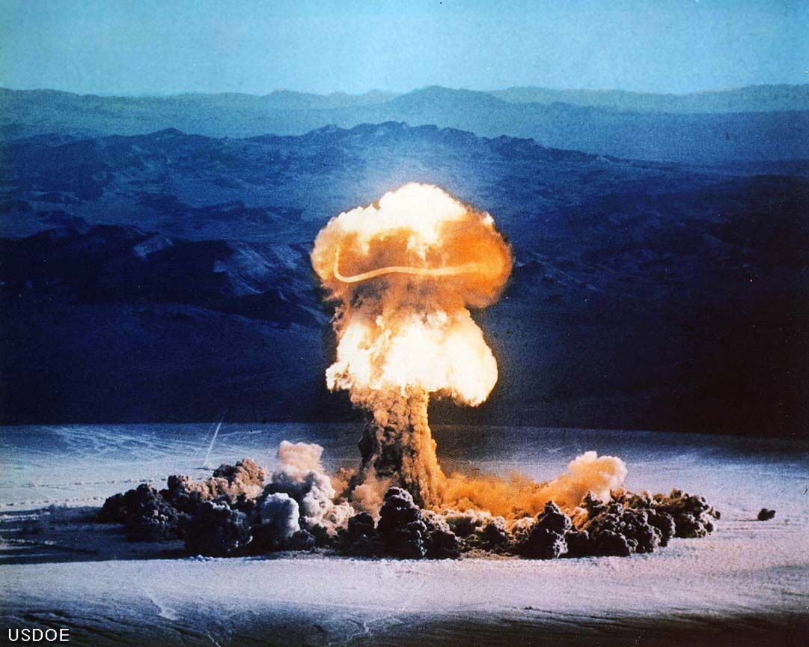
Energy and Reactions
All chemical reactions release or absorb energy.
Takes the form of:
Heat
Light
Sound
Electricity

Slide 9
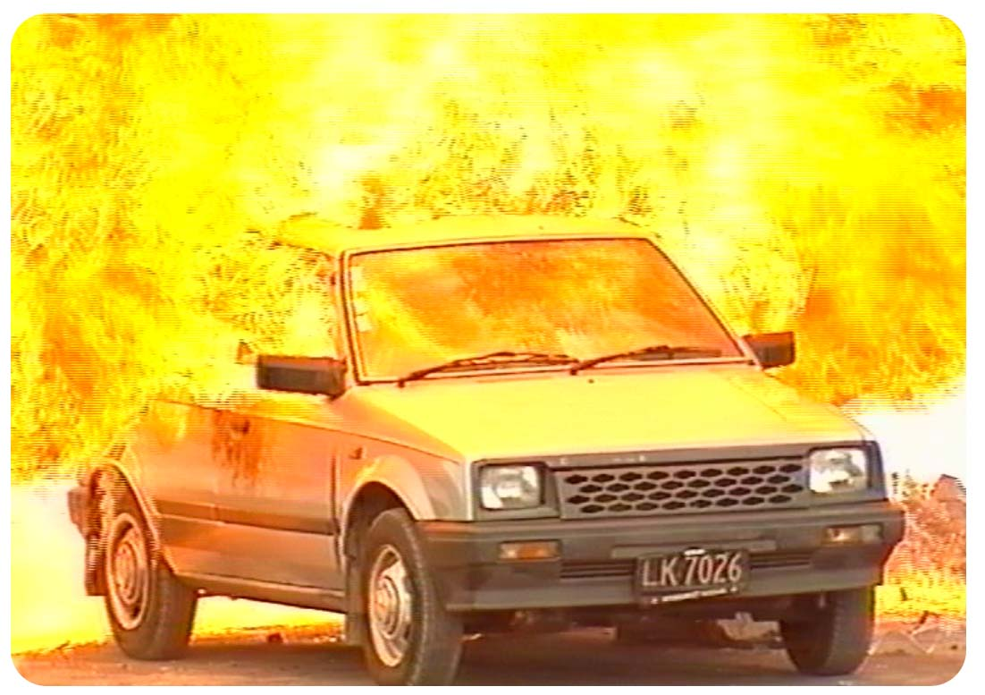
Energy and Reactions
When chemical reactions take place -
Some chemical bonds in the reactants are broken
Requires energy
In order for products to be produced, new bonds must form.
Bond formation releases energy.

Slide 10
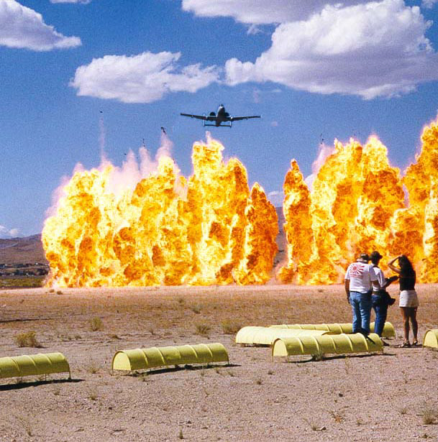
Exothermic Reaction
Exothermic Reaction - The energy given off in a reaction is in the form of heat
Heat Release
Examples –
Burning wood or exploding dynamite

Slide 11
Endothermic Reaction
Endothermic Reaction - The energy needed is in the form of heat
Heat absorption

Slide 12
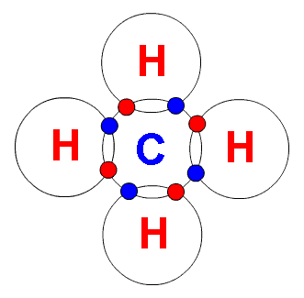
Balancing Equations
Methane + oxygen → carbon dioxide + water
CH₄ + O₂ → CO₂ + H₂O

Slide 13
1. H2 + O2 → H2O
Reactants Products
H 2 H 2
O 2 O 1
H2 + O2 → H2O
H2 + O2 → 2H2O
2H2 + O2 → 2H2O
Reactants Products
H 2 H 4
O 2 O 2
Reactants Products
H 4 H 4
O 2 O 2

Slide 14
2. HgO → Hg + O2
Reactants Products
Hg 1 Hg 1
O 1 O 2
HgO → Hg + O2
2HgO → Hg + O2
2HgO → 2Hg + O2
Reactants Products
Hg 2 Hg 1
O 2 O 2
Reactants Products
Hg 2 Hg 2
O 2 O 2

Slide 15
3. CO2 + H2O → C6H12O6 + O2
Reactants Products
C 1 C 6
H 2 H 12
O 3 O 8
CO2 + H2O → C6H12O6 + O2
CO2 + 6H2O → C6H12O6 + O2
6CO2 + 6H2O → C6H12O6 + O2
6CO2 + 6H2O → C6H12O6 + 6O2
Reactants Products
C 1 C 6
H 12 H 12
O 8 O 8
Reactants Products
C 6 C 6
H 12 H 12
O 18 O 8
Reactants Products
C 6 C 6
H 12 H 12
O 18 O 18

Slide 16
4. Na + H2O → NaOH + H2
Reactants Products
Na 1 Na 1
H 2 H 3
O 1 O 1
Na + H2O → NaOH + H2
Na + 2H2O → NaOH + H2
Na + 2H2O → 2NaOH + H2
2Na + 2H2O → 2NaOH + H2
Reactants Products
Na 1 Na 1
H 4 H 3
O 2 O 1
Reactants Products
Na 1 Na 2
H 4 H 4
O 2 O 2
Reactants Products
Na 2 Na 2
H 4 H 4
O 2 O 2

Slide 17
5. H3PO4 → H4P2O7 + H2O
Reactants Products
H 3 H 6
P 1 P 2
O 4 O 8
H3PO4 → H4P2O7 + H2O
2H3PO4 → H4P2O7 + H2O
Reactants Products
H 6 H 6
P 2 P 2
O 8 O 8

