Slide 1
Parts of an Atom
Chapter 7-2

Slide 2
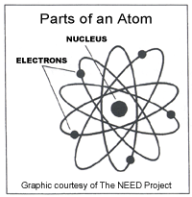
Inside an Atom
Nucleus – center of an atom
Contains protons and neutrons
Proton – particle with a positive charge (+)
Neutron – particle with no charge (0)
Most of mass

Slide 4
Inside an Atom
Electrons – particle inside an atom with a negative charge
Neutrally charged - Equal number of protons and electrons
Located in electron cloud

Slide 5
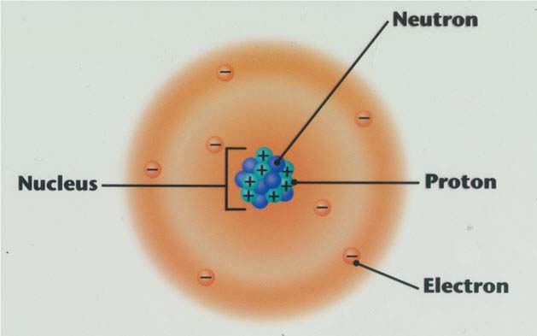

Slide 9
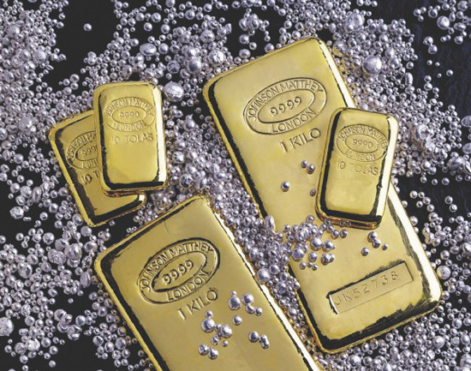
Natural Elements
Commonly found on Earth
Nitrogen, Oxygen
Gold, Silver

Slide 10
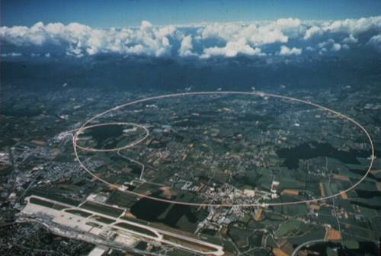
Synthetic Elements
Synthetic Elements – made in machines called particle accelerators
Not commonly found on Earth

Slide 11
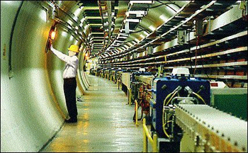

Slide 12
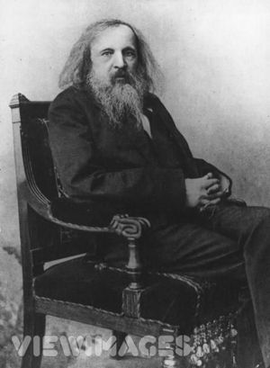
Periodic Table
Based on the work of Dimitri Mendeleev
Periodic Table – chart that organizes elements by the number of protons in the nucleus

Slide 14
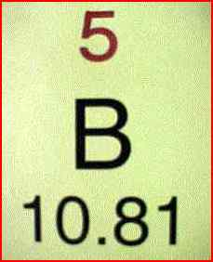
Periodic Table
Provides atomic mass
Pattern of electrons
Solid, liquid, or gas

Slide 15
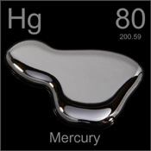

Slide 16
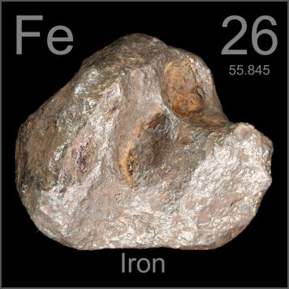
Chemical Symbol
1, 2, or 3 letter abbreviation
Hydrogen – H
Some come from Latin Words
Iron – Fe
ferrum

Slide 17
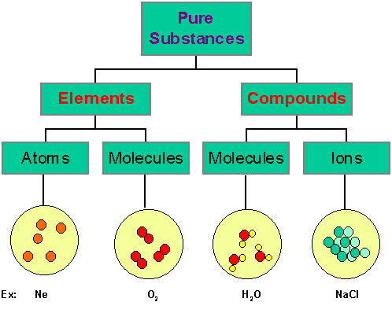
Pure Substances
Materials are made of a pure substance or a mixture of substances.
Pure substance - Elements or compounds

Slide 18
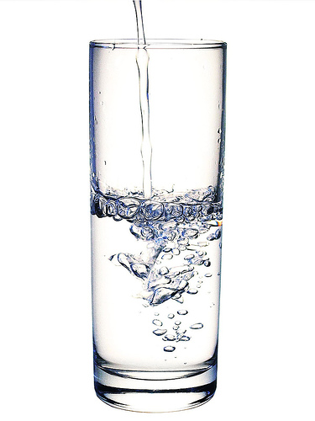
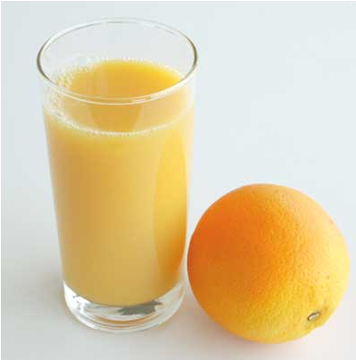

Slide 19
Compounds
Compound – substance made of 2 or more different elements
Chemically combine
Example – Water or H₂O
Elements hydrogen (2 atoms) and oxygen (1 atom) combine to form water

Slide 20
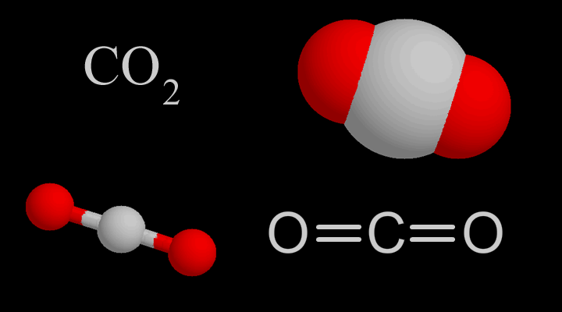

Slide 21
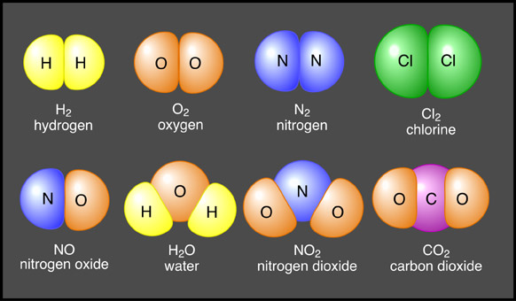
Molecules
Molecules – smallest unit of a substance that behaves like the substance
More than one atom together
Same or different atoms

Slide 22
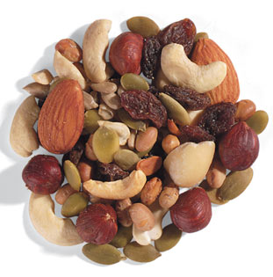
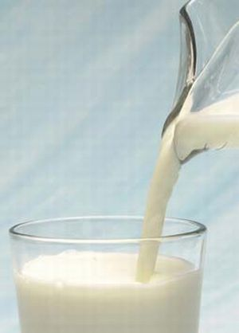
Mixture
Mixture – 2 or more substances put together that don’t form a compound

Slide 23
Heterogeneous Mixture
Heterogeneous mixture – substances aren’t mixed uniformly and aren’t distributed evenly

Slide 24
Heterogeneous Mixtures

Slide 25
Homogeneous Mixtures
Homogeneous mixture – 2 or more substances blended evenly throughout

Slide 26
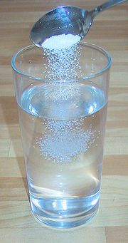

Slide 28
BREAK!

Slide 29
Ion
Ion – atom that has lost or gained one or more electrons
Has a charge

Slide 30
Ions
No longer has the same # of p+ and e-

Slide 31
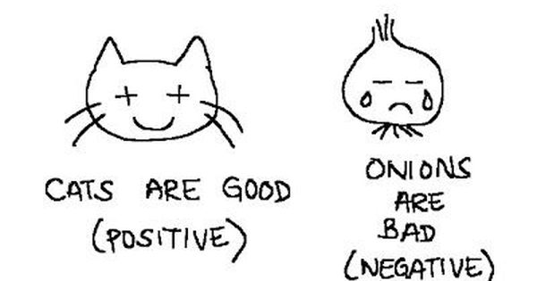
Cation
Cation – positive ion
Li⁺

Slide 32
Anion
Anion – gains an electron to become a negative ion
F⁻

Slide 33
Atomic Mass
Nucleus - contains most of the mass of the atom
Protons and neutrons - far more massive than electrons.
1,836 times larger than an electron.
Proton mass = Neutron mass

Slide 34
Atomic Mass
Mass number – sum of the # of protons and neutrons in the nucleus
Atomic mass unit (amu).

Slide 36
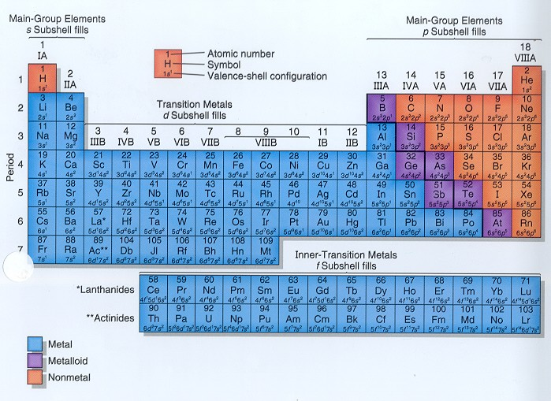

Slide 37
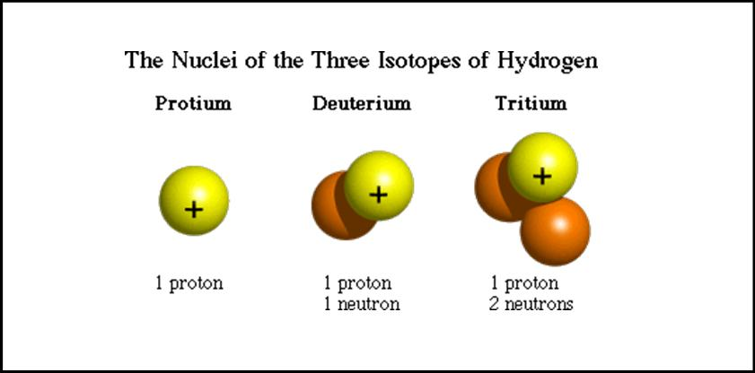
Isotopes
Isotopes - Atoms of the same element that have different numbers of neutrons
Name of the element followed by the mass number of the isotope to identify each isotope
Example: Hydrogen-2 and Hydrogen-3.

Slide 39
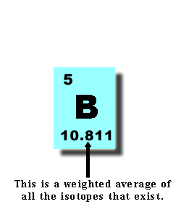
Identifying Isotopes
Average atomic mass – weighted average mass of the mixture of its isotopes.

Slide 40
Chemical Formulas
Chemical Formulas – made up of symbols and numbers
Tell what elements and ratios in compound

Slide 41
Chemical Formulas
H₂O
2 Hydrogen; 1 Oxygen
2H₂O
4 Hydrogen; 2 Oxygen

Slide 42
Chemical Formula
Chemical formula – shows how many atoms of each element are in a substance
# in front of letter = # of molecules
# in subscript = # of atoms
3C₁₂H₂₂O₁₁
3 molecules of sugar
Each molecule contains given # of atoms

Slide 43
Radioactivity
Elements that release radiation
Energy released
# of protons changes
Changes element

Slide 44
Nuclear Decay
Unstable nuclei
Changes into another more stable nuclei
Emits radiation

Slide 45
Alpha Decay
Particle released with 2 protons and 2 neutrons

Slide 46
Beta Decay
Neutron changes into a proton and a high energy electron called a Beta particle

Slide 47
Gamma Decay
No change in nucleus
Lots of energy released

