Slide 1
Parts of an Atom
Chapter 7-1

Slide 2
Early Ideas
2,000 years ag0 – Greek philosophers thought matter was made of 4 elements:
Fire
Air
Water
Earth

Slide 3
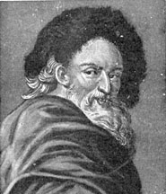
Early Ideas
Democritus
Matter is made of small solids that cannot be created or destroyed
Atom – Greek word meaning “can not divide”
Atoms moving all the time
Different matter = different atoms
His ideas were debated.

Slide 4
Aristotle
Challenged Democritus
Didn’t believe empty space existed
Believed in the 4 types of matter
He went with the popular belief.
Democritus's ideas weren’t studied for 2,000 years later!

Slide 5
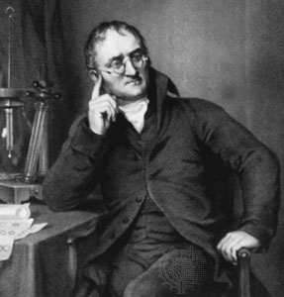
Revisiting Democritus
John Dalton – 1st model of an atom
Used new technology to form the Atomic Theory
All of the atoms in something are identical
Atoms of different elements are different from each other
Atoms cannot be created, divided, or destroyed

Slide 6
Atom
Atom – smallest piece of an element that still represents that element

Slide 7
What is Matter?
Matter – a term used to describe anything that has mass and takes up space
Not matter
Light
Heat
Energy

Slide 8
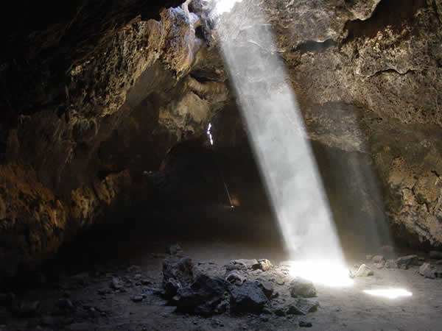

Slide 9
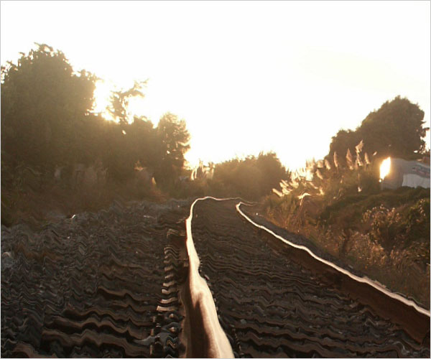

Slide 10
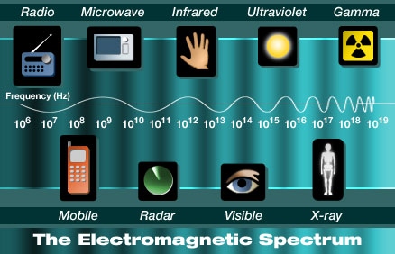

Slide 11
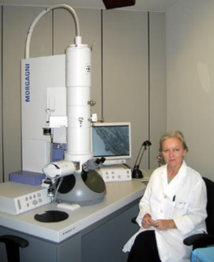
Size of an Atom
1980’s – electron microscopes
Allowed Scientist to see an atom
7.5 trillion carbon atoms could fit into a period in a book

Slide 12
Seeing Atoms
STM – Scanning Tunneling Microscope
Still can’t see inside an atom.

Slide 13
J.J. Thomson – Discovered Electrons
Cathode ray tubes – old T.V.’s and computer screens
Glass tube with pieces of metal (electrodes) attached inside the tube
Air removed
Electricity passed through tube
What were the rays made of?

Slide 14
Discovery of Electrons
Electrons – particle inside an atom with a negative charge

Slide 15
Thomson’s Atomic Model
Positive and negative charges
Negative charged electrons mixed with positive charges

Slide 16
Ernest Rutherford
Alpha particles – dense and positively charged
His Idea:
If shot through atom it would go straight through
Positive charge of atoms would spread out – not dense enough to deflect alpha particles

Slide 17
Gold Foil Experiment
Shot the alpha particle at a gold foil
Results:
Most of the particles traveled though foil
Some bounced to the sides
Alpha particles must have hit something dense and positively charged

Slide 18
Atomic Model
Most went through – atoms were made of mostly empty space
Some bounced back – most of the mass and positive charges of an atom are in the center
Nucleus – center of an atom

Slide 19
Inside an Atom
Nucleus – center of an atom
Contains protons and neutrons
Most of Mass
Proton – positive charge (+)
Neutron – no charge (0)

Slide 20
Niels Bohr’s Model
If certain elements were heated different colors of light was emitted with different energy
Why?
Experimented with hydrogen and adding electric energy

Slide 21
Bohr’s Model
Electrons move in circular orbits with different amounts of energy
Electrons closer to nucleus have less energy
If you add energy they move away

Slide 22
Modern Atomic Model
Electron cloud – area around the nucleus where atoms are likely to be
Electron speed and location can only be predicted

Slide 23
Quarks
Protons and neutrons are made of quarks
6 different types

