Slide 1
Using Thermal Energy
Chapter 5-3

Slide 2
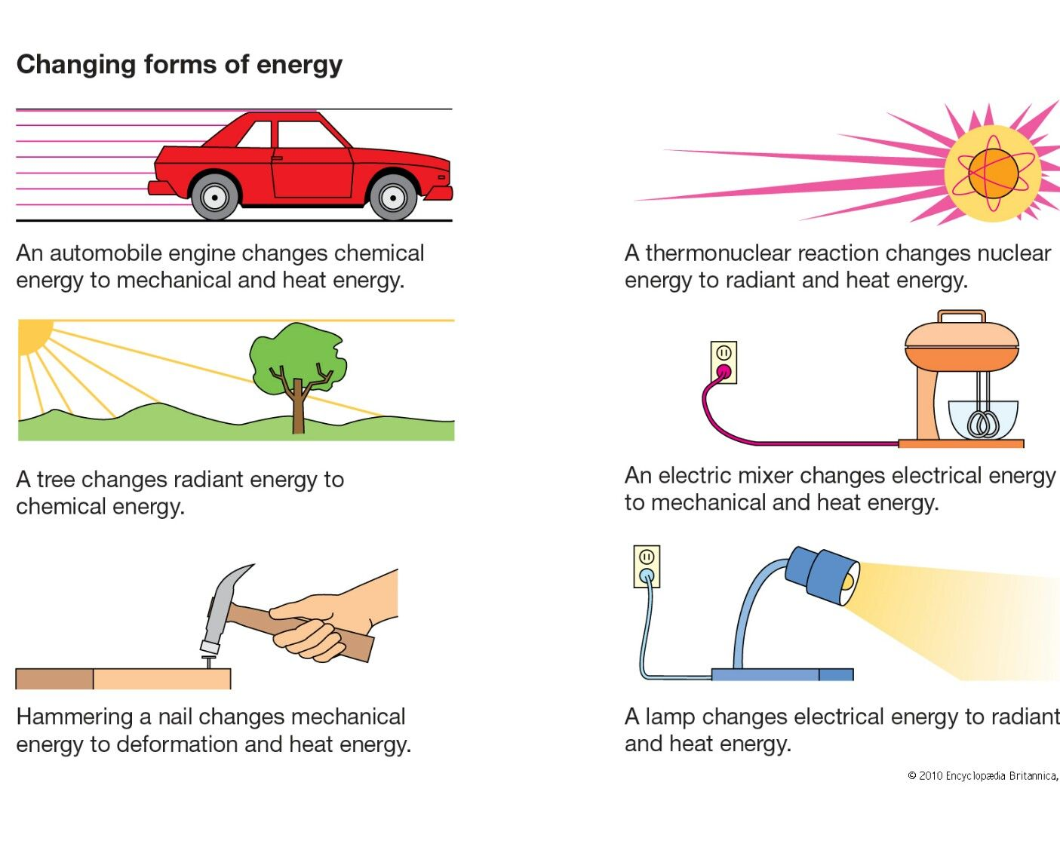
Thermal Energy Transformation
You can convert many types of energy into thermal energy
Rubber band
Burning wood
Toaster
All will get HOT!
Vise versa:
Burning coal - electricity
Thermostats - mechanical

Slide 3
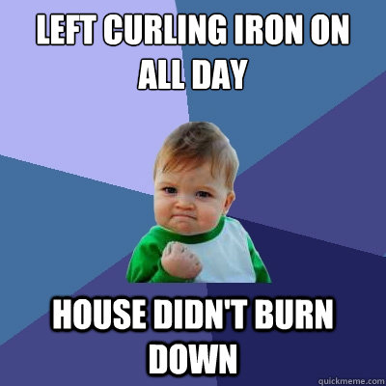
Heating Appliances
Converts electrical energy into thermal energy
Curling Irons - Youtube
Coffeemaker
Electrical devises

Slide 4
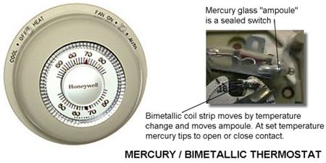
Thermostats
Regulates temperature of a system
Bimetallic coil – 2 types of metal in a coil
Metals expand and contract differently – metal moves – triggers switch

Slide 5
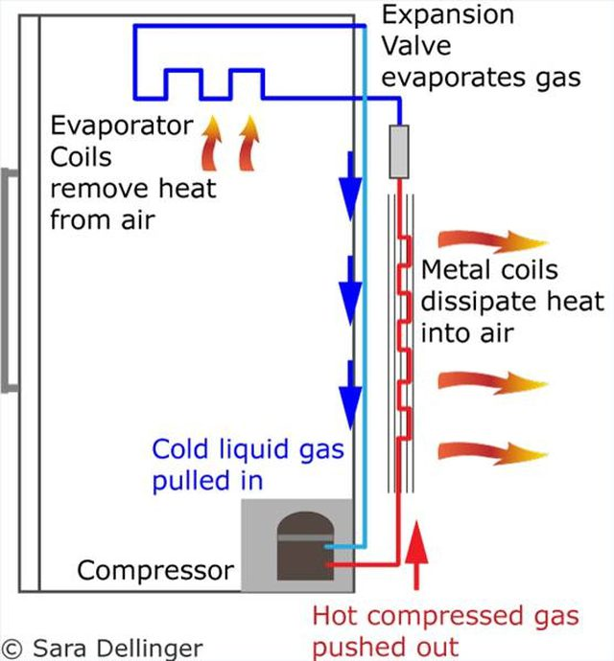
Refrigerators
Uses electrical energy to transfer thermal energy from a cooler place to a warmer place
Pipes filled with a coolant fluid
Thermal energy (inside fridge) transfers to the coolant

Slide 6
Vaporizing the Coolant
Coolant – substance that evaporates at a low temperature
Begins as liquid – passes through expansion valve and cools
Cold gas absorbs thermal energy

Slide 7
Condensing the Coolant
Flows into compressor
Forced into smaller space – increases thermal energy
In coils – thermal energy of gas is greater than surrounding air
Heat flows behind refrigerator

Slide 8
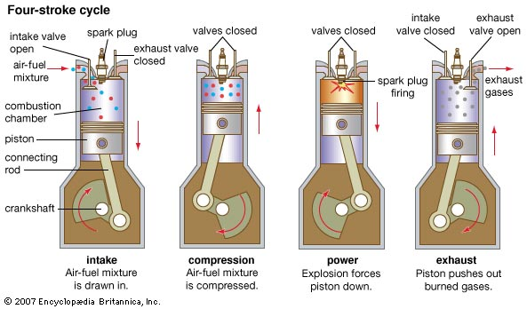
Heat Engine
Machine that converts thermal energy into mechanical energy
Internal combustion engines (car)
Not efficient – only 20% of chemical energy in gas is transferred to mechanical energy

Slide 9
