Slide 1
Thermal Energy Transfer
Chapter 5-2

Slide 2
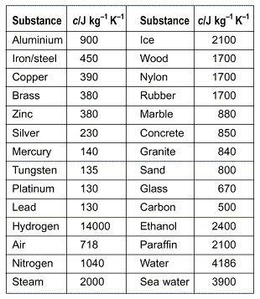
Specific Heat
Specific Heat - Amount of heat that is needed to raise the temperature of 1 kg of some material by 1°C
Measured in joules per kilogram Kelvin [J/(kg °K)].

Slide 3
Water
Specific heat of water - high because water molecules form strong bonds with each other.

Slide 4
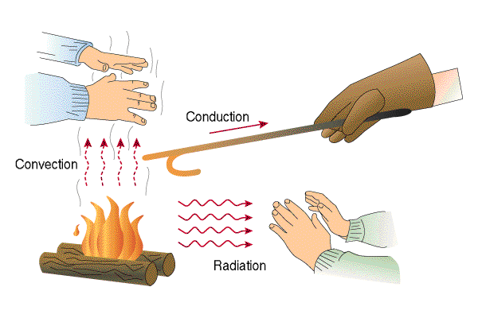
Transfer of Energy
Energy can be transferred by:
1. Thermal Conduction
2. Convection
3. Radiation

Slide 5
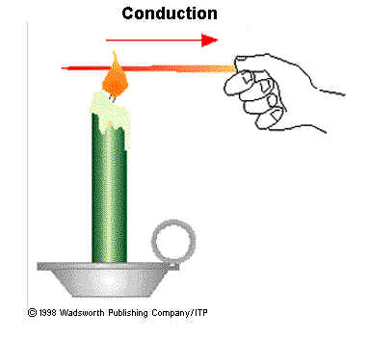
Thermal Conduction
Conduction - transfer of thermal energy by collisions between particles in matter.
Conduction = touching

Slide 6
Thermal Insulators
Material which thermal energy doesn’t flow easily
Fewer collisions between atoms

Slide 7
Thermal Conductors
Material in which thermal energy flows easily

Slide 8
Heat moves faster by conduction in solids and liquids than in gases.
Gases - particles are farther apart
Collisions with other particles occur less frequently than they do in solids or liquids.

Slide 9
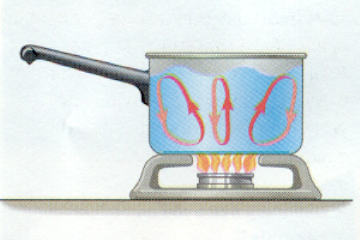
Convection
Convection - transfer of thermal energy by the movement of particles
Fluids – gas or liquid

Slide 10
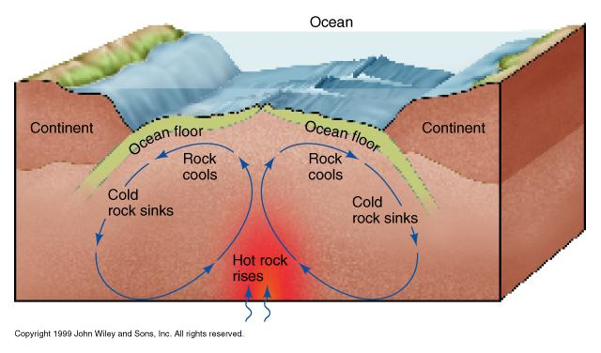

Slide 11
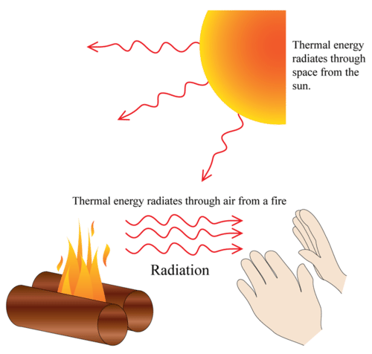
Radiation
Almost no matter exists in the space between Earth and the Sun
Heat reaches Earth by radiation.
Radiation - transfer of energy by electromagnetic waves.

Slide 12
Thermos
Vacuum - contains almost no matter
Prevents heat transfer by conduction or radiation between liquid and air outside of thermos.
Coated with aluminum to make each surface highly reflective.

Slide 13
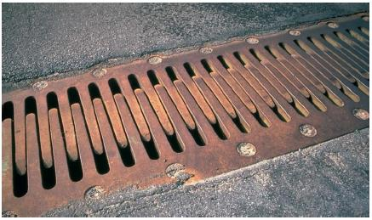
Thermal Expansion
Adding heat = more energy
More energy = more movement of particles
Particles move and object expands

Slide 14
Thermal Contraction
Losing heat = less energy
Less energy = Less movement of particles
Particles move less and object shrinks

Slide 15
Sidewalk Gaps

Slide 16
Hot-Air Balloons

Slide 17
Ovenproof Glass
Expands less than normal glass

Slide 18
Video Clip - Youtube
Misconceptions About Temperature
Veritasium

