Slide 1
Thermal Energy
Chapter 5-1

Slide 2
Kinetic Energy (KE)
Energy due to motion

Slide 3
Potential Energy (PE)
Stored energy
Chemical
Position

Slide 4
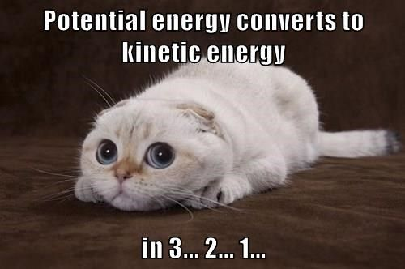

Slide 5
Mechanical Energy
Potential + Kinetic Energy

Slide 6
Thermal Energy
All matter is made of particles
Particle vibrate in place = KE
The greater the distance between particles = more PE

Slide 7
Thermal Energy
Sum of the KE and PE of particles in a material

Slide 8
Temperature
Average KE of the particles in a substance
More KE = higher temperature

Slide 10
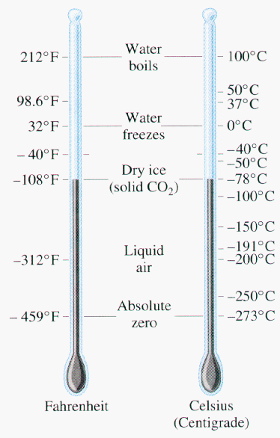
Temperature
SI unit for temperature is kelvins (K).
273, 373
Celsius (°C)
0, 100
Fahrenheit (°F)
32, 212

Slide 11
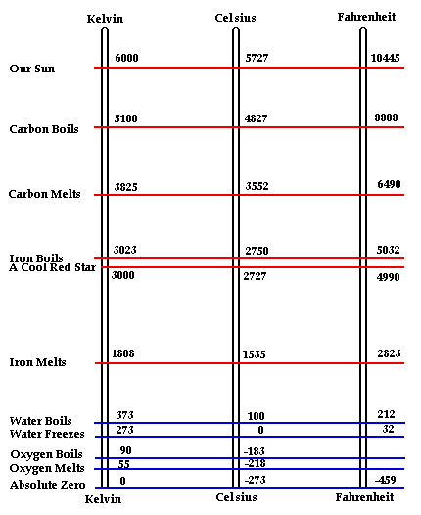

Slide 12
Thermometers
Thermometers – instruments that measure and indicates temperature
Liquid Thermometer
Refrigerator Thermometer
Digital Thermometer

Slide 13
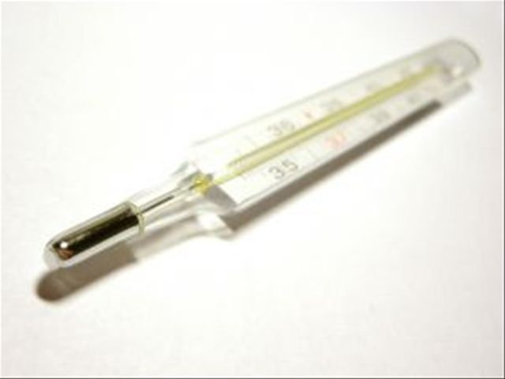
Liquid Thermometer (Bulb)
Expansion of a liquid, alcohol, or mercury, to indicate change in temperature.
Liquid heated = expands
Liquid expands = rises up tube

Slide 14
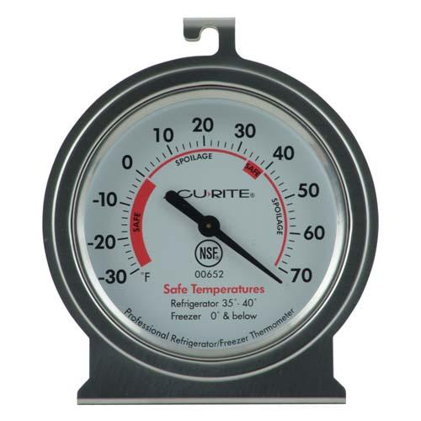
Refrigerator Thermometer
Used for extreme temperatures (liquid boils or freezes)
Uses the bending of a strip made from two metals to indicate the correct temperature

Slide 15
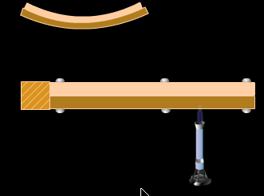

Slide 16
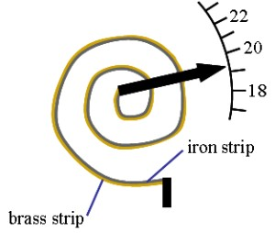

Slide 17
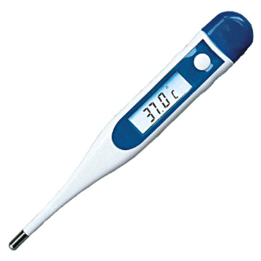
Digital Thermometer
Measures temperature by a change in current.
Temperature causes changes in electrical current.

Slide 18
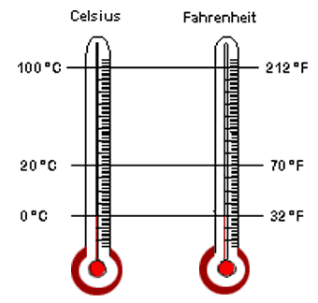
Fahrenheit vs. Celsius
Most countries other that US use Celsius
0 °C – Freeze
100 °C – Boil
USA uses Fahrenheit
32 °F – Freeze
212 °F - Boil

Slide 19
Fahrenheit vs. Celsius
Fahrenheit = (1.8 x Celsius) + 32
Celsius = (Fahrenheit – 32)
1.8

Slide 20
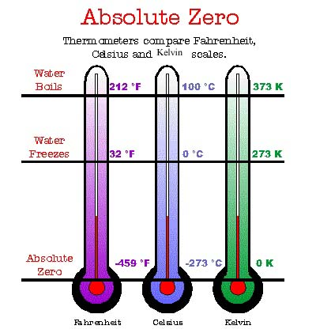
Kelvin
Absolute Zero – lowest temperature possible
-273.16 °C
-459 °F
0 K
Molecules stop moving
No negative #’s in Kelvin

Slide 21
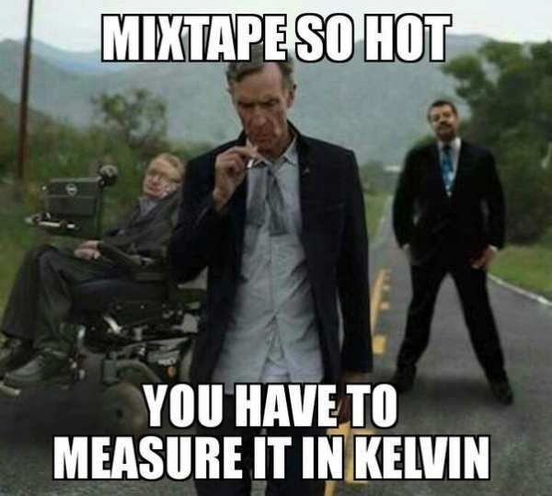
Kelvin
Kelvin = Celsius + 273

Slide 22
Heat
Heat – movement of thermal energy from a warmer to cooler object
Warm to cool
Measured in Joules

