Slide 1
Mirrors, Lenses, and the Eye
Chapter 4-3

Slide 2
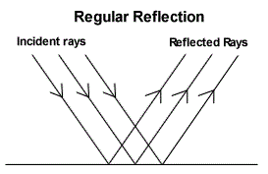
Regular Reflection
Regular reflection – smooth surface

Slide 3
Diffuse Reflection
Diffuse reflection – rough surface

Slide 4
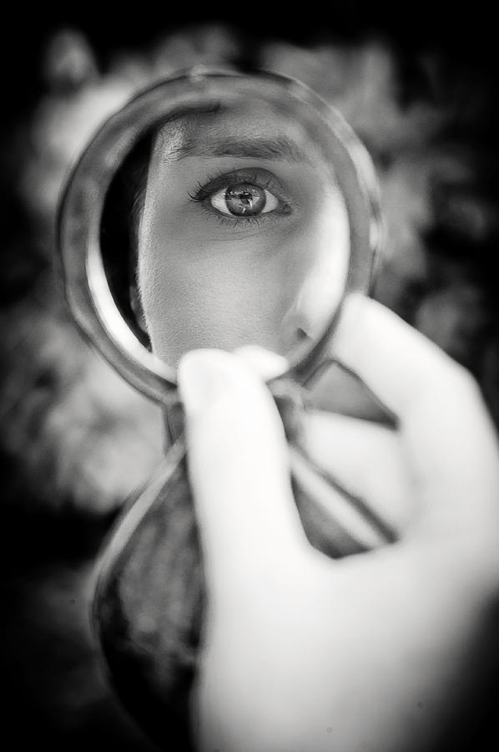
Mirror
Any reflective surface formed by regular reflection

Slide 5
Plane Mirror
Image reversed
Size of image depends on distance from mirror

Slide 6
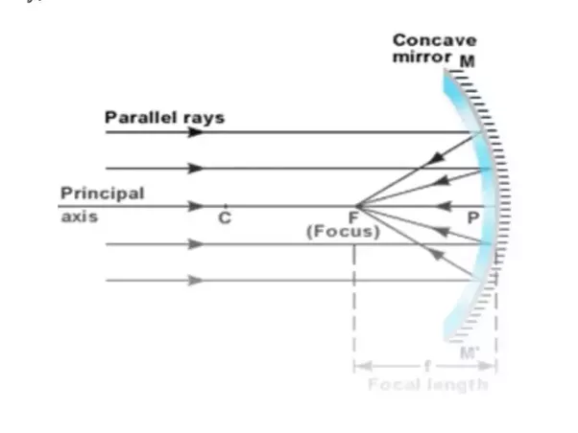
Concave Mirrors
Concave mirror – surface curved inward
Distance from mirror to focal point is the focal length

Slide 7
If an object is more than one focal length away = image upside down

Slide 8
If object is closer than one focal length = right-side up
If object is at focal point = no image

Slide 9
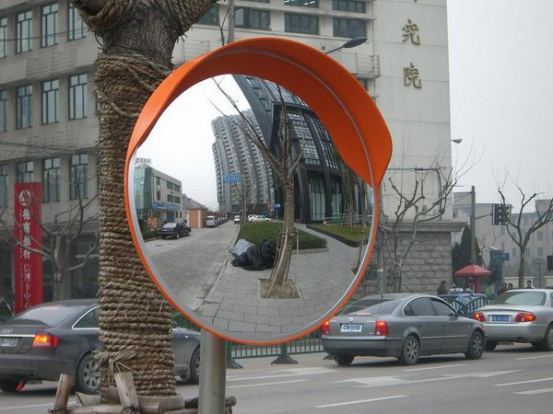
Convex Mirrors
Convex mirror – curved outward
Light rays spread out
Always right-side up
Smaller

Slide 10
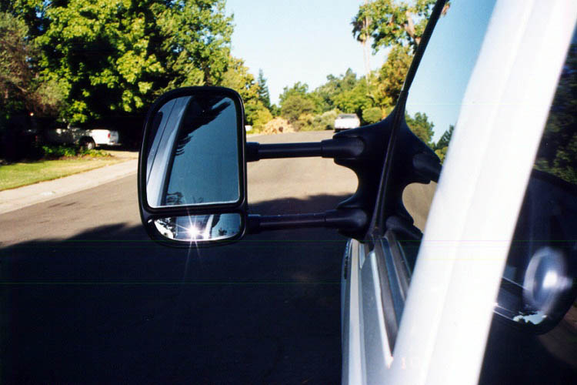

Slide 11
Lens
Transparent
Curved side
Causes light to change direction

Slide 12
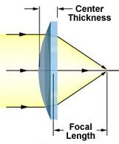
Convex Lenses
Convex lens - thicker in the middle than at the edges

Slide 13
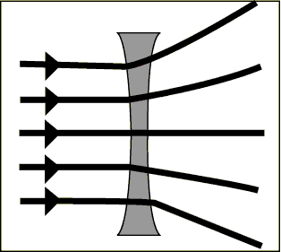
Concave Lenses
Concave lens - thinner in the middle and thicker at the edges

Slide 14
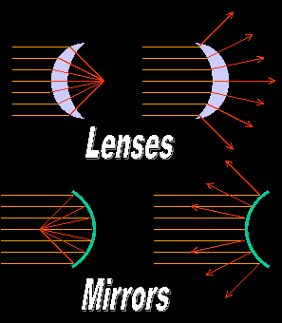

Slide 15
Lenses and Eyesight
Light enters your eye through a transparent covering on your eyeball called the cornea
Convex lens

Slide 16
Lenses and Eyesight
The light then passes through an opening called the pupil
Colored part - Iris
Lens - helps focus light rays formed on your retina

Slide 17
Focusing Near and Far
The lens in your eye is flexible
Muscles attached to it change its shape to focus

Slide 18
Retina
Layer of light sensitive cells in the back of the eye
Sends images back to brain

Slide 19
Rod and Cone Cells
Rod – allows you to see in dim light
Cone – allows you to see color
Needs brighter light
3 types that see different colors

Slide 20
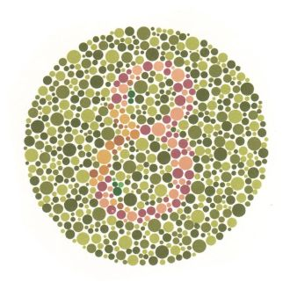
Color Blindness

Slide 21
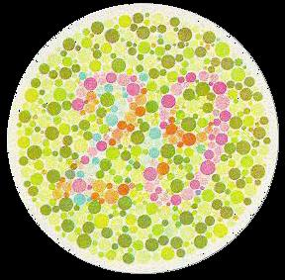

Slide 22
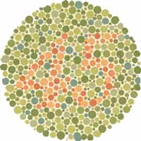

Slide 23
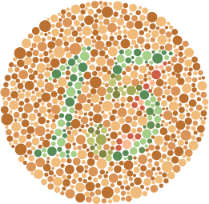

Slide 24
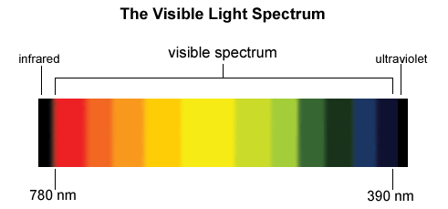
ROYGBIV

Slide 25
