Slide 1
4-2
Population

Slide 2
Population
Total number of people in a given area
Influences:
Businesses
Transportation
Schools

Slide 3
Population density
A measure of the number of people living in an area
People per square mile

Slide 5
Japan – 880 people per square mile
More people
Expensive
Australia – 6 people per square mile
Less people
More space

Slide 6
Where people live
Not many in:
Northern North America
Greenland
Northern Asia
Australia
Lots in:
Asia
Europe
Eastern North America

Slide 7
Population change
Population affects:
Housing
Jobs
Schools
Hospitals
Food

Slide 8
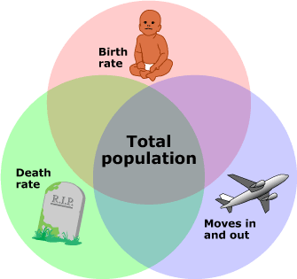
birthrate
Annual number of births per 1,000 people
Birthrate – Deathrate = Natural Increase
Rate at which population is changing

Slide 10
Migration
The process of moving from one place to live in another
War
Jobs
Farmland

Slide 12
World population trends
In the last 200 years the Earth’s population exploded.
Over 7 billion people
Improvements in healthcare and food production

Slide 13
Industrialized nations – growth has slowed
Less industrialized nations – growth rate is high
Why?

