Slide 1
Light
Chapter 4-2

Slide 2
Wave Speed
670,616,629 mph in the vacuum of space
Nothing travels faster than the speed of light!
You would be able to circumnavigate the globe approximately seven and a half times in one second. Meanwhile, a person flying at an average speed of about 500 mph, would take over 50 hours to circle the planet just once.

Slide 3
A Range of Frequencies
Range of electromagnetic wave frequencies - electromagnetic spectrum

Slide 5
Light Source
Something that emits light
Sun
Candles
Light bulb

Slide 6
Light Ray
Narrow beam of light that travels in a straight line

Slide 7
Interaction of Light and Matter
Reflection – bounce off

Slide 8
Seeing Objects
Light travels directly from the source
Light is reflected

Slide 9
Transmission – light travels through an objects

Slide 10
Absorption – converts light energy into other forms of energy

Slide 12
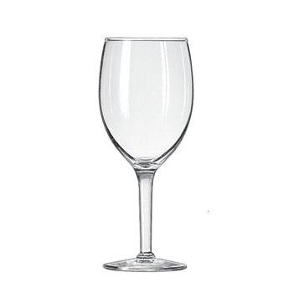
Color
Transparent – Transmit most light (Glass Window)

Slide 13
Color
Translucent – Transmit some light

Slide 14
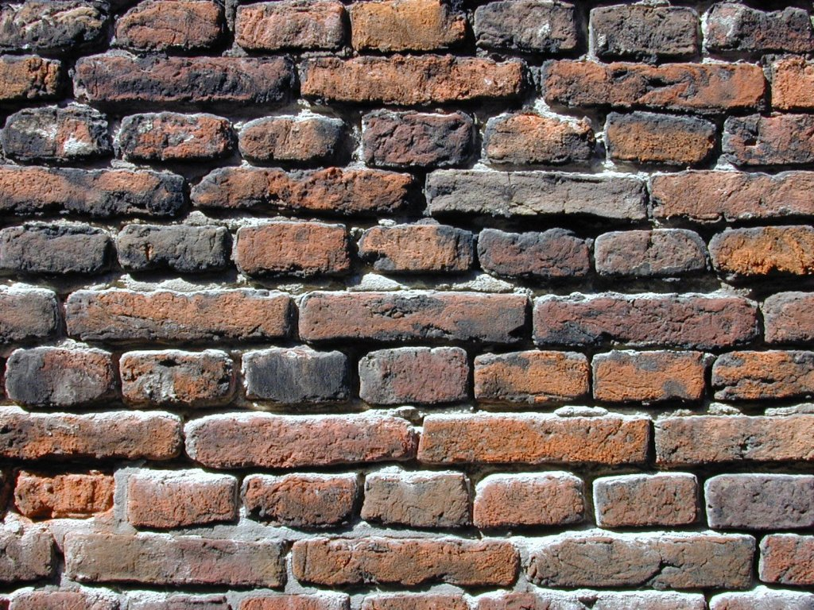
Color
Opaque – Does not transmit light (Wall)

Slide 15
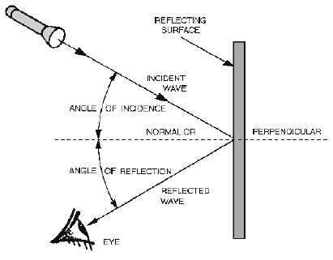
Reflection:
Angle of Reflection – Angle the light is being reflected
Angle of Incidence – Angle of the light striking the surface
Law of Reflection – Angle of Incidence = Angle of Reflection

Slide 16
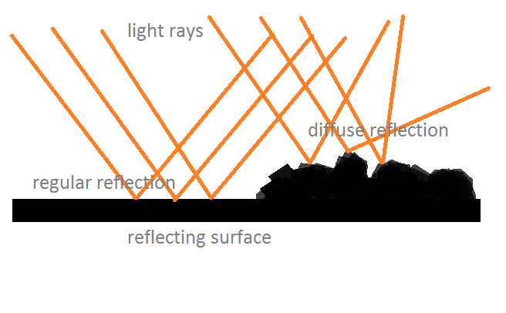

Slide 17
Scattering
Light traveling in one direction reflect and travel in many directions
Dust

Slide 18
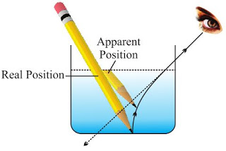
Refraction of Light
Refraction - change in the speed of a wave when it passes from one material to another

Slide 19
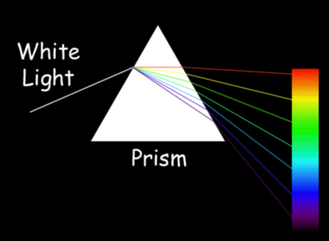
Prism

