Slide 1
Sound
Chapter 4-1

Slide 2
Physical Science Sound

Slide 3
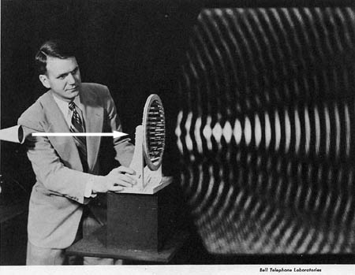
What causes sound?
Every sound is produced by an object that vibrates.
Sound waves are longitudinal waves

Slide 4
Sound
Longitudinal Waves –made of compressions and rarefactions.

Slide 6
Speaker

Slide 7
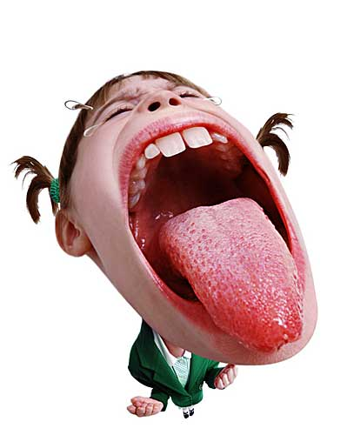
Sound
Sound waves can travel through any type of matter⎯solid, liquid, or gas.
Most is through air

Slide 8
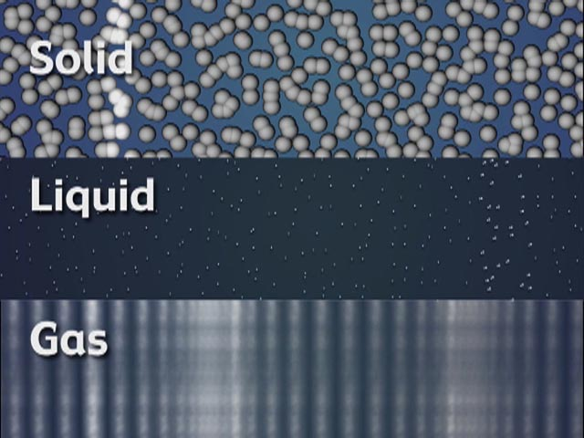
Sound
Matter that a wave travels through is called a medium
Cannot travel through empty space

Slide 9
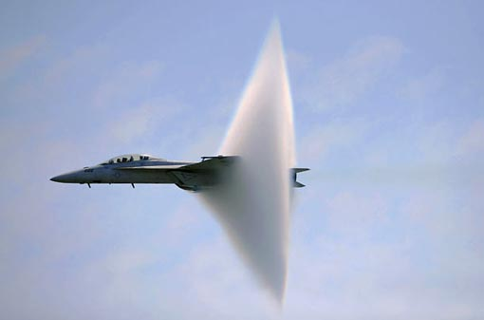
Sound:
Speed of Sound – 340 m/s or 760 mi/hr
In Air
Sonic BOOM! (Monkey See)

Slide 10
Sound
Sound depends on the substance the medium is made of

Slide 11
Sound
Slow – gas
Medium – liquid
Fast – solid
Depends on spacing of molecules

Slide 12
Sound and Temperature
Increase Temperature
Increase molecule movement
Increase Speed of Sound

Slide 13
Wavelength
Distance between a point on an wave and the nearest point just like it

Slide 14
Frequency
Number of waves that pass a given point in one second
SI unit – Hertz (Hz)
More vibration = higher frequency

Slide 18
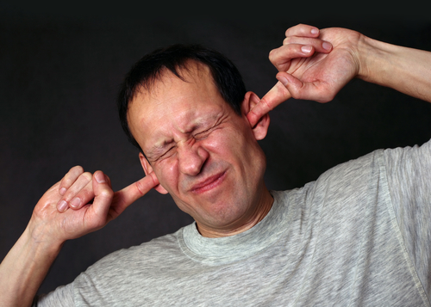
Sound Speed
Sound Speed - Doesn’t depend on loudness of sound
Loud and soft sounds travel through a medium at same speed

Slide 19
Intensity and Loudness
The amount of energy a wave carries corresponds to its amplitude.

Slide 20
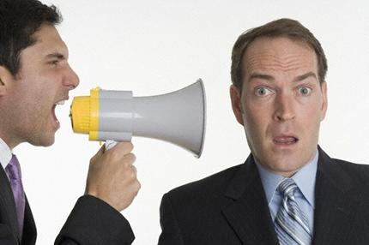
Intensity
Loudness - human perception of sound intensity.
Decibel – unit of intensity

Slide 22
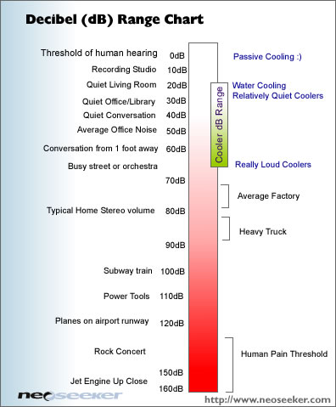

Slide 23
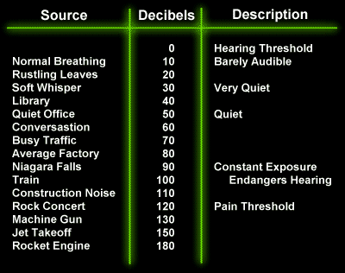

Slide 24
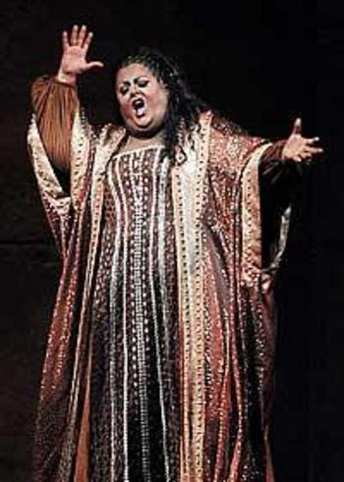
Pitch
Pitch - how high or low a sound seems to be.
Related to frequency (Hz)
Human : 20 – 20,000 Hz

Slide 25
Making Pitches
Vocal cords – membranes above trachea
Muscles attached to vocal cords can change pitch

Slide 28
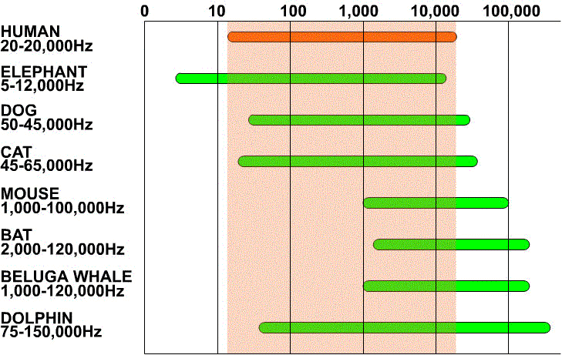

Slide 29
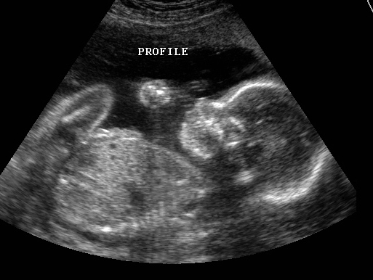
Infrasound and Ultrasound
Infrasound – low frequencies < 20 Hz
Ultrasound – high frequencies > 20,000 Hz

Slide 30
Outer Ear
Collects sound waves
Ear canal
Channels sound waves into middle ear

Slide 31
Middle Ear
Amplifies sound waves
Eardrum – thin membrane across canal
3 tiny bones – Hammer, anvil, and stirrup

Slide 32
Inner Ear
Converts sound waves into nerve signals to brain
Cochlea – fluid filled chambers
Tiny hair like cells transfer signals

Slide 33
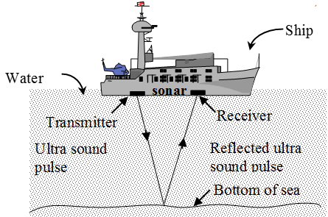
Sonar
Echo – reflected sound wave
Sonar –
Sound
Navigation
And
Ranging

Slide 34
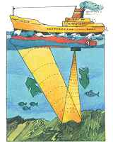
Sonar
D=S*T
D = distance
S = speed
T = time

Slide 35
Echolocation

Slide 36
Sonar / Liberty Ships

