Slide 1
4-1
Culture

Slide 2
Culture
Culture – set of beliefs, values, and practices that a group of people have in common
Languages
Religions
Clothes
Music
Food

Slide 3
Culture Trait
An activity or behavior in which people often take part
Some are shared by all
Soccer
Others change
Chop sticks vs forks

Slide 4
How do cultures develop?
Passed down generations
Cultures develop as people learn new traits
Immigrants and language
History and environment

Slide 5
Culture group
People who share similar culture traits
Age
Language
Religion
Location
Teenagers are a culture group

Slide 6
Culture region
An area in which people have many shared culture traits.
Arab region – SW Asia and North Africa
Speak Arabic
Muslim

Slide 7
Cultural diversity
Countries can have many culture regions
Ethnic group – people who share common culture and ancestry

Slide 8
Cultural diversity – having a variety of cultures in the same area
Can lead to conflict
French Canadians vs the rest of Canada

Slide 9
Changes in culture
Wild West of late 1800’s

Slide 10
Innovation and contact with other people lead to change
New ideas – Alexander Graham Bell
Internet

Slide 11
Cultures change when societies come in contact with each other
Firearms and horses brought to America’s by Spanish changes Native Americans
Spanish learned about potatoes and chocolate

Slide 12
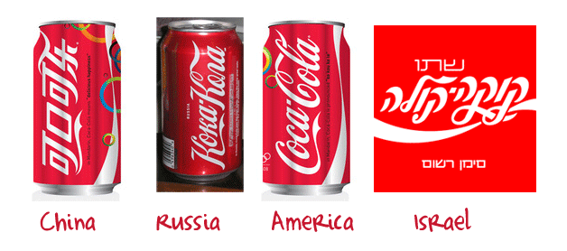
How ideas spread
Cultural diffusion – the spread of culture traits from one region to another
Movement of people

