Slide 1
3-3
Natural Environments

Slide 2
Environment
Environment - surroundings

Slide 3
Limits on life
Limits on life:
Temperature
Rainfall
Soil
Plants and animals adapt to survive

Slide 4
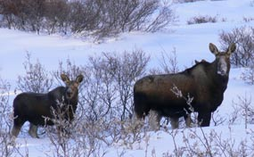

Slide 5
ecosystem
Group of plants and animals that depend on each other to survive
Pond
Park
Rain forest

Slide 6
Changes in ecosystems
Small changes can have a big affect
Clear cutting – soil erosion – loss of food and shelter

Slide 7
habitat
Place where plants and animals live
Rainforest – most diverse habitat

Slide 8
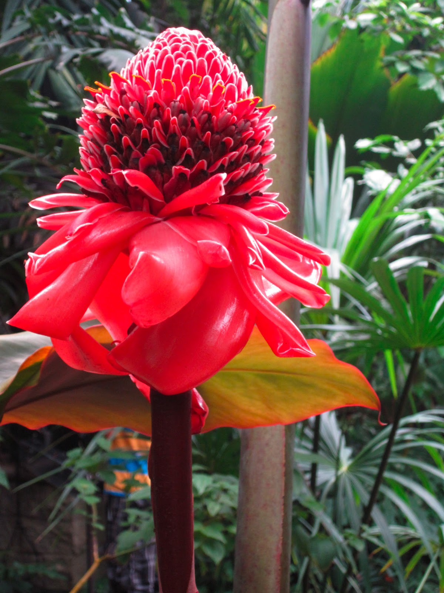

Slide 9
Extinction
When species die out
Dodo birds
Mauritius Island
Habitat destruction

Slide 11
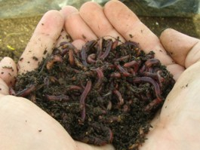
Soil
Humus – decayed plant or animal matter
Fertile soils support lots of life

Slide 12
Loss of fertility:
Soil erosion
Planting the same crops
Desertification – spread of desert like conditions

