Slide 1
3-2
World Climates

Slide 2
Major Climate Zones
Five major climate zones:
Tropical
Temperature
Polar
Dry
Highland
Based on: Temperature, precipitation, and native plants

Slide 4
Tropical
Tropic of Cancer to Tropic of Capricorn
Starts at equator

Slide 6
Humid Tropical
Warm
Muggy
Rainy
450 inches a year

Slide 7
Humid Tropical
Monsoons – seasonal winds that bring dry or moist air
Rainforest

Slide 8
Tropical Savanna
Long, hot dry season
Short periods of rain
Savannas – areas of tall grasses and scattered trees or shrubs

Slide 10
Dry Climates
Desert climate
Less than 10 inches of rain a year
130 F during day
Cool at night

Slide 11
Steppe Climates
Steppes – semidry grasslands or prairies
Next to deserts
Short spread out grasses

Slide 12
Temperate Climates
“Moderate or Mild”
4 seasons
Middle latitudes

Slide 14
Mediterranean Climate
Hot, dry, sunny summers
Mild wet winters
Coastal areas

Slide 15
Humid Subtropical
Hot and muggy summers
Warm moist air from ocean
Hurricanes
SE United States

Slide 16
Marine West Coast
West coast of areas
Moisture from sea
Mild temperature all year

Slide 17
Humid Continental
4 distinct seasons
Michigan!
Mild spring and fall
Cold snowy winters
Hot summers

Slide 19
Polar and Highland Climates

Slide 20
Subarctic Climate
Very cold winters
Short cool summers
Taiga forests - evergreen

Slide 22
Tundra
Coastal areas along Arctic Ocean
Permafrost – permanently frozen soil

Slide 24
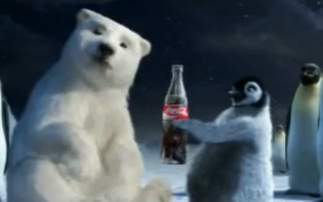
Ice Cap
North and South Poles
-120 F
No plants
Penguins and Polar Bears

Slide 25
Highland Climates
Mountains

