Slide 1
Chapter 26-3
China Today

Slide 2
Economy
US market economy
You choose your career
Decide what you sell
Keep profits earned

Slide 3
China Today Video Clip

Slide 4
Command economy
Government own all business
Makes all decisions

Slide 5
China
Used to have a command economy
1970’s – started a mixed economy
Special economic zones for foreign businesses
Allowed some private business
2nd largest economy

Slide 6
Agriculture
Most Chinese are farmers
15% of land is good for farming
Terraces
Land worked at high levels

Slide 7
Industry
Most profitable part of economy
Growing rapidly

Slide 8
Economic Growth
Improved living standards
Electricity
Cars
Computers
Rural still poor

Slide 9
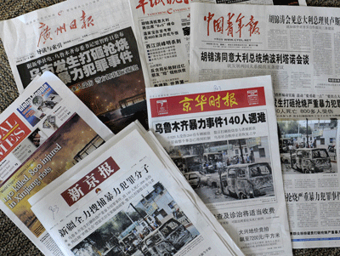
Government
No political freedom
Newspapers
Internet
Controls information
Limiting trade – Human rights issues

Slide 10
1989 – Tiananmen Square
Beijing - Capital
100,000 pro-democracy protestors
Tanks and troops killed hundreds

Slide 11
1950 – Controlled Buddhist region of Tibet
1959 – Rebellion
China crushed revolt
Dalai Lama – leader
Fled to India

Slide 13
Rural vs Urban China

Slide 14
Shanghai – largest city
15 million people
Seaport
Industrial and commercial center
Nightlife

Slide 16
Beijing
Forbidden City
Former home of China’s emperors
Once off limits
Museum

Slide 18
Hong Kong and Macao
Port cities
Trade
Tourism
European colonies
Hong Kong – UK 1997
Macao – Portugal 1999

Slide 19
Environment
Pollution
Large population
Coal power plants
Loss of farms and forests

Slide 20
Three Gorge Dam
Hydroelectric power
Chang Jiang River
World’s largest
Millions of people displaced

Slide 22
Dam video clip

