Slide 1
Adaptations and Evolution
22-3

Slide 2
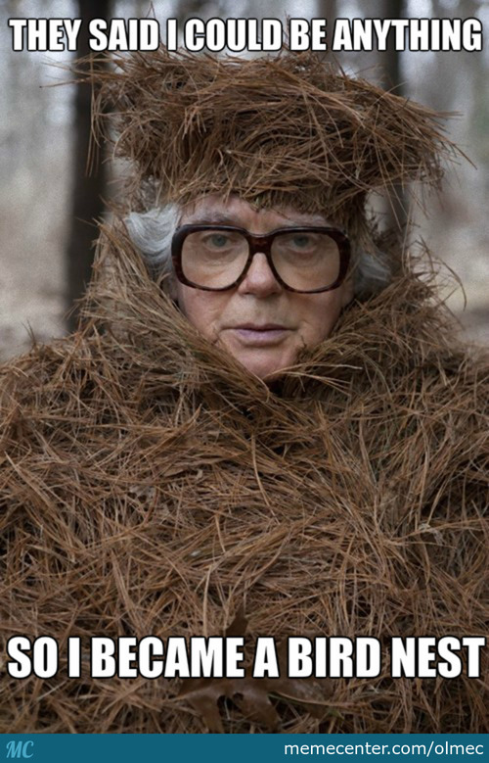
Variations
Slight differences in inherited traits among individuals in a population
Mutations can produce slight differences
Feather color
Nest building skills

Slide 3
Galapagos Islands Then
Youtube Clip

Slide 4
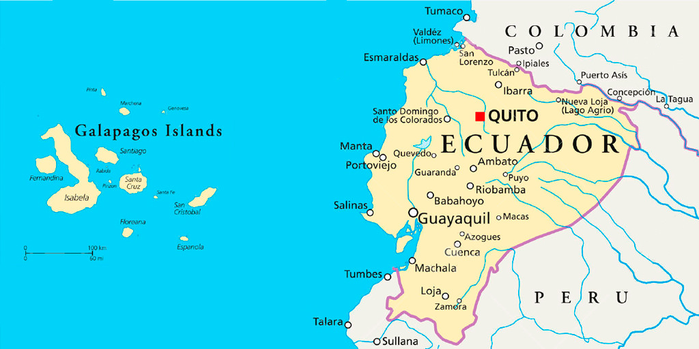
Galapagos Islands Today
1976 – Measured traits in a population of medium ground finches
Birds had variations in beak size
Most – smaller beaks
All – preferred to eat small, soft seeds

Slide 5
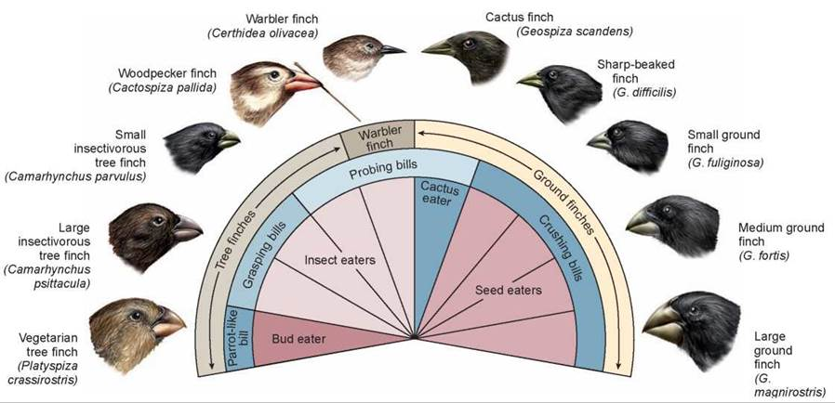

Slide 6
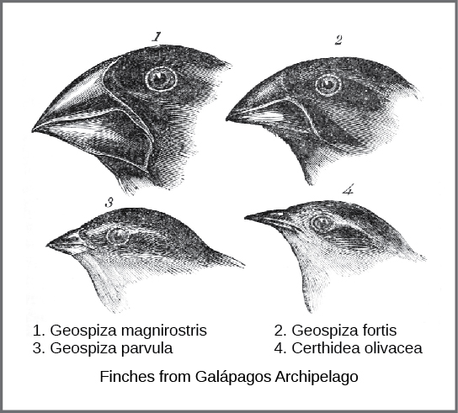
The next year…
No rain
No plant reproduction = no new seeds
All the small eats were eaten = birds started to die
Only seeds left were larger and hard to open.
WHO STARTED TO THRIVE?

Slide 7
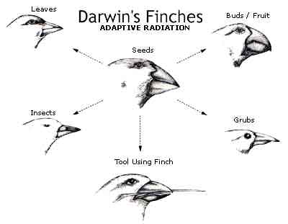
The next year…
1978 – Measured the beaks of the surviving birds
Most were larger
In just 2 years the population had changed or evolved.

Slide 8
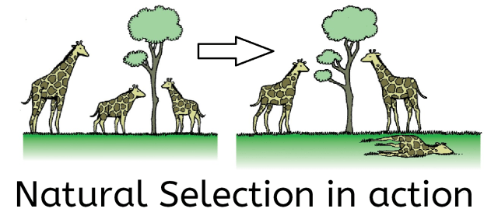
Natural Selection
Process that helps individuals with variations survive their environment
Able to reproduce
Survival of the Fittest!

Slide 9
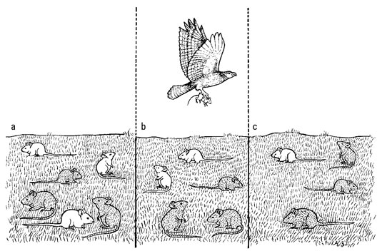

Slide 10
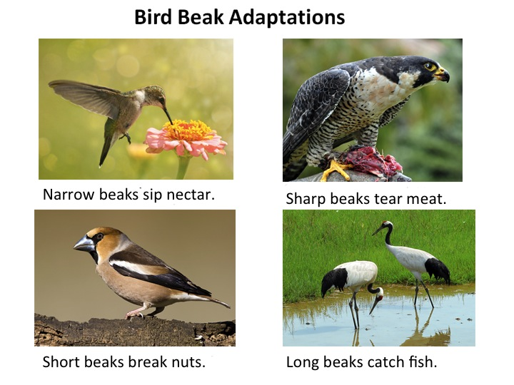
Adaptations
Inherited trait that increases an organism’s chance of surviving and reproducing in an environment

Slide 11
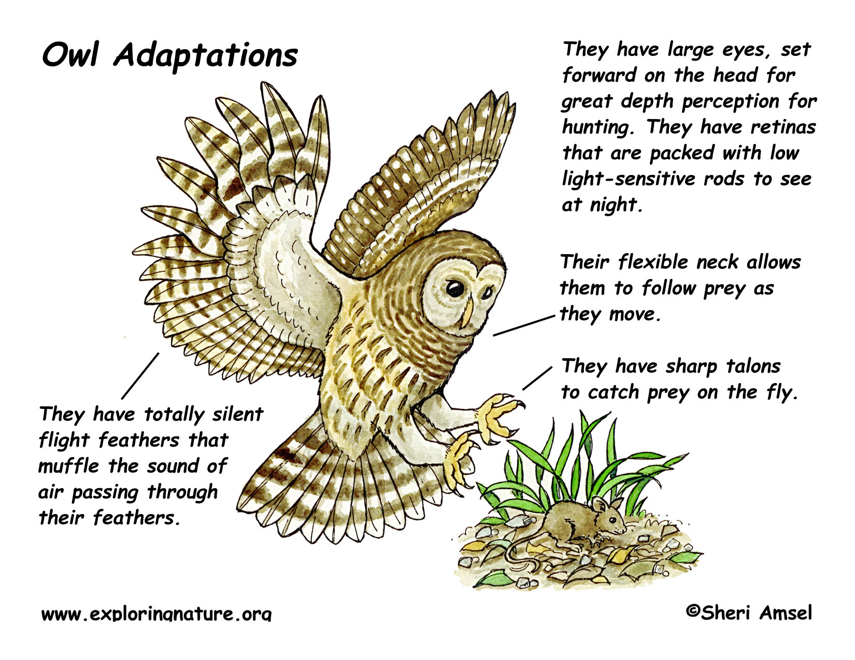
Structural Adaptations
Physical characteristics – how its buit
Color
Shape
Teeth
Feet
Thorns

Slide 12
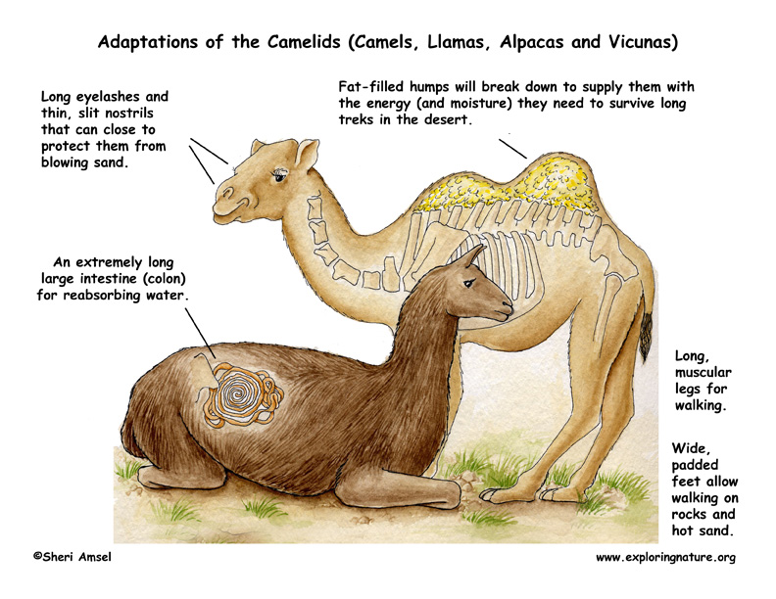
Functional Adaptations
Internal systems
Physiology – normal functions of an organism
Biochemistry
What the structures do for the organism

Slide 13
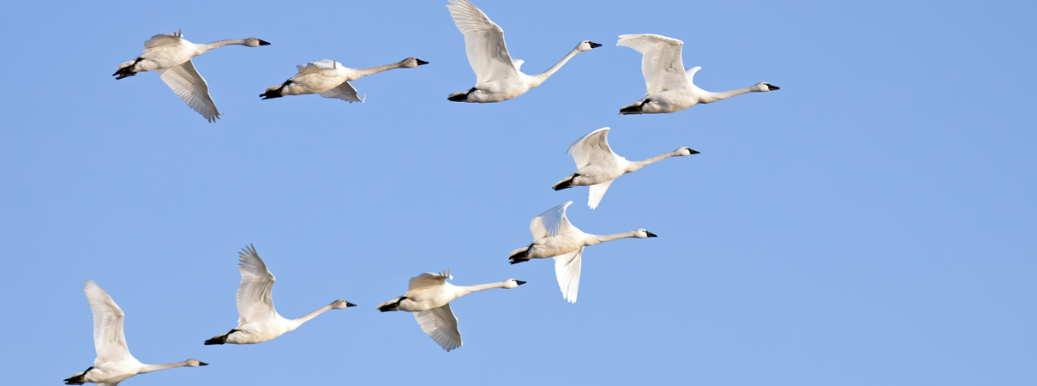
Behavioral Adaptations
Behavior or action
Migration
Hibernation

Slide 14
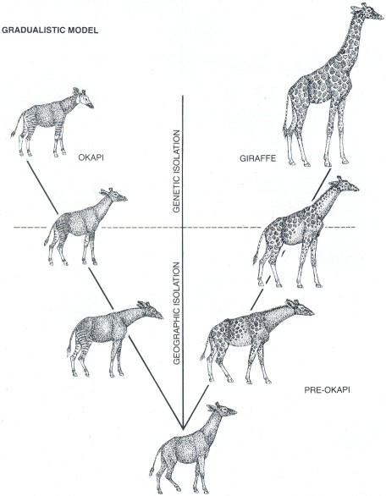
Evolution
Change over time
Look or behave differently that ancestors

Slide 15
How Evolution works
Kurzgesagt – In a Nutshell

Slide 16
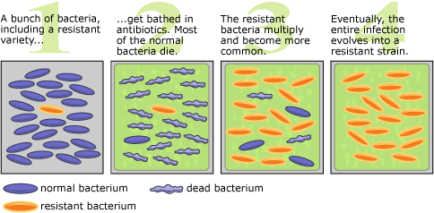
Change Over Time
Antibiotic Resistance – bacteria evolve to resist medicine and surviving bacteria pass of traits
Super colds

Slide 17
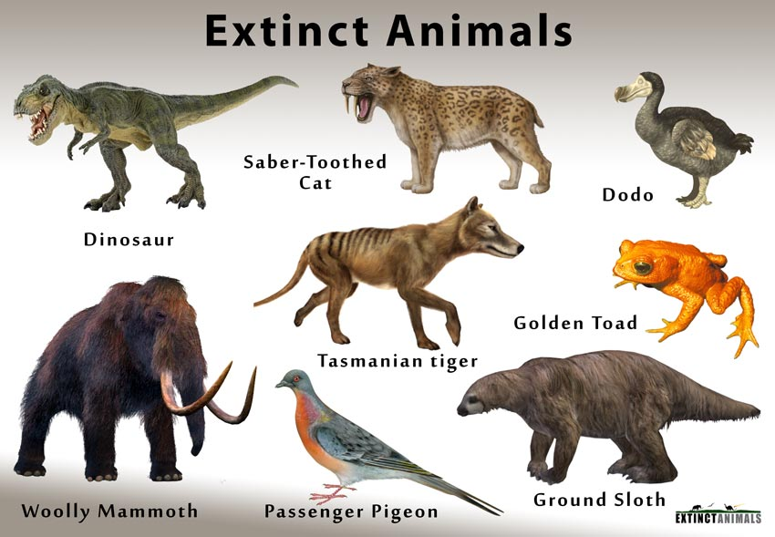
Extinction
When the last individual of a species dies
This happens when a species lacks variation

Slide 18
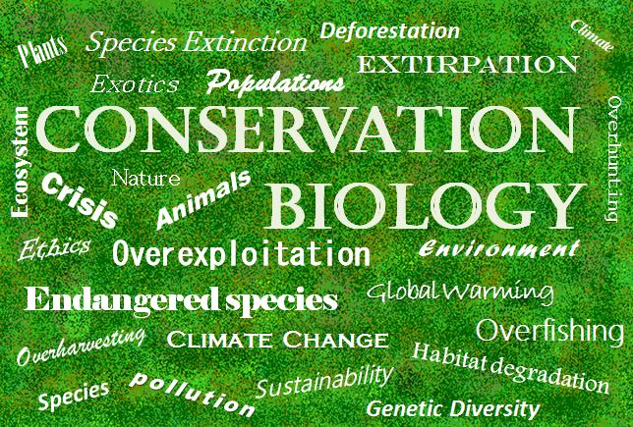
Conservation Biology
Branch of biology
Studies why many species are in trouble and how to save them

