Slide 1
How Traits are Inherited?
22-1

Slide 2
Parent to Offspring
We are:
Homo sapiens – Species
We all have variations: eye, hair, height
Heredity – passing of traits from parents to offspring

Slide 4
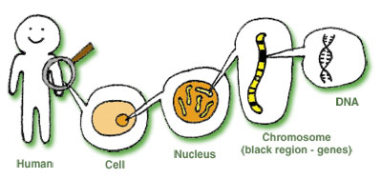
Genetics
The study of how traits pass from parent to offspring
Genes:
Shape
Function
Behavior

Slide 5
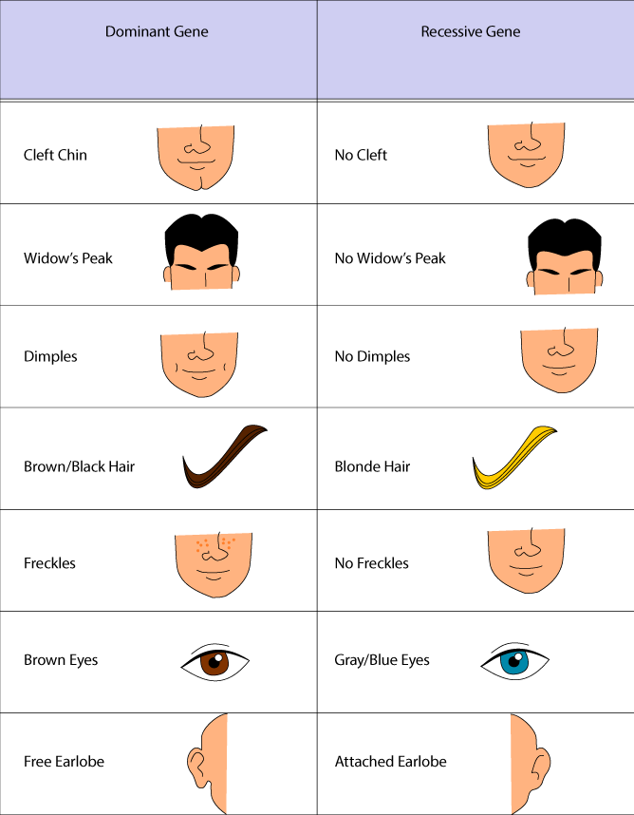

Slide 6
Genes
Sections of DNA with information
Chromosome – coiled strands of DNA

Slide 7
Allele
A gene with different information for a trait
Example - dimples

Slide 8
How are Traits Inherited?
1. Asexual reproduction
Usually single celled – Bacteria
Single cell splits
Some plants
Single organism
Genes from that parent only

Slide 10
2. Sexual Reproduction
2 organisms
½ of genes from an egg cell
½ of genes from sperm cell
Most animals and some plants

Slide 12
Asexual and Sexual Reproduction Ameoba Sisters
Youtube

Slide 13
Traits come from your Parents
Unless you are an identical twin no other person has the same combination of genes

Slide 14
Acquired Traits
Things you learn after birth

Slide 15
Why Study Genetics?
How traits are inherited
Development
Disease
Family history

Slide 16
Common Ancestors
How organisms re related
Scientists removed the gene that controls eye development from a mouse and inserted it into the embryo of a fruit fly
Fruit Fly developed normal eyes

Slide 17
So ….. What ????
Scientists removed the gene that controls eye development from a fruit fly and inserted into a frog embryo
The frog developed normal eyes.
This shows that these species share a common ancestor!
What is Common Ancestry? - Youtube

Slide 18
Selective Breeding
Breeding organisms for desired traits
More eggs
Bigger animals
Bigger fruits and vegetables
Disease resistant plants

Slide 21
Mutations
Permanent change in the sequence of DNA
Change appearance of function
Cancer, diabetes, birth defects

Slide 22
Genetic Engineering
Genetic material is modified by inserting DNA from another organism
Insulin helps control sugar levels in blood
Scientist inserted the human insulin gene into bacteria
Bacteria then make human insulin

Slide 23
Top 7 Genetically Modified Animals Youtube

