Slide 1
21-3
West Africa today

Slide 2
Nigeria
Africa’s largest population
Strong economy

Slide 3
Conflicts between ethnic groups
Igbo – tries to secede from Nigeria
Secede – to break away from the main country

Slide 4
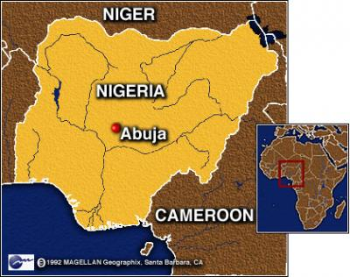
Lead to a bloody civil war
Igbo lost
Capital – Abuja
Low population – less conflict
Democracy
Past – military rule

Slide 5
Economy
Oil – 95% of exports
Good roads and rails
Lagos – former capital
Oil trade center

Slide 6
Nigerians are poor
High birthrate
Bad government
Food issues

Slide 7
Senegal and Gambia
Peanuts major crops
Tourism
Speak Wolof
Griots – story tellers

Slide 9
Guinea, Guinea-Bissau, and Cape Verde
Poor countries
Bauxite – use to make aluminum
Cape Verde – Island country
Very stable government

Slide 11
Liberia
Americans founded it as a home for freed slaves
Clashed with African already there
Civil War
Rubber and iron

Slide 12
Sierra Leone
Civil War
Wrecked economy
Killed thousands
Diamonds

Slide 13
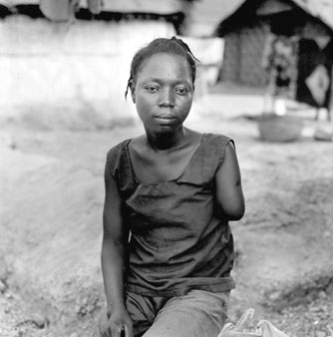

Slide 14
Ghana
Gold, timber, cacao

Slide 15
Cote d’Ivoire
Ivory Coast
Africa’s largest Christian church

Slide 16
Togo and Benin
Unstable governments
Poor economies
Farming and herding

Slide 17
Niger
Sahel countries – some of the poorest areas in the world
11% of land can be farmed
Famine – food shortage
Locust

Slide 18
Chad
Lake Chad
Fishing and water
Drought hurt lake
Oil recently discovered

Slide 19
Mali
40% of land covered by Sahara
Cotton and gold
Stable democracy
Timbuktu - tourism

Slide 20
Burkina Faso
Few trees – cut for fire wood
Thin soil, poor minerals
Travel for work

