Slide 1
20-3
North Africa Today

Slide 2
Egypt
Most populated country
Poor farmers
Limited jobs and resources

Slide 3
Government
Republic influenced by Islamic law
Fewer personal freedoms
Leader of Arab countries

Slide 4
Conflict
Supporters of Islamic government
Violence
Attacks on tourists
Most of people:
Poverty
Literacy issues

Slide 5
Resources
Limited farmland
Delta – cotton
Nile – vegetables and fruit

Slide 6
Economy
Suez Canal - $5 billion a year
Communications
Natural gas
Work in other countries

Slide 8
Cities
Nile Valley and Delta
99%
Cairo – Capital
Poor, polluted
Slums
Overpopulated
Some live in cemeteries and tombs

Slide 10
Rural
Fellahin – own small plots along Nile
Work on large farms owned by powerful families

Slide 11
Maghreb
“West”
Western Libya, Tunisia, Algeria, Morocco

Slide 12
Souks
Souks – Marketplaces
Free port – almost no taxes on goods

Slide 13
Libya
Ruled by a dictator
Acts of violence against Israel
Muammar Gaddafi
Uprising in 2011

Slide 14
Algeria
1990’s – violence between government and Islamic groups
Thousands killed

Slide 15
Tunisia
Most women’s rights in region
Economic ties with Europe

Slide 16
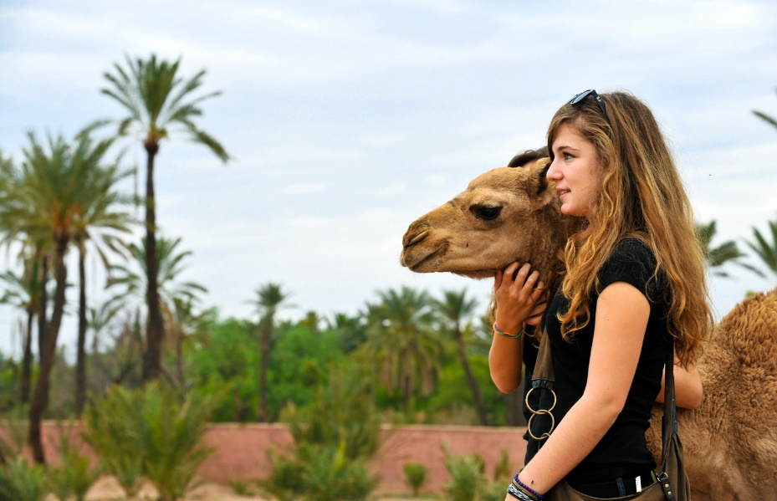
Morocco
Only country in region with little oil
Fertilizer
Nile

