Slide 1
20-2
History and Culture

Slide 2
Ancient Egyptians
Pyramids
Tomb monuments for pharaohs
Blocks rolled on logs to Nile
Moved by barges
Dirt and brick ramps

Slide 3
The Great Pyramid
2.3 million block of stone
2.5 tons per brick
10,000 to 30,000 workers
20 years to build

Slide 6
Egyptian Writing
Hieroglyphics
Pictures and symbols
Carved into temples
Records of pharaohs

Slide 8
Greek and Arab Civilization
Northern coastline open to invasion from Greeks and Romans
Alexander the Great – founded Alexandria in Egypt
Important seaport and learning center

Slide 10
Arab armies came from SW Asia
Brought:
Arabic language
Muslim religion

Slide 13
European Influence
1912 – had authority over entire region
Italy – Libya
Spain – Morocco
France – Morocco, Tunisia, Algeria
British - Egypt

Slide 14
Countries gradually gained independence
Major battle ground in WWII

Slide 15
Modern Africa
Countries have tried to build stronger ties with other Arab countries

Slide 16
People of Egypt
Egyptians
Bedouins – nomadic herders
Berbers – ethnic group native to North Africa
Most speak Arabic

Slide 17
Religion
Muslims who practice the religion of Islam
Stop to pray 5 times a day
Fridays – meet in mosques for prayer
90%

Slide 18
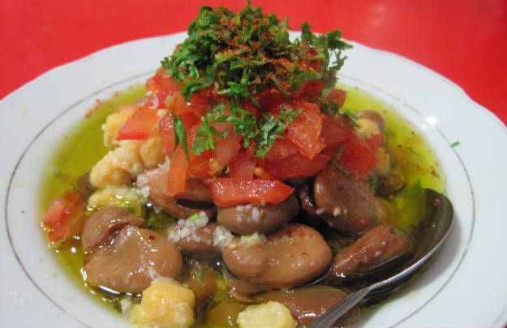
Food
Couscous – small pellets of pasta
Fuul – fava beans with seasonings
Harissa – chili paste

Slide 19
Holidays
Birthday of Muhammad
Prophet of Islam
Ramadan – holy month
Don’t eat during the day

Slide 20
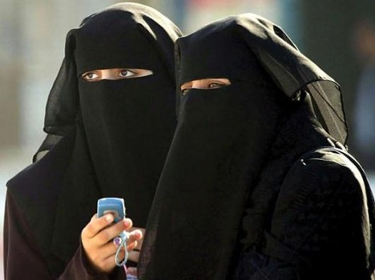
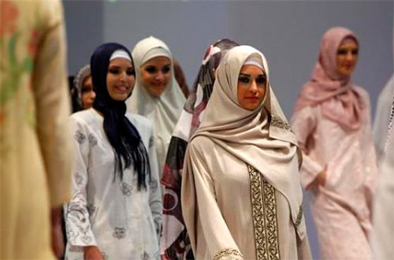
Customs
Long loose fitting clothes
Hot climate
Religion

Slide 21
Art
Hand woven carpets
Film industry
Sintir – music
3 stringed instrument

