Slide 1
Chapter 20-1
Physical geography
North Africa

Slide 2
Physical Features
Morocco, Algeria, Tunisia, Libya, Egypt
Atlantic Ocean to Red Sea
Sahara desert – vast desert

Slide 5
The Nile
World’s longest river
Formed from the Blue and White Rivers
4,000 miles

Slide 7
Floods leave areas rich in silt
Silt – fertile soil for crops
Nile delta – mouth of the river

Slide 9
Aswan High Dam
Controls floods along the Niles
Prevents silt from moving downriver

Slide 11
Sinai and Suez Canal
Sinai Peninsula – desert and rocky mountains
Suez Canal – French built
Connects Mediterranean Sea with Red Sea

Slide 13
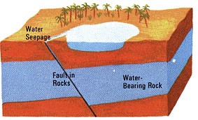
Sahara
Largest desert in the world
Arabic word meaning “desert”
Oasis – wet, fertile area with well or spring

Slide 14
Mountains
Dunes can rise 1,000 ft
Mountains ranges up to 9,800 ft
Atlas Mt’s – Northwest Sahara
13,600 ft

Slide 17
Climate
Dry
Occasional floods
3 climates:
1. Desert
136F in Libya
Temperature drops quick at night – low humidity
Below freezing

Slide 18
2. Mediterranean climate
NW coast
Summer – hot, dry
Winter – mild, moist
3. Steppe climate – semi arid, sparse grass

Slide 19
Natural Resources
Oil and gas – Libya, Algeria, Egypt
Iron ore - Morocco

