Slide 1
Newton’s Third Law
Chapter 2-4

Slide 2
Opposite Forces
When you push against a wall the wall pushes back on you
When an object applies a force on another object, the second object applies a force of the same strength on the first object, in the opposite direction.

Slide 3
Newton’s Third Law
Newton’s Third Law
For every action there is an opposite and equal reaction.
Notes:
3

Slide 5
Forces
All Forces come in pairs
Equal Forces don’t always have equal effects
Force pairs do not act on the same object
Notes:
5

Slide 6
Action and Reaction Forces
Action Forces – Force exerted by the push
Reaction Forces – Force exerted back on the object doing the pushing
Notes:
6

Slide 7
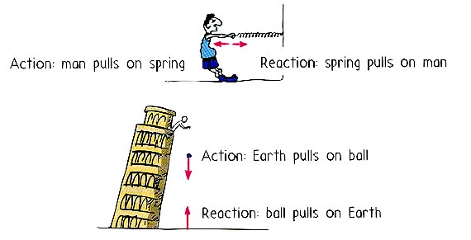
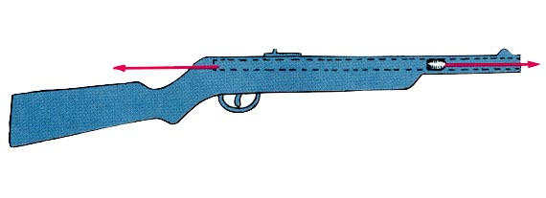
Action – Reaction Forces
Notes:
7

Slide 8
Momentum
How hard it is to stop a moving object
Notes:
8

Slide 9
Momentum
Momentum – Force resisting the change in motion
Momentum = Mass x Velocity
More mass more momentum
More velocity more momentum
Notes:
9

Slide 10
Conservation of Momentum
The total amount of momentum in an isolated system is conserved
Unless an outside force acts on it (friction)
(it can not be created or destroyed)
Momentum is Transferred
Notes:
10

Slide 11
Collision Types
Elastic – objects bounce off each other
Inelastic – objects don’t bounce off each other but stick together

