Slide 1
Newton’s First Law
Chapter 2-2

Slide 2
Net Force
Combination of all forces acting on an object

Slide 3
Net Force Examples

Slide 4
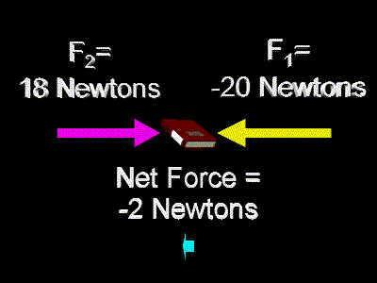
Notes:
4

Slide 5
Force and Direction
Forces have direction
Reference direction – choosing a positive and negative direction

Slide 6
Forces
Balanced Forces – Equal forces acting in the opposite direction
A. No movement occurs
Net Force = 0
Unbalanced Forces – Unequal forces acting in any direction
A. Movement occurs
Net Force is not 0
Notes:
6

Slide 7
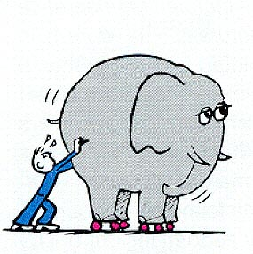
Newton’s First Law
Newton’s 1st Law –
An object at rest will remain at rest and an object in motion will stay in motion unless acted on by an outside force.
Also called the law of inertia
Notes:
7

Slide 9
1st Law
If net force is zero the motion doesn’t change

Slide 10
Velocity
Velocity – speed and direction
50 mph North

Slide 11
Inertia
Inertia – Tendency of an object to resist a change in motion
Notes:
11

Slide 13
Why do objects stop moving?
Friction!

