Slide 1
Gravity and Friction
Chapter 2-1

Slide 2
Force
Force – a push or pull
Net force – a combination of all forces
Notes:
2

Slide 3
Force
Force
Latin word “fortis” which means strength
Example - fortress
Notes:
3

Slide 4
Contact Forces
A force to an object that is touched.
Push or pull
Can be weak and strong

Slide 5
Noncontact Forces
A force without touching
Gravity
Magnetic
Electric

Slide 6
Forces have Strength and Direction

Slide 7
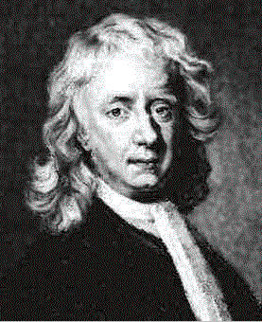
Who is Newton?
Sir Isaac Newton – described the relationship between motion and force
Notes:
7

Slide 8
Newton
Newton - sitting under an apple tree, an apple fell on his head, and he suddenly thought of the Universal Law of Gravitation.
Force – measured in Newtons (N)
Notes:
8

Slide 9
Gravity
Law of Universal Gravitation: All objects attract each other through gravitational force
G = Gravity
G Forces
Notes:
9

Slide 10
Gravity
All matter is affected by gravity
Gravity increases as mass increases
Gravity increases as distance decreases
Notes:
10

Slide 11
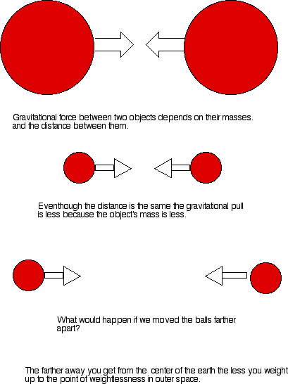
Notes:
11

Slide 12
Free Fall
Free Fall – The motion of a body when only the force of gravity is acting on the body.
This is not free fall
Notes:
12

Slide 13
Acceleration and Gravity
Acceleration due to gravity on Earth = 9.8 m/s²
Acceleration due to gravity is constant close to earth
A = F/M
Heavier = more gravitational force
Heavier object = harder to accelerate
Cancel out each other
Notes:
13

Slide 14
Weight
Weight – Force of gravity on an object
Weight is measured in Newton (N)
Notes:
14

Slide 15
Weight
Weight = mass x free-fall acceleration
W = M x G
What will a 66 kg person weigh?
66 kg x 9.8 m/s² = 650 N

Slide 16
Apparent Weightlessness
Apparent Weightlessness
– When all objects surrounding a person are accelerating at the same rate
– Creates a feeling of weightlessness.
- Elevator
- Space
Notes:
16

Slide 17
Weight vs. Mass
Weight is different than Mass
Mass is constant
Weight depends on gravity – Can Change!!!
Notes:
17

Slide 18
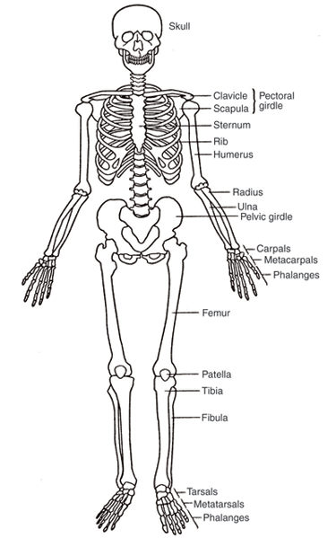
Weight
Weight influences Shape:
Need strong skeletons to hold against the force of gravity.
Fish live in Apparent Weightlessness – Don’t need big skeletons
Notes:
18

Slide 19
Friction
Friction - A force that opposes motion between two surfaces that are in contact
Notes:
19

Slide 20
Sliding Friction
Opposes the motion of sliding surfaces

Slide 21
Fluid Friction
Friction from water or air

Slide 22
What Causes Friction?
Microscopic bumps
Reducing friction:
Lubrication
Reducing surface area

