Slide 1
Turkey 17-2

Slide 2
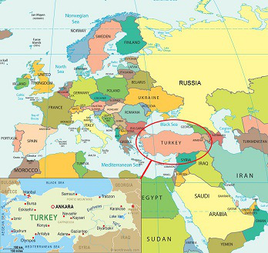

Slide 3
History
One of the world’s earliest farming villages
8,000 years old
Centuries of invasion of powerful empires

Slide 4
Invasions
Romans captured Byzantium
Renamed it Constantinople
Crossroads of Europe and Asia
Trade port

Slide 5
Constantinople
Ottoman Turks captured the city
Made it capital of their Islamic empire

Slide 6
Ottoman Empire in 1500’s and 1600’s
Empire in N. Africa, SW Asia, SE Europe
Fought on losing side during WWI
Lost lands

Slide 7
Military took over government
Mustafa Kemal
AKA Kemal Ataturk “Father of Turks”
Created democratic nation
Moved capital to Ankara
From Constantinople
Constantinople was later named Istanbul – largest city

Slide 9
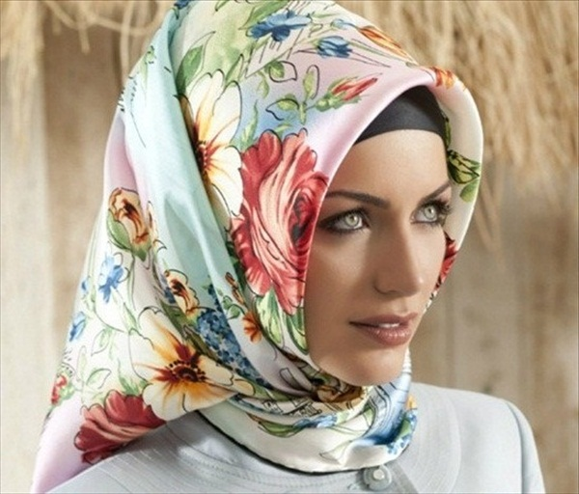
Modern Turkey
Ataturk wanted Western methods
Banned fez – hat
No veils for women
Vote, work
Changed Arabic alphabet to Latin alphabet
Metric system

Slide 10
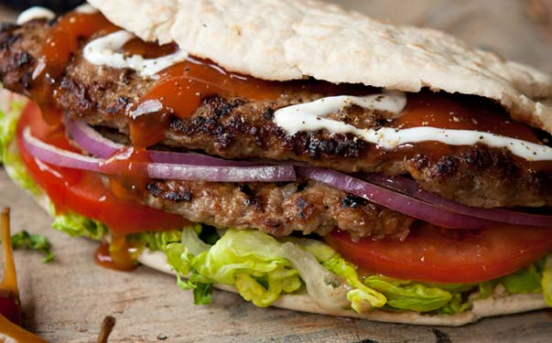
Islam -religion
Kebabs - food

Slide 11
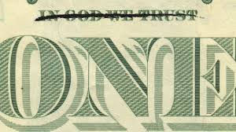
Government
Secular – religion is separate from government
For example:
Islam says you can have 4 wives
Law says 1 wife

Slide 12
Economy
Trade within Europe

Slide 13
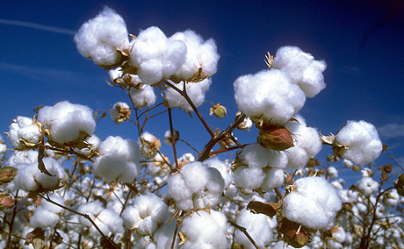
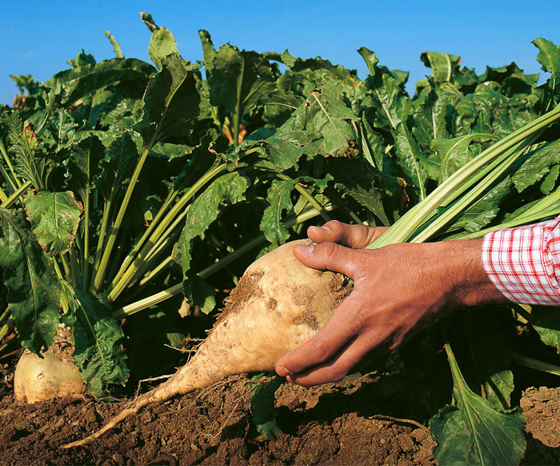
Major Crops
Grains, cotton, sugar beets, and hazelnuts

