Slide 1
Chapter 16-2
Determining Relative Age

Slide 2
Processes that change the Earth today are very slow
Millions of years would have to have passes to get what we have today

Slide 3
Relative Age
Age of rocks and geologic features compared with others nearby
Indicates that one layer of rock is older than another
Nothing about age

Slide 5
Superposition
A layer of rock is older than the layer above it
It is younger than the layer below it

Slide 6
Original Horizontality
Rock forms in horizontal layers
Unless disturbed

Slide 7
Rocks that are not horizontal have been tilted or deformed

Slide 8
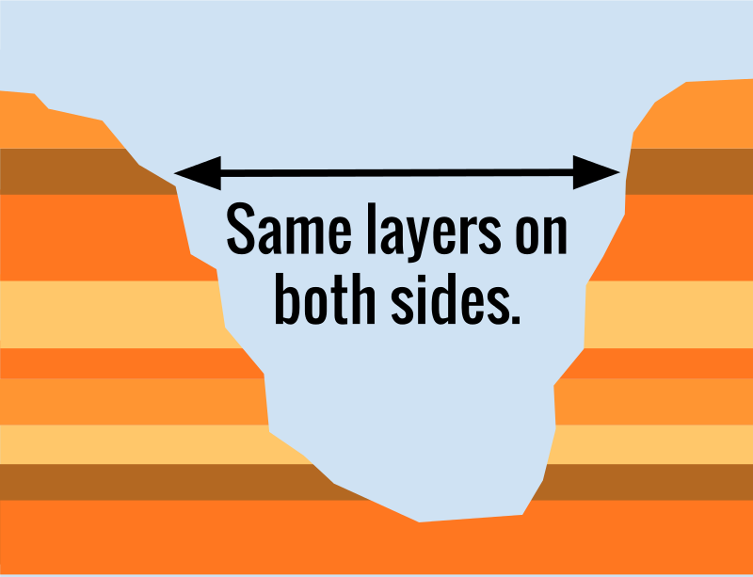
Lateral Continuity
Sediment is deposited in large, continuous sheets in all lateral directions

Slide 10
Inclusion
Piece of an older rock that becomes part of a new rock

Slide 11
Crosscutting Relationships
Fault or intrusions are younger than the rock it cut through

Slide 12
Unconformity
Area where rock has been eroded away
Gap in rock record
New layer deposited on old

Slide 13
Correlation
Matching rocks from separate locations

Slide 14
Index Fossils
Fossils widespread, abundant, and distinct
Lived during a short time span

