Slide 1
The Fossil Record
16-1

Slide 2
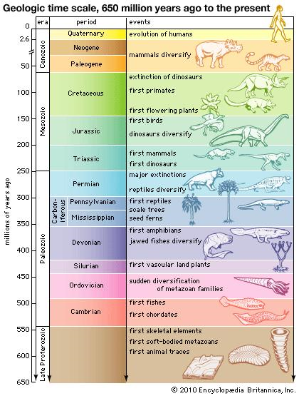
Fossils
Fossils – Evidence or remains of ancient plants or animals
What type of rocks would you find fossils in?

Slide 3
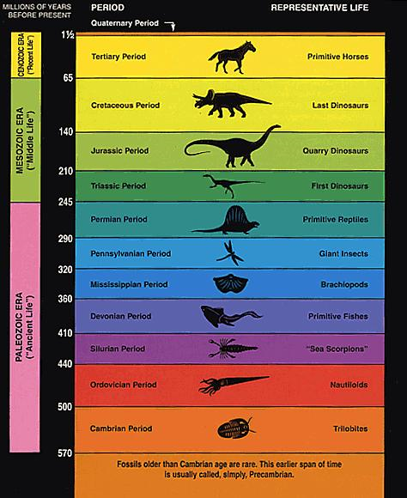

Slide 4
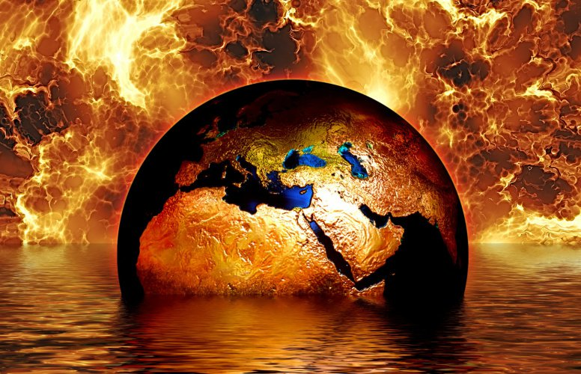
Catastrophism
Idea that conditions and organisms on Earth change is quick violent events
Volcanism
Flooding

Slide 5
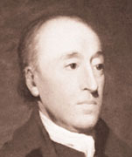
Age of the Earth
4.6 billion years old
James Hutton - 1st to determine this
Scottish physician and farmer

Slide 6

Earth’s Age
Before Hutton most believed Earth was 6,000 years old
Many believed that all features formed at the same time

Slide 7
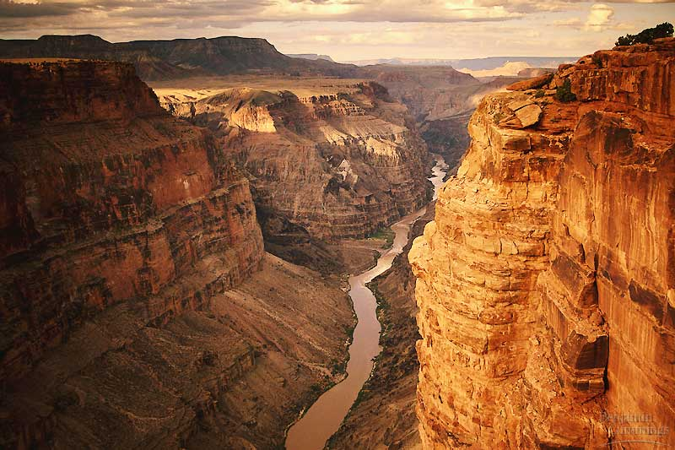
Uniformitarianism
Same forces that change the Earth today changed it years ago
Present is the key to the past

Slide 8
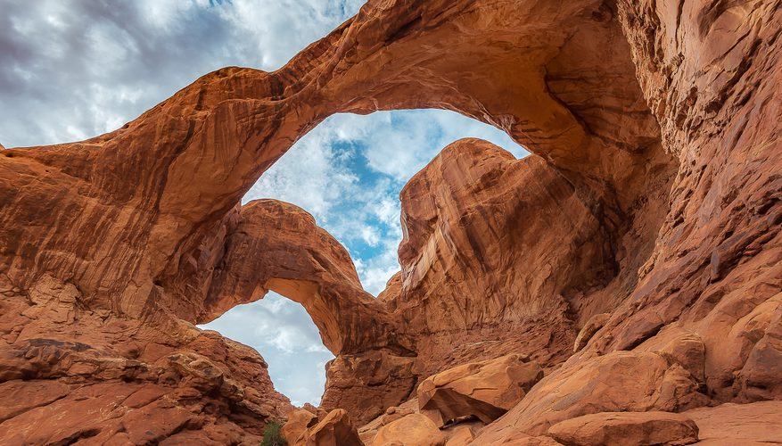
Rate of processes may change
Process that shape the earth stay the same

Slide 9
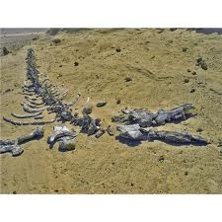
Interpreting the Fossil Record
Clues to environmental changes
Marine fossils found in desert areas

Slide 10
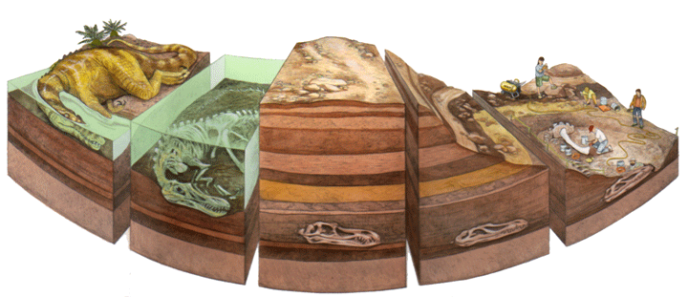
Fossilization
Most animals decompose or are eaten after death.
Usually just hard parts of organisms become fossils

Slide 11
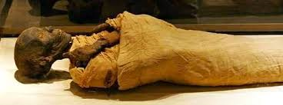
Mummification
Removal of internal organs
Wrapping the body in cloth
Dry areas
  Not much bacteria

Slide 12
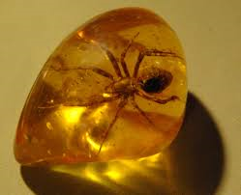
Amber
Hardened tree sap
Insects become trapped and preserved

Slide 13
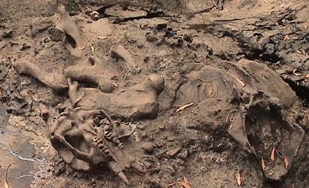
Tar Seeps
Petroleum oozes to the surface
Animals become trapped

Slide 14
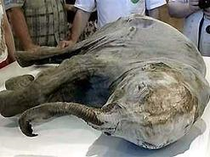
Freezing
Organisms buried in frozen ice or soils do not decay
Bacteria cannot survive

Slide 15
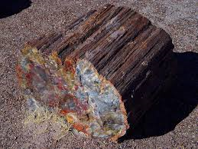
Petrification
Mineral solutions replace original organic sediment with new material

Slide 16
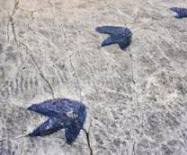
Imprints
Carbonized imprints
Partially decays and leaves print behind

Slide 17
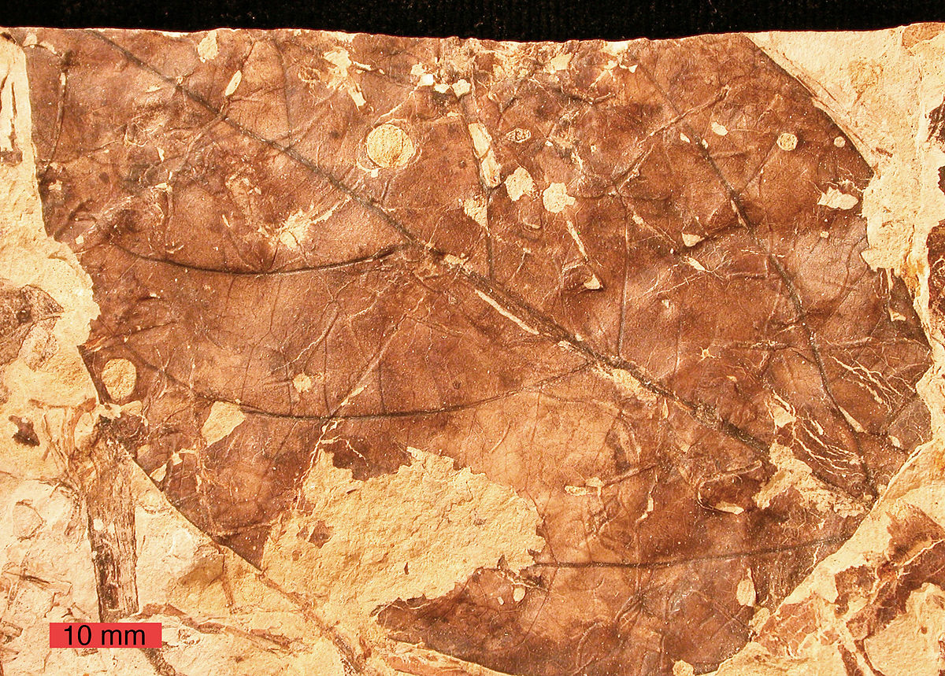
Carbon Film
Fossilized carbon outline of an organism or part of an organism

Slide 18
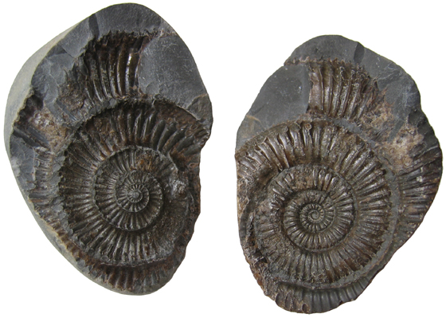
Molds and Casts
Mold – impression left
Cast – fossil copy of an organism made from mold

Slide 19
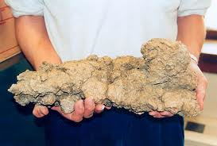
Coprolites
Fossilized poop
Feeding habits

Slide 20
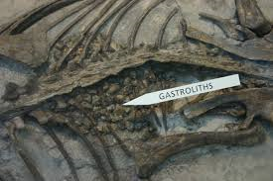
Gastroliths
Stones in dinosaurs digestive system

Slide 21
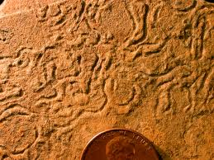
Types of Fossils
Trace fossils – fossilized evidence of organisms
Footprints, nests, tracks

Slide 22

Paleontologists
Scientist who studies fossils

Slide 23
Fossil Kit

Slide 24
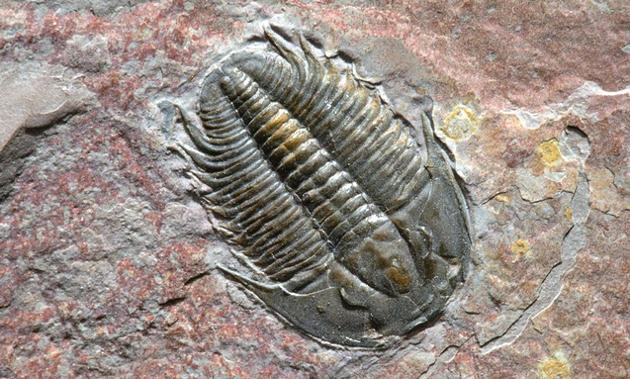
1.Trilobita - Cambrian

Slide 25
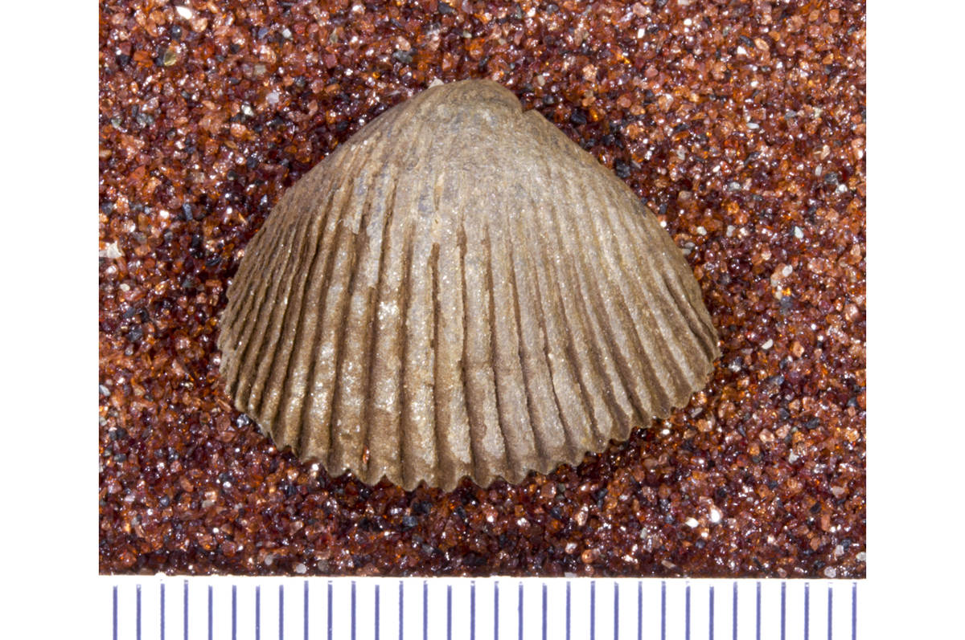
5. Articulate - Devonian

Slide 26
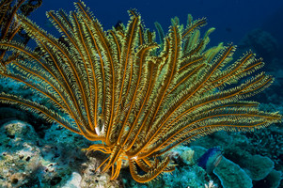
10. Crinoidea - Pennsylvanian

Slide 27
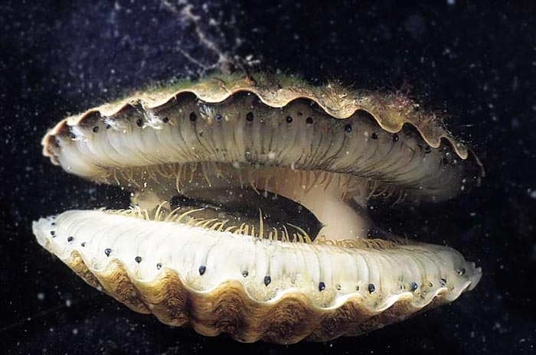
16. Bivalvia - Triassic

Slide 28
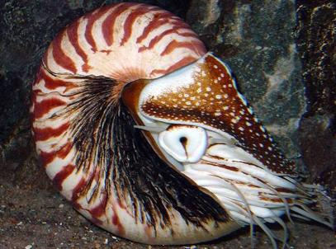
19. Cephalapoda - Jurassic

Slide 29
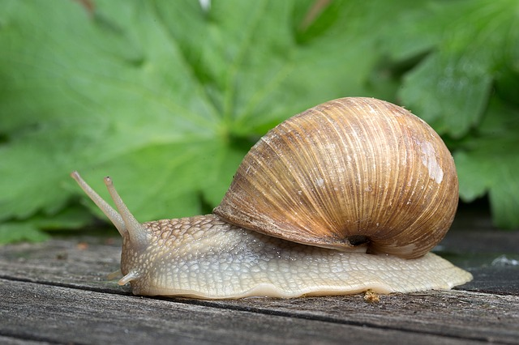
23. Gastropoda - Cretaceous

Slide 30
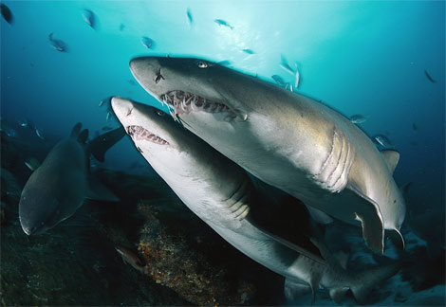
35. Chondrichthyes – Sand Tiger Shark (Tertiary)

Slide 31
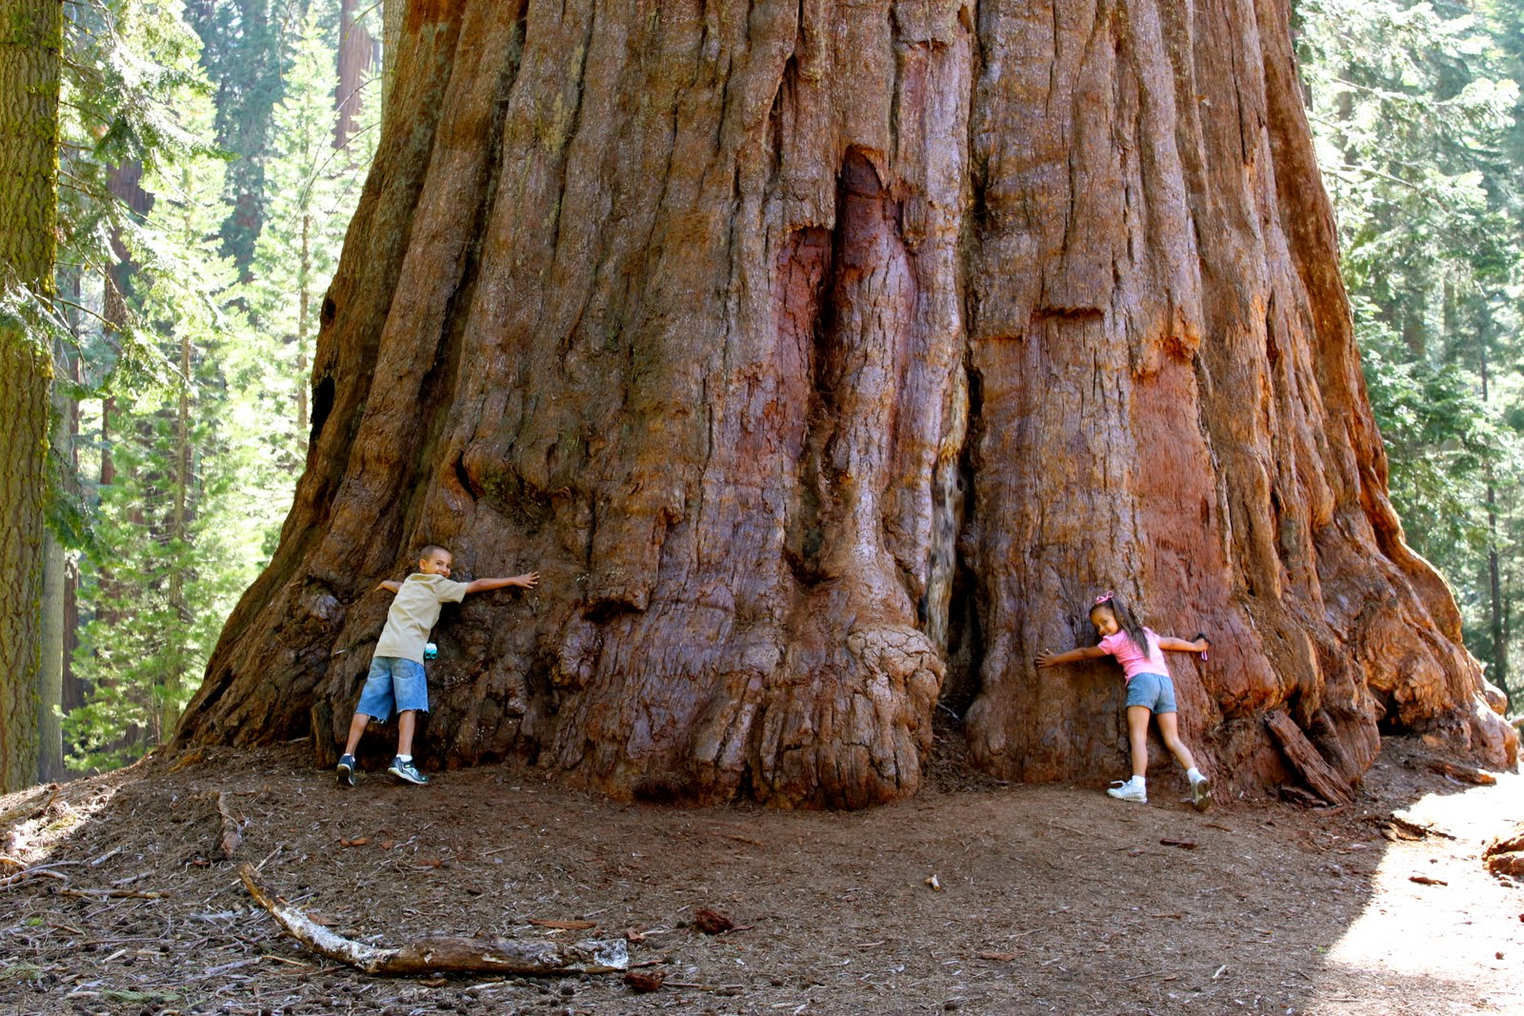
38. Petrified Wood

Slide 32
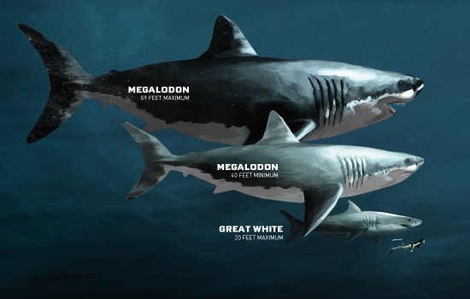
40. Megalodon

Slide 33
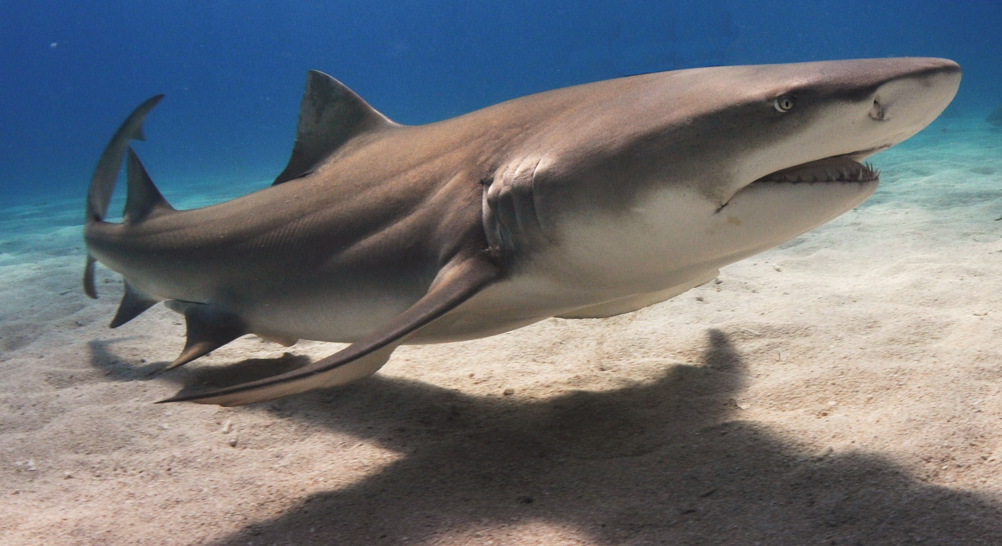
41. Lemon Shark

