Slide 1
Chapter 15 Eastern Europe

Slide 3
Physical Geography
Carpathians – low mountain range
Extension of the Alps
End by Black Sea

Slide 4
The Great Hungarian Plain – mostly in Hungary, fertile
Dinaric, Alps, and Balkan Mountains

Slide 5
Water
Adriatic Sea
Black Sea
Transportation and trade

Slide 6
Rivers
Danube – longest
Flows across Hungarian Plain
Germany to the Black Sea

Slide 7
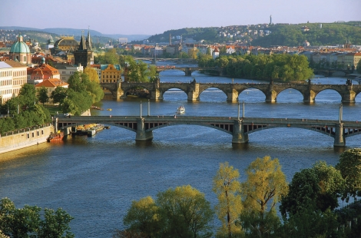
Danube
Transportation
Largest cities
Hydroelectric power

Slide 8
Baltic Coast
Huge forests
Lots of fog – Maybe 30 sunny days a year
Cold

Slide 9
Interior Plains
Mild
More rain
Plains
Forests
Wildflowers

Slide 10
Chernobyl
1986
Nuclear reactor meltdown
Ukraine
Radiation poisoning
Millions of acers of forest

Slide 13
Balkan Coast
Mediterranean climate
Not much rain – shrubs
Tourists - beaches

Slide 14
15-2 Poland and the Baltic Republics

Slide 15
Early History
Independent kingdoms
Lithuania and Poland – strong
Ruled most of region
Latvia and Estonia – smaller
Often invaded

Slide 16
World Wars
WWI – Most of fighting in Poland
Lots killed
WWII – German invaded Poland
Much of country was destroyed

Slide 17
Soviet Domination
After WWII soviets had much of the control in region
Estonia, Latvia, and Lithuania became part of Soviet Union
Poland was free but all were forced into communism
Early 90’s – countries broke away

Slide 18
Cultural Differences
Differences in language and religions

Slide 20
Cultural Similarities
Food
Potatoes, sausage, and seafood
Crafts
Pottery, painting, embroidery
Music and dance

Slide 21
The Region Today
Soviets did not rebuild a good infrastructure
Economy suffered
Warsaw – Poland’s capital
Industrial center
Tourism

