Slide 1
14-3
Scandinavia

Slide 2
History
Vikings – Scandinavian warriors who raided Europe and the Mediterranean
Middle Ages
Conquered: British isles, Finland, parts of France, Germany, and Russia

Slide 4
Viking Explorers
1st settlement in Iceland – 800’s
Greenland – 900’s
1st Europeans to reach North America – Leif Erikson
Ruins found in Newfoundland and Canada

Slide 6
3 Kingdoms
Norway
Sweden
Denmark
All competed for power

Slide 7
Denmark ruled a union of all the Scandinavian territories.
Sweden left the union with Finland
Years later Sweden won control of Norway

Slide 8
1900’s
Scandinavian countries wanted independence
Denmark – Greenland (self governed)
Norway
Sweden
Finland
Iceland

Slide 9
Today
Strong economies
Well educated
Wealthy cities
Highest standards of living
Free health care
Peaceful, stable, and prosperous nations

Slide 10
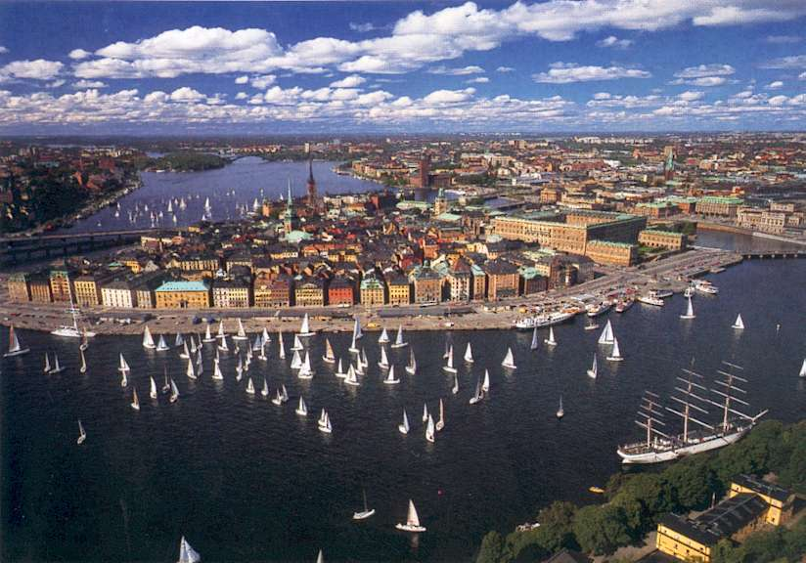
Sweden
Largest, most populated
Most live in urban areas
Stockholm – capital
Floating city – 14 islands with mainland
Neutral – does not takes sides
UN and EU

Slide 11
Denmark
Smallest
Densely populated – 336 people per square mile
50% of land for farming – meat and dairy
Iron, steel, textiles, electronics

Slide 12
Greenland
Geographically part of North America
Territory of Denmark
Ice covers 80% of island
Uninhabitable – not able to support human settlements
Talk of becoming independent

Slide 13
Norway
One of the longest coastlines in the world
Fjords shelter harbors
Fishing, shipping
Oslo – capital
Highest per capita GDP in region
Oil fields – expected to run dry soon

Slide 14
Finland
Helsinki – capital
Trade important
Forest products
Shipbuilding
Electronics

Slide 15
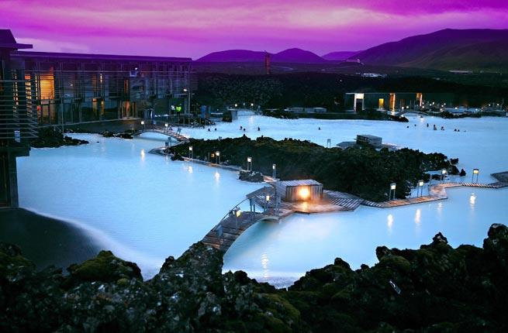
Iceland
Fertile farmland
Fishing – 70% of exports
Hot springs and geysers
Geothermal energy
Tourism

