Slide 1
13-3
Germany and the alpine countries

Slide 2
History
Tribes from N. Europe settled
Germania – named after one of the tribes
Small German states ruled by princes

Slide 4
States became part of the Holy Roman Empire
Supported by Roman Catholic Church
Prussia – strongest state
Wanted a united nation
Industrial and military power

Slide 5
War and Division
1914-1918 WWI
Lost
Economy was bad
Adolf Hitler and Nazi Party
Looked to restore the countries strength again

Slide 6
WWII
1939 – Germany attacked Poland
Conquered much of Europe
Holocaust
Killed European Jews
Lost the war

Slide 7
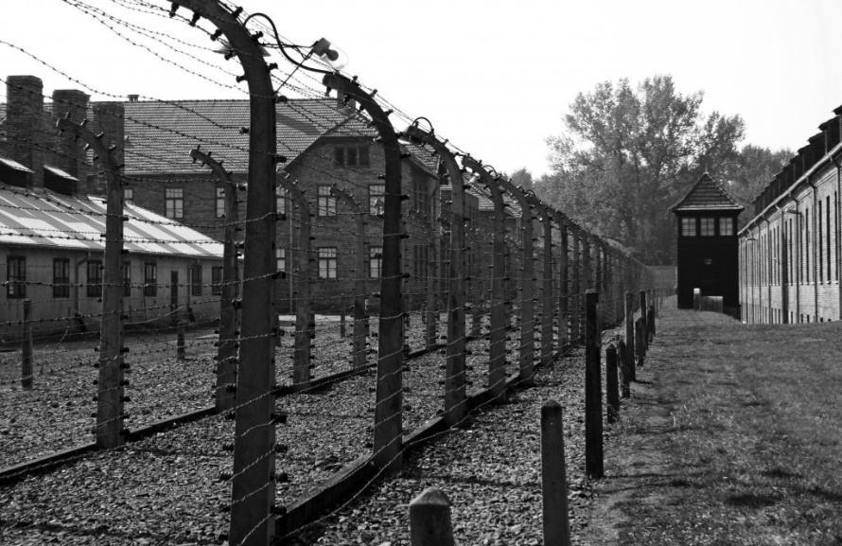
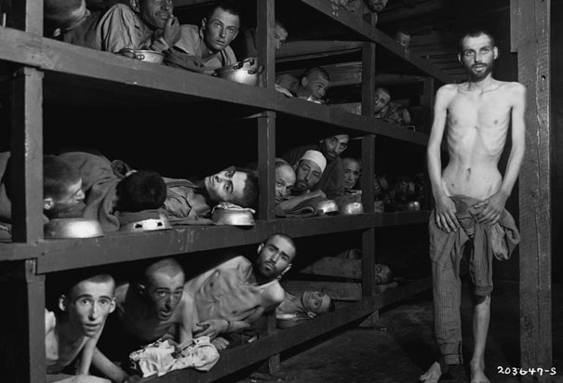

Slide 8
After the War
West Germany
British, French, and US
East Germany
Soviet Union
Over time two countries merged

Slide 9
Berlin Wall
Berlin – Communist East Germany
West Germany kept control of the west side of the city
1961 – Communist leaders build Berlin Wall
Keep East German’s from fleeing

Slide 10
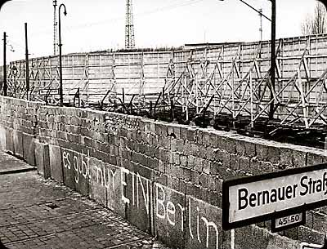

Slide 11
Reunited Germany
West Germany rebuilt quickly
US help
Economy good
East Germany
Poor economy
Little freedoms

Slide 12
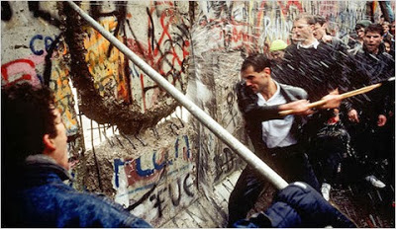
1989 - Movement for democracy in Eastern Europe
Communist governments began collapsing
Wall torn down

Slide 13
People
90% ethnic German
German language
Recent migration is creating diversity

Slide 14
Religion
German Monk – Martin Luther
Reformation – Protestant
North
Roman Catholic
South
East
Few religious ties

Slide 15
Customs
Christmas is a major event
Christmas tree tradition began here
Oktoberfest – Bavaria (SW region)
Food and drink

Slide 17
Arts and Sciences
Bach and Beethoven
Chemistry, engineering, medicine, and physics

Slide 18
Government and Economy
Federal republic
Parliament chooses a chancellor – prime minister
President – ceremonial duties

Slide 19
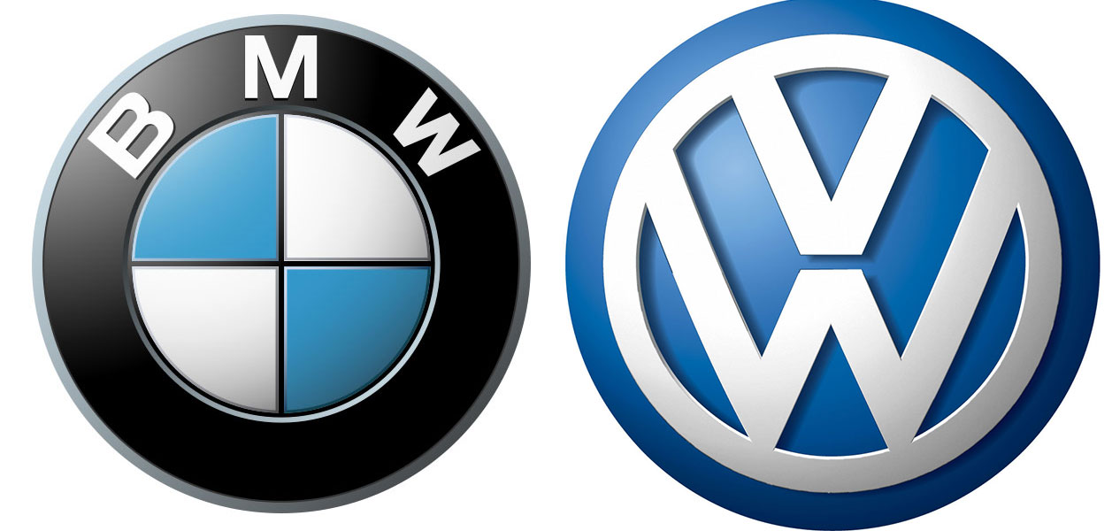
Market economy
Ruhr – industrial district
BMW
Volkswagen
Industry
Chemicals
Steel

Slide 20
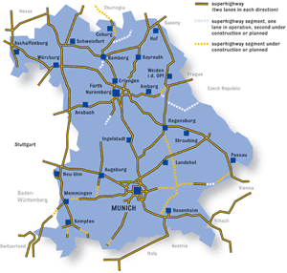
Cities
Berlin – capital
Most live in cities
Autobahn – highway system

Slide 21
Austria
Habsburg family – controlled most of area
Spain, Netherlands, Germany, Italy, Eastern Europe
Family was on the losing side of WWI

Slide 22
Austria
German language
Federal republic
Roman Catholic
Vienna – capital
Good economy
½ country works in banking

Slide 23
Switzerland
Bern - capital
Federal republic
German and French language
Cantons – 26 districts

Slide 24
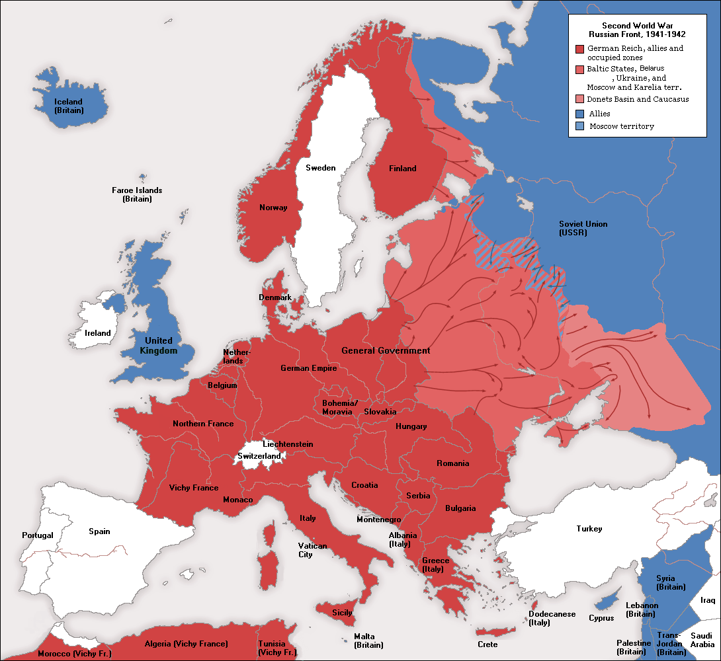
Switzerland
All men serve in military
Neutral – has not joined EU or NATO
High standard of living
Banking, watches, chocolate, cheese

