Slide 1
13-1
Physical geography
West-central Europe

Slide 2
Physical Features
Field of Tulips
Sunny beaches
Icy mountains
Plains
Uplands
Mountains

Slide 6
Plains
Area looks like an open fan with Italy as the handle
Northern European Plain – broad coastal plain
Atlantic Coast to Eastern Europe
Outer edge of fan

Slide 7
Less than 500ft above sea level
Netherlands – below sea level
Build sea walls
Brittany – northwest France
Plateau

Slide 8
Best farmland
Regions largest cities
Many people live here

Slide 10
Central Uplands
Center of fan
Rounded hills, plateaus, valleys
Coalfields
Rocky
Little farming

Slide 11
Massif Central
Plateau region and Jura Mountains
French-Swiss border

Slide 12
Germany
Uplands cover 2/3 of country
Black Forest – dense forests

Slide 13
Alpine Mountains
Inner part of fan
Alps and Pyrenees Mts
Alps
Mont Blanc – highest peak in France

Slide 15
Water
North – North Sea and English Channel
West – Bay of Biscay and Atlantic Ocean
South – Mediterranean Sea

Slide 16
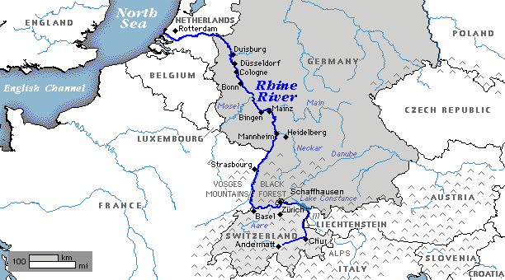
Rivers
Danube
Rhine
Used to transport goods and people
Navigable river – a river that is deep and wide enough for ships

Slide 17
Climate
Warm ocean current – makes much of the area pleasant
Mild summers
Cold winters
Frequent storms

Slide 18
High elevations – colder and wetter
Southern France – Mediterranean climate

Slide 19
Natural Resources
France – coal and iron
Germany – coal
Netherland – natural gas
Many countries import fuels
Tourism is important

