Slide 1
Spain and Portugal
12-4

Slide 2
History
Iberian Peninsula – Iberia
Western
Empires in control:
Phoenicians
Greeks
Roman Empire

Slide 4
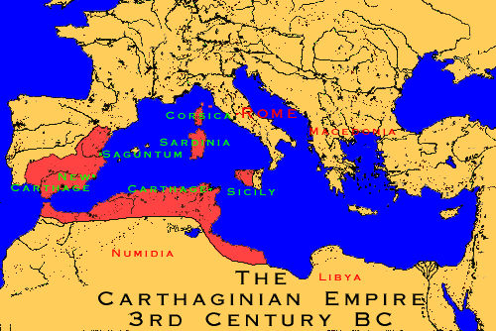
Fall of Roman Empire
Moors – Muslims from North Africa

Slide 5
Muslims Driven Out
Christian kingdoms of Spain and Portugal

Slide 6
Language
Spanish and Portuguese
Basque people of Pyrenees
Own language
Want their own independent country

Slide 7
Religion
Roman Catholic
Fiestas – festivals in honor of patron saints

Slide 8
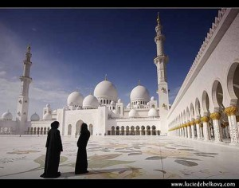
Music and Art
Portuguese – sad folk songs (fados)
Spanish – song and dance (flamenco)
Architecture – Muslim design

Slide 9
Economy
Both economies are struggling
Once Europe’s richest countries
Gold and silver

Slide 10
Spain
Relied on gold
Slow in developing manufacturing

Slide 11
Parliamentary Monarchy
Spain is still ruled by a king
King shares power with elected parliament and prime minister

Slide 12
Madrid – capital (Spain)
Barcelona – industry

Slide 13
Republic
Portugal has elected officials
Lisbon – industry
Harvest cork

Slide 14
About every 9 years – doesn’t hurt tree

