Slide 1
12-2
Greece

Slide 2
History
Ancient Greece – one of the oldest civilizations
Theater, Philosophy, and Democracy
Lifelike art and statues
Temples of marble

Slide 3
Romans and the Turks
Greece became part of Alexander the Great’s Empire
Greece later was under the Roman Empire

Slide 5
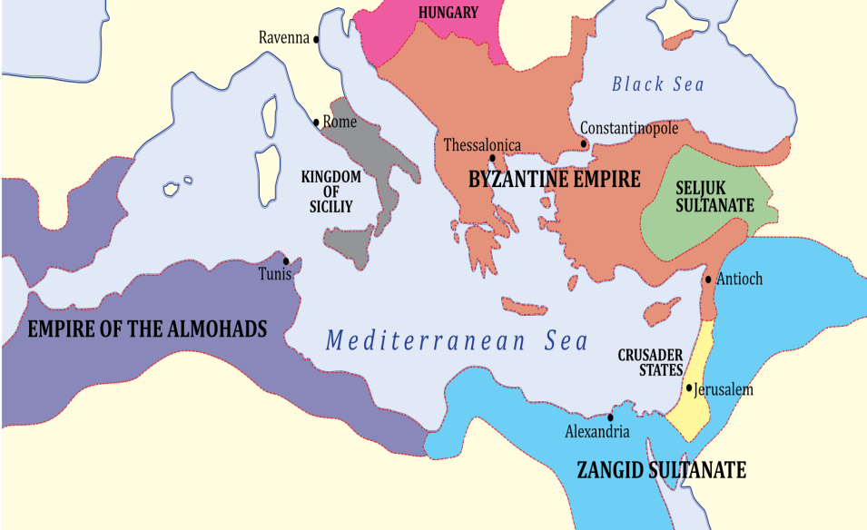
Roman empire divided into 2 parts - Byzantine Empire
Christianity and Greek language
Ottoman Turks – Central Asia
Muslims and Christians
Spoke Greek and Turkish

Slide 6
Independent Greece
1800’s - Greeks rebelled against the Turks and drove them out
Became a monarchy
Later – Military dictatorship
Now - Democracy

Slide 7
Language
One of the oldest language spoken in Europe
A form of same language ancestors spoke

Slide 8
Religion
Orthodox Church
Branch of Christianity
Byzantine Empire

Slide 9
Customs
Local ingredients:
Lamb
Olives
Turks:
Yogurt
Honey
Italians:
Pasta

Slide 10
Urban Areas
3/5 live in cities
Athens – capital
Largest
Modern Skyscrapers
Ancient ruins
Pollution is damaging the ruins

Slide 12
Rural Areas
Mountain villages
Grow crops
Raise sheep or goats

Slide 13
Economy
Economic growth
Large governmental debt
1/5 of land can be farmed
Few mineral resources

Slide 14
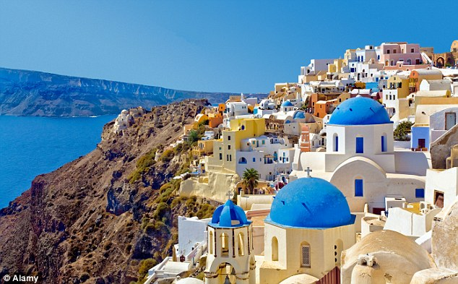
Shipping – one of the largest fleets in world
Cargo from all around Europe
Tourism
Great climate
Ancient ruins
Many islands

