Slide 1
Experiment Parts
Chapter 1-3

Slide 2
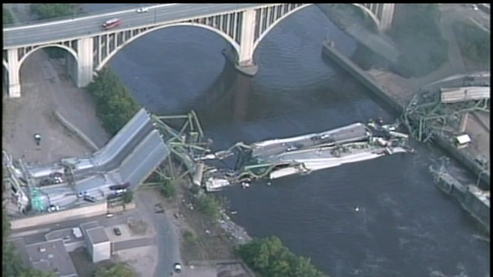
Minneapolis Bridge Failure
August 1, 2007
More than 100 cars
Killed 13 people
Why did the bridge fail?

Slide 3
Variable and Control
Variable - Factors in an experiment that change.
Bridge strength variable – type of material
Control – Factors in an experiment that stay the same.
Bridge strength variable – size, shape

Slide 4
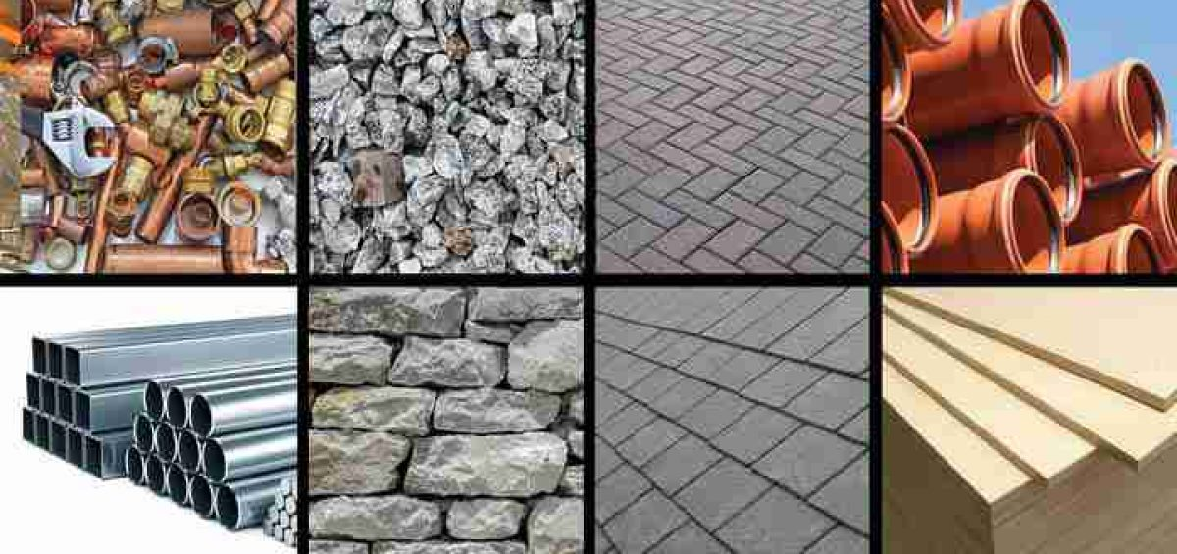
Independent Variable
Independent Variable – the part that changes in order to do your experiment

Slide 5
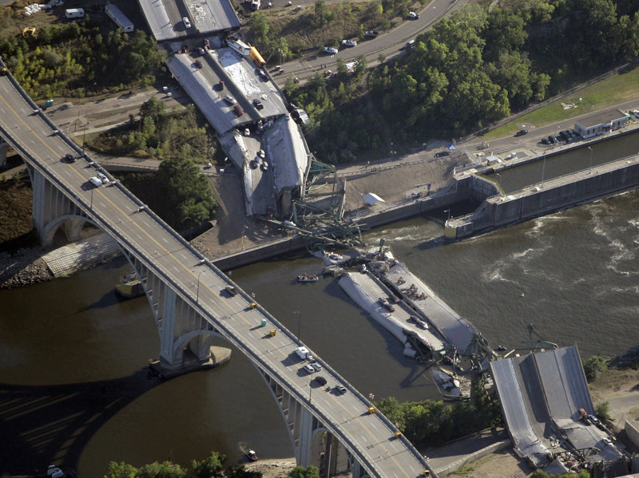
Dependant Variable
Dependent variable - what changes when the independent variable changes
Dependent variable depends on the outcome of the independent variable.

Slide 6
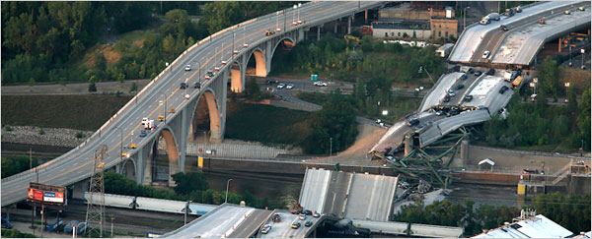
Control Group
Control Group
  Group that is untreated
  Compared to group that was treated

Slide 7
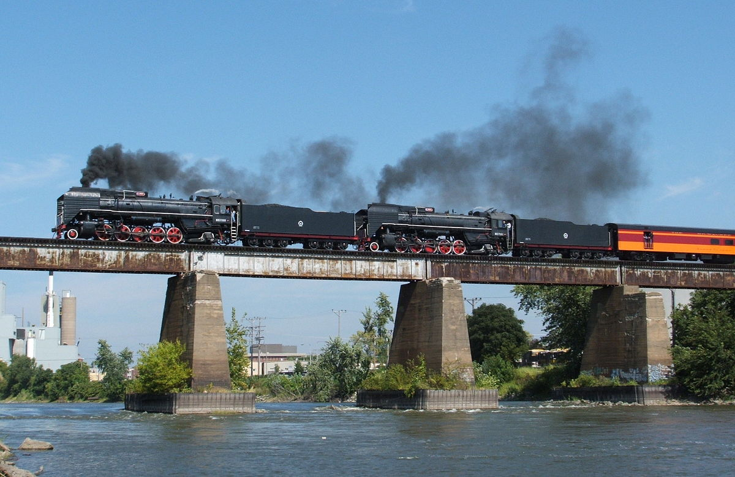
Simple Beam Bridges

Slide 8
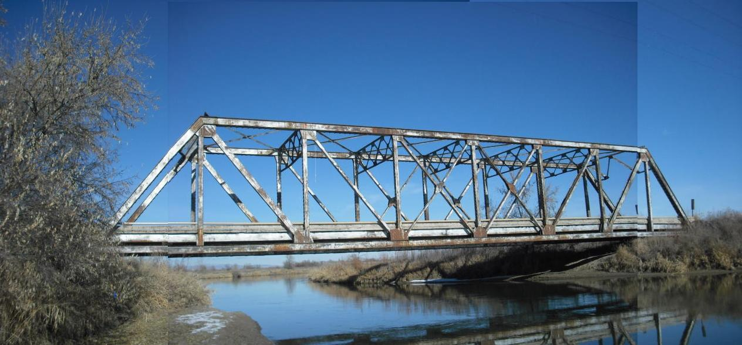
Truss Bridges

Slide 9
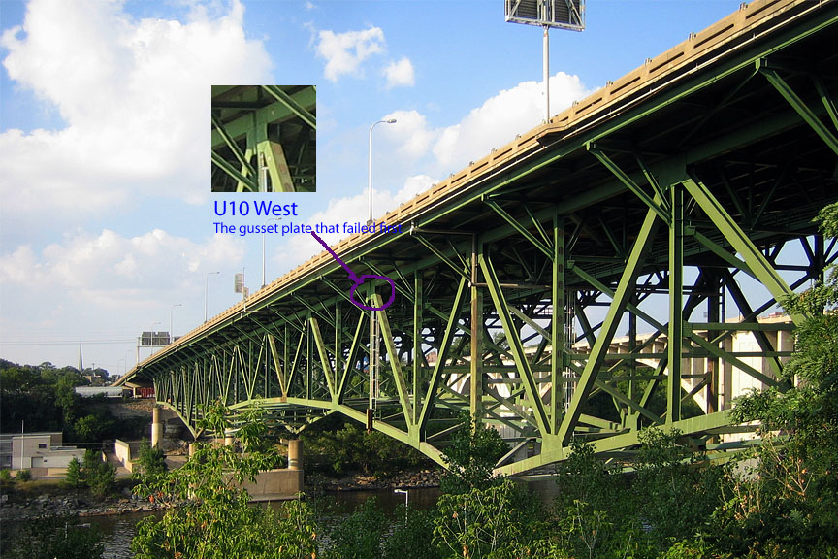
Scientific Method! Observations
Recovering structure from river
Looking at breaks in structure
Surveillance video of the collapse
  Video Clip

Slide 10
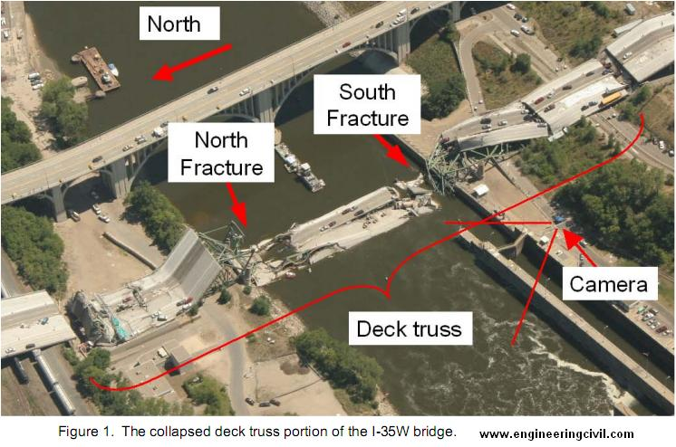
Asking Questions
Faulty design?
Lacking maintenance?
Too much weight?
Combination of factors?

Slide 11
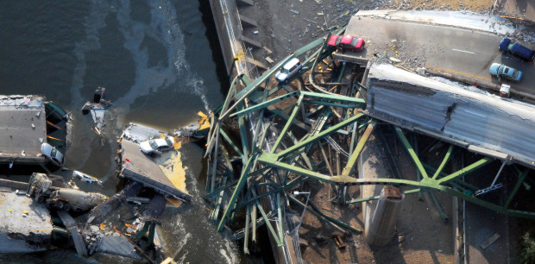
Gather Data
Looked at:
Modifications
Weather
Found an extra layers of concrete were added

Slide 12
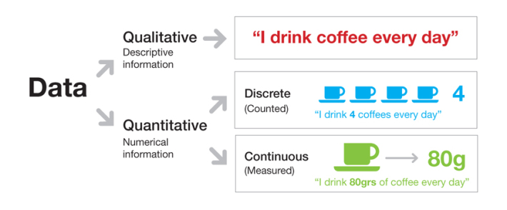
Gathering Data
Qualitative – uses words to describe
Quantitative – uses numbers to describe

Slide 13
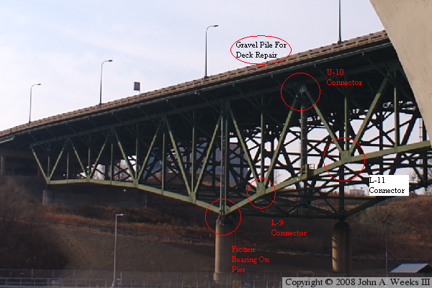
Hypothesis
Renovations were undergoing
Added weight from materials and equipment
Normal traffic
Too much weight!

Slide 14

Computer Models
Weights entered into computer models
Stated that the bridge was not overweight

Slide 15
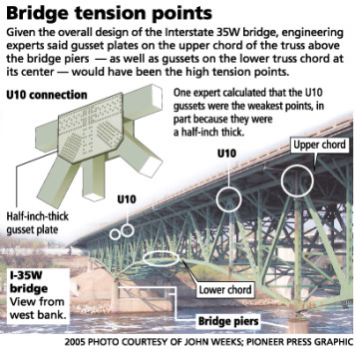
Revising Hypothesis
Images showed gusset plates were bowed
Failure in plates caused the collapse

Slide 16

Testing Hypothesis
Entered new numbers to calculate for the weakened structure

Slide 17
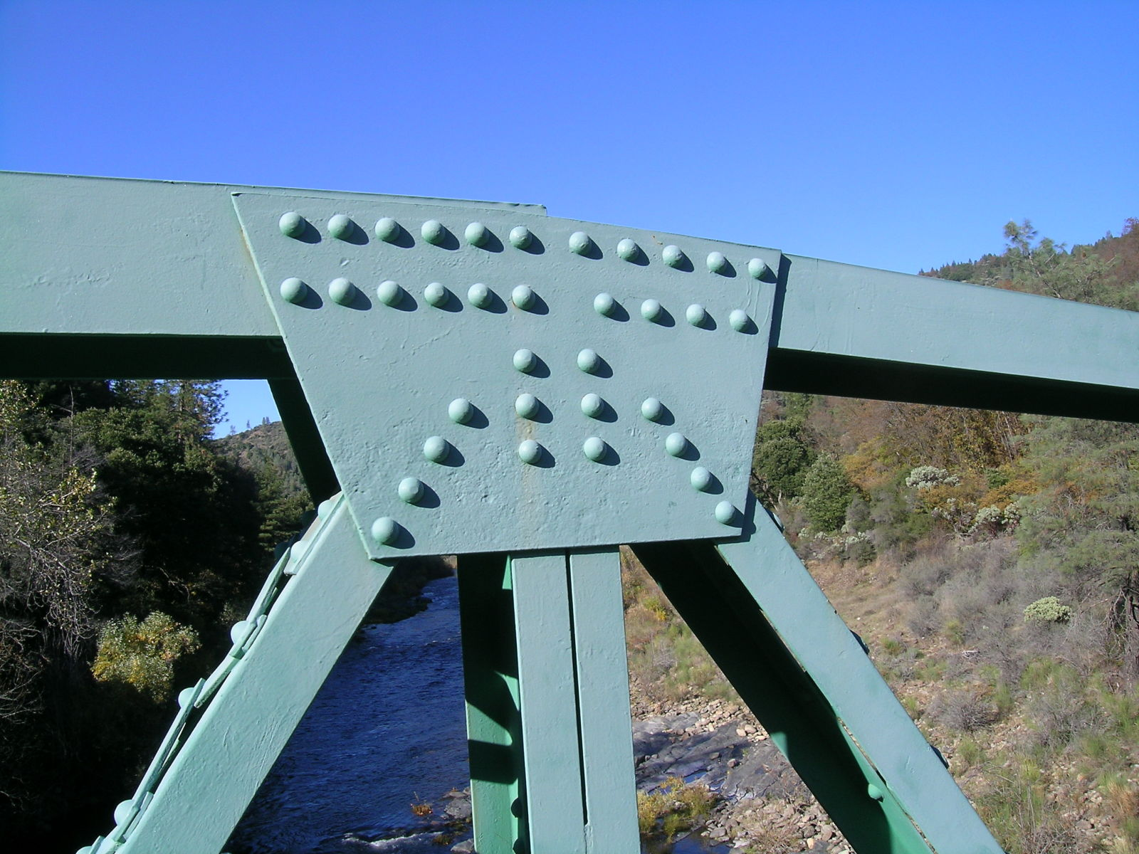
Analyzing Results
The plates were ½ as thick as they should have been.

Slide 18
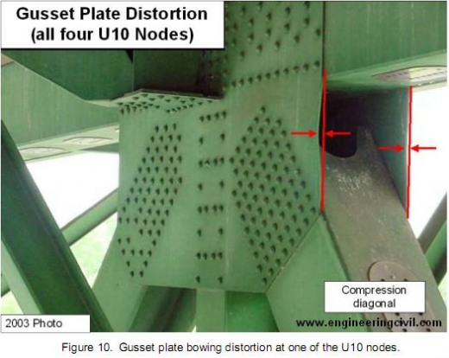
Drawing Conclusions
The original design was bad.
The plates used should have been larger.

