Slide 1
Measurements and Scientific Tools
Chapter 1-2

Slide 2
Descriptions
Spoken or written summary of observations
Measurements taken during an experiment

Slide 3
Explanations
Interpretation of observation
Written inferences to your problem

Slide 4
Universal Measurements
With the person sitting next to you at the table pick a unit to measure your table with (hands, feet, pencils, books, folders, face?).
Record your data on the board.

Slide 5
Unit #

Slide 6
Units of Measurements
Scientist came up with a system of measuring that all scientists around the world could use.
SI – International System of Units

Slide 7
The SI system is easy to use because it is based on multiples of ten.

Slide 8
Measuring Distance
SI base unit of length - meter, m.
The size of the unit you measure with will depend on the size of the object being measured.

Slide 9
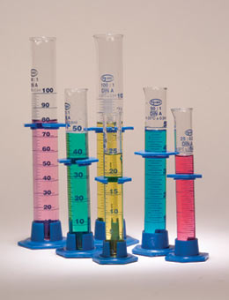
Volume
The amount of space occupied by an object
Liter (L)

Slide 10
Measuring Matter
Mass - a measurement of the quantity of matter in an object
Kilogram (kg)

Slide 11
Mass vs Weight?
Mass – amount of matter in an object
Kilograms
Triple beam balance
Weight – force of gravity on an object
Newtons
Spring scale

Slide 12
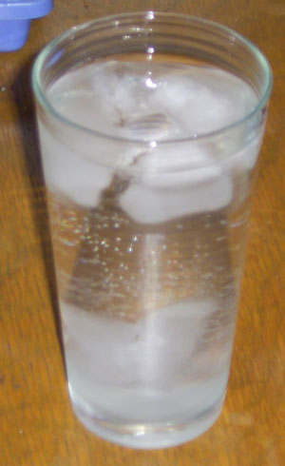
Density
A measure of how much matter is packed into a certain volume.
Density = mass / volume

Slide 13
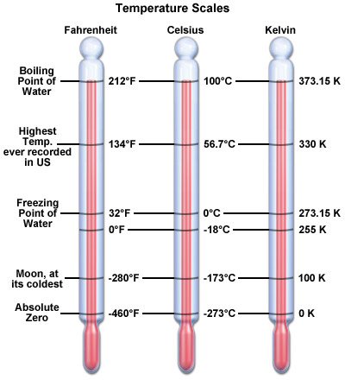
Temperature
A measure of how fast atoms are moving
Degrees Celsius

Slide 14
Scientific Notation
Scientific Notation - To express measurements using numbers that are very large or small use.

Slide 15
1E4 = 10⁴ = 10,000
1E3 = 10³ = 1,000
1E2 = 10² = 100
1E1 = 10¹ = 10
1E0 = 10 ⁰ = 1
1E-1 = 10 ⁻¹ = 0.1
1E -2 = 10⁻² = 0.01
1E-3 = 10⁻³ = 0.001

Slide 16
Accuracy and Precision:
Accuracy – How close a measurement is to the true value
Precision – The exactness of the measurement

Slide 18
Percent Error
Expression of error as a percentage of the accepted value

Slide 19
A student measures the boiling point of water at 97.5 C. The accepted value to boiling water in 100 C. What is the percent error?
% error = experimental value – accepted value x 100%
accepted value
% error = 97.5 - 100.0 x 100%
100.00
% error = 2.50%

