Slide 1
Chapter 1-1
Scientific Inquiry

Slide 2
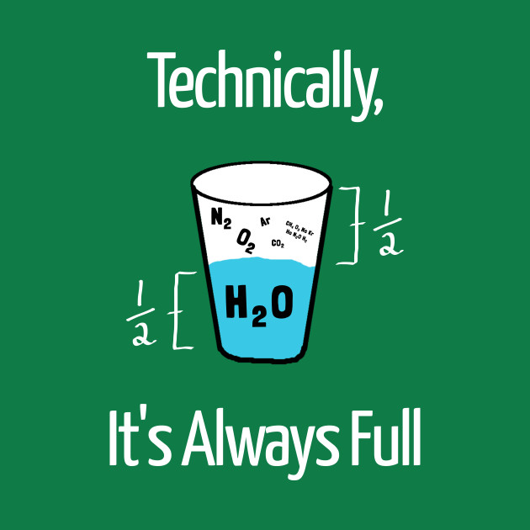
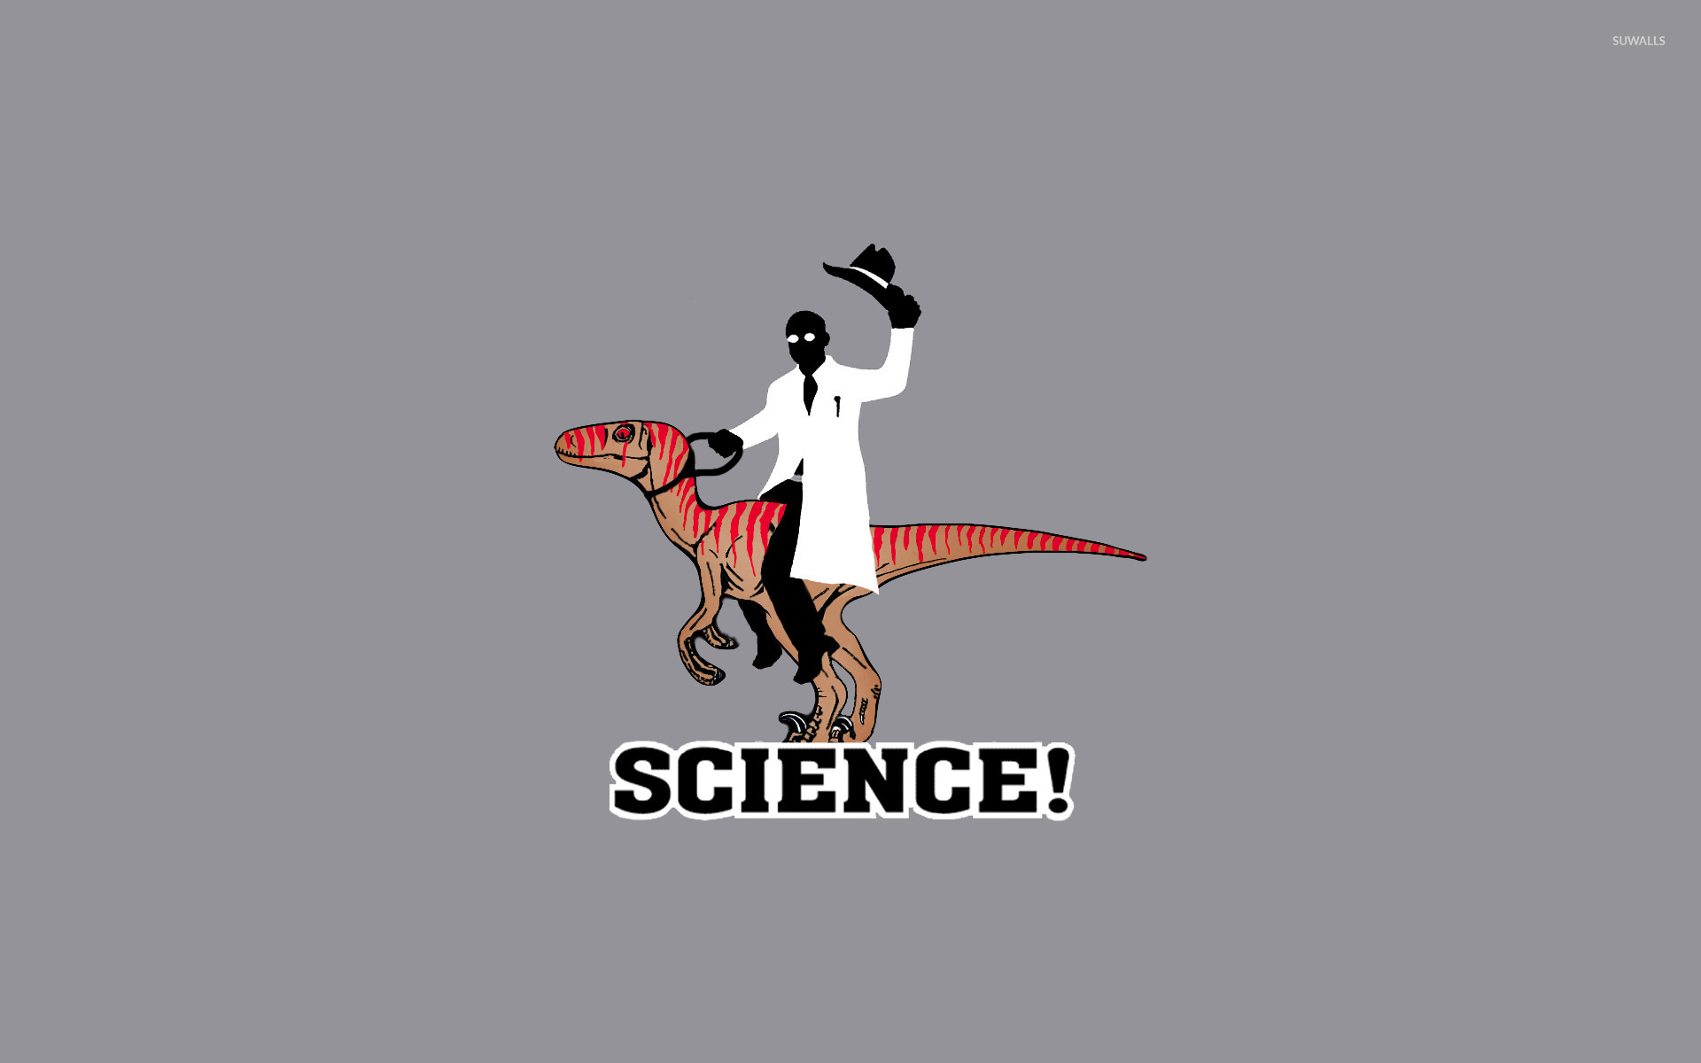
What is Science?
Investigating and exploring
Natural events
Finding new information

Slide 3
Branches of Science
Physical Science – Physics and Chemistry
Matter and energy
What happens to energy in a chemical reaction?
How does gravity affect a roller coaster?
What parts make up an atom?

Slide 4
Branches of Science
Earth Science – Processes that occur on and inside Earth
Why is the sky blue?
How is energy transferred on Earth?
What causes an earthquake?

Slide 5
Racetrack Playa

Slide 6
Branches of Science
Life Science – All organisms and their processes
What adaptations help animals survive their environments?
How do we breath?
How do plants make food?

Slide 7
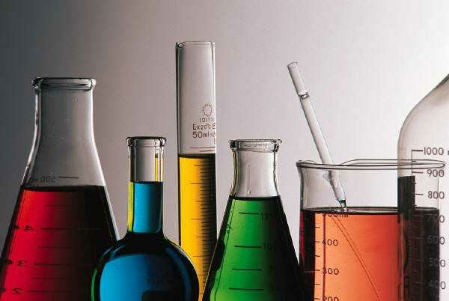
Technology and Science
Technology -the use of knowledge learned through science.
Practical use of science
Technology and science depend on one another

Slide 8
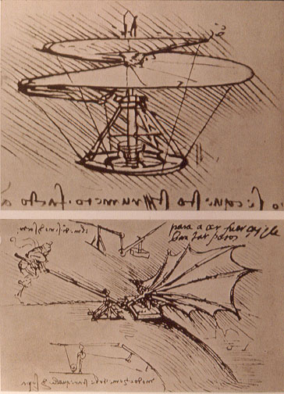
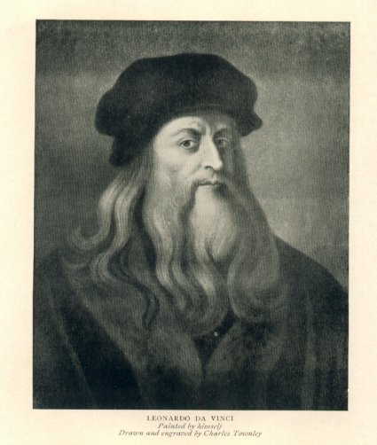
Leonardo da Vinci

Slide 9
Leonardo da Vinci

Slide 10
Scientific Inquiry
Process used to help answer questions

Slide 11
Ask Questions
Observations – Using your senses to gather information
Taking notes as to what occurs
Example: Logs burning
What happens to the logs as they burn?

Slide 12
Inferences – A logical explanation of an observation
Uses prior knowledge
Where is the T.P.?

Slide 13
Hypothesis
Possible explanation for an observation
Can be tested by scientific investigations
What is a good one for the burning log?

Slide 14
Prediction
What will happen next in a sequence of events?
What will happens when a log burns?

Slide 15
Test Hypothesis
Design an experiment and do it!

Slide 16
Analyze Results
What happened during the experiment?
Record data.

Slide 17
Conclusion
Summary of information
Hypothesis confirmed
Test multiple times
Hypothesis wrong
Make a new hypothesis

Slide 18
Communicate Results
Share data so others can benefit from it
Video Clip

Slide 19
The Scientific Method
The Strange Case of BeriBeri
In 1887 a strange nerve disease attacked the people in the Dutch East Indies. The disease was beriberi. Symptoms of the disease included weakness and loss of appetite, victims often died of heart failure. Scientists thought the disease might be caused by bacteria. They injected chickens with bacteria from the blood of patients with beriberi. The injected chickens became sick. However, so did a group of chickens that were not injected with bacteria.
One of the scientists, Dr. Eijkman, noticed something. Before the experiment, all the chickens had eaten whole-grain rice, but during the experiment, the chickens were fed polished rice. Dr. Eijkman researched this interesting case. he found that polished rice lacked thiamine, a vitamin necessary for good health.
1. State the Problem
2. What was the hypothesis?
3. How was the hypothesis tested?
4. Should the hypothesis be supported or rejected based on the experiment?
5. What should be the new hypothesis?

Slide 20
Scientific Theory
Explanation of why and how and effect occurred.
Based on knowledge gained from many observations and investigations
Can be modified later.

Slide 21
Scientific Law
States that an event will occur.
Describes a repeatable pattern in nature.
Does not explain why or how.

Slide 22
Critical Thinking
Using what you already know with new information

