Slide 1
Covalent Bonds
8-2

Slide 2
Covalent Bonds
Formed when two atoms share valence electrons
Unstable atoms
Nonmetals

Slide 6
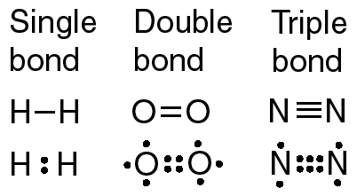
Double Bond
Two atoms share two pairs of electrons
Stronger

Slide 7
Triple Bond
Three atoms share two pairs of electrons
Strongest

Slide 8
Covalent Compound Properties
Low melting and boiling point
Usually gases or liquids are room temp
Poor conductors of thermal energy and electricity

Slide 9
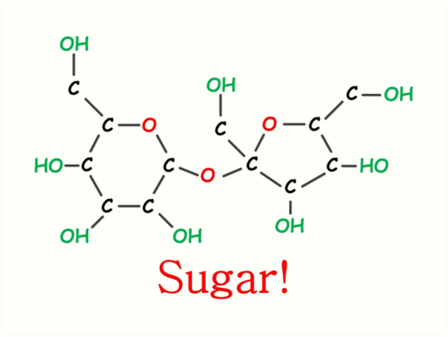
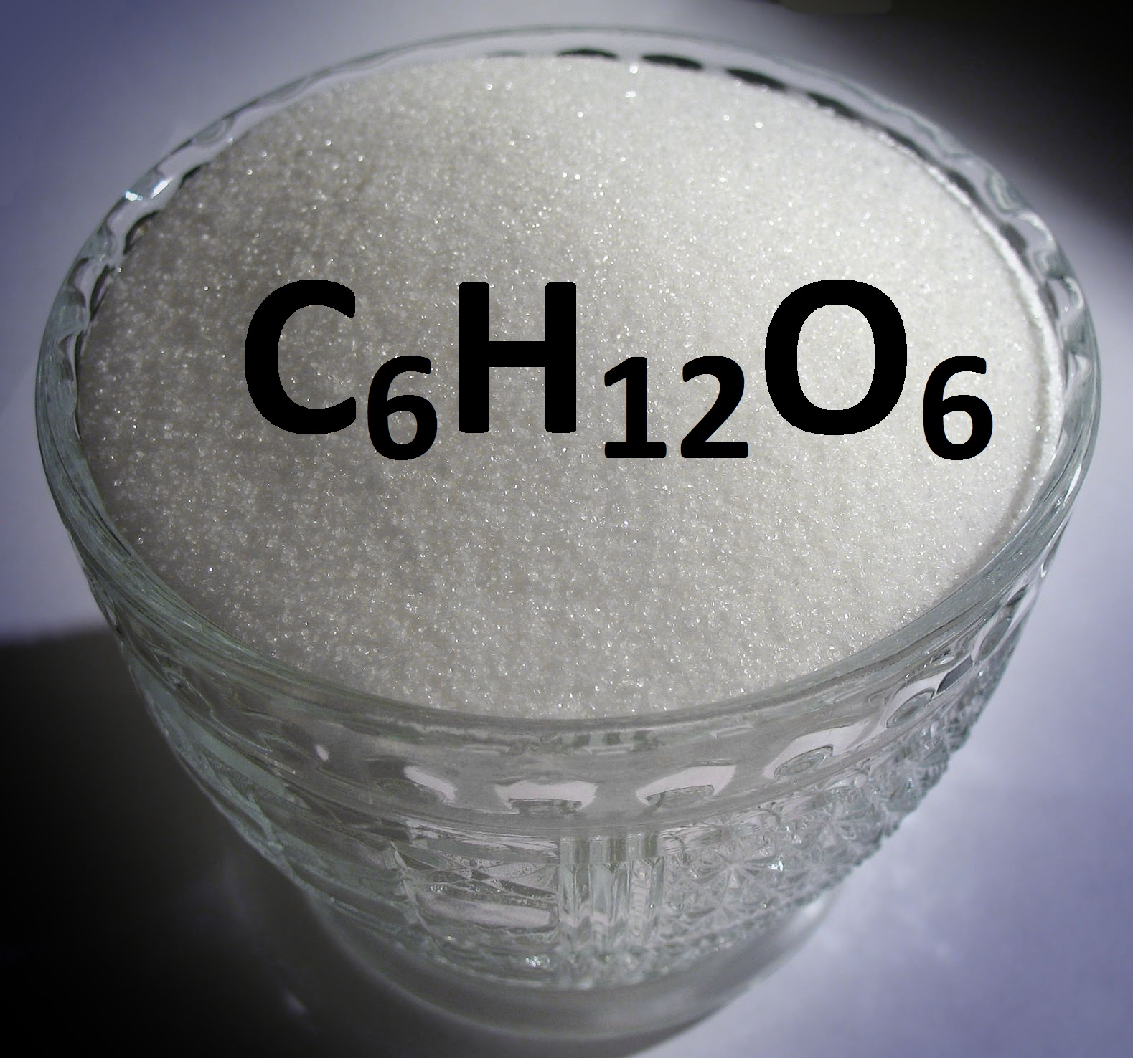
Molecules
Group of atoms held together by covalent bonding
Acts as independent unit
Example - sugar

Slide 10
Polar Molecules
Molecule that has a partial positive and a partial negative end
Due to sharing of electrons
Water

Slide 11
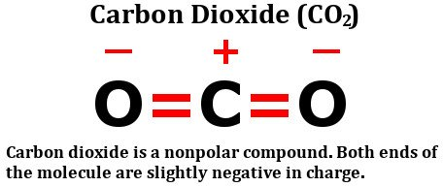
Nonpolar Molecule
Atoms are identical
Attraction is equal

Slide 12
Chemical Formula
Group of chemical symbols and numbers that make the compound

