Slide 1
Types of Maps
3

Slide 2
Types of Maps
Topographic Map
Most widely used
Topography
Shows natural, constructed features
Shows elevation

Slide 3
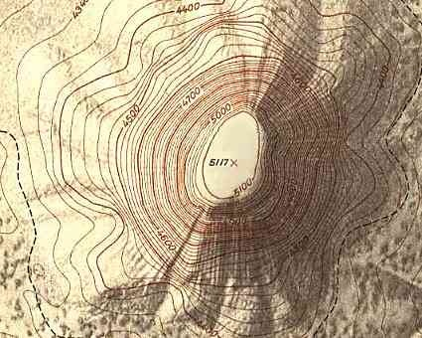

Slide 5
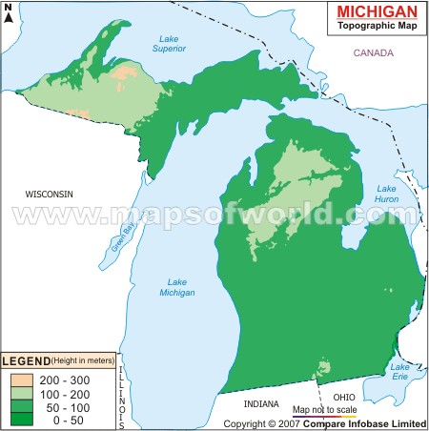

Slide 6
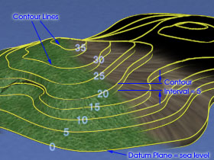
Topographic Maps
Advantages
Shows size, shape and elevation
Elevation on Topographic Maps
Contour Lines
Reflect shape of land
Relief – difference in elevation
Contour Interval
Index Contours

Slide 7
Landforms on Topographic Maps:
Widely spaced contour lines = Little change in elevation
Narrowly spaced lines = steep surface

Slide 8
V-shaped lines = Valleys
Closed loops = Hilltop or depression

Slide 10
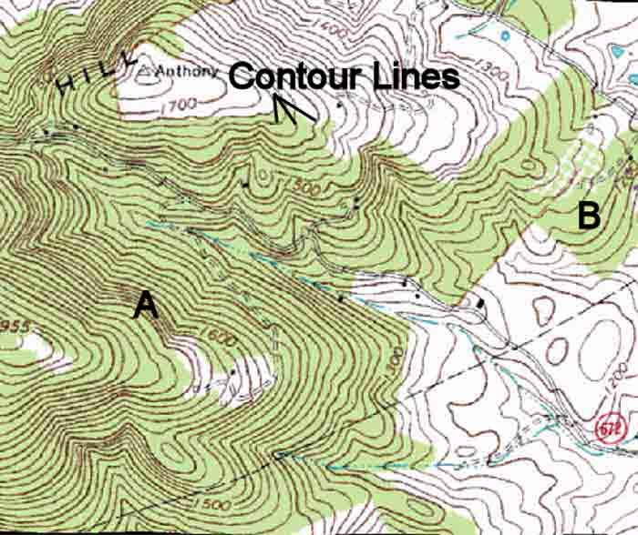

Slide 11
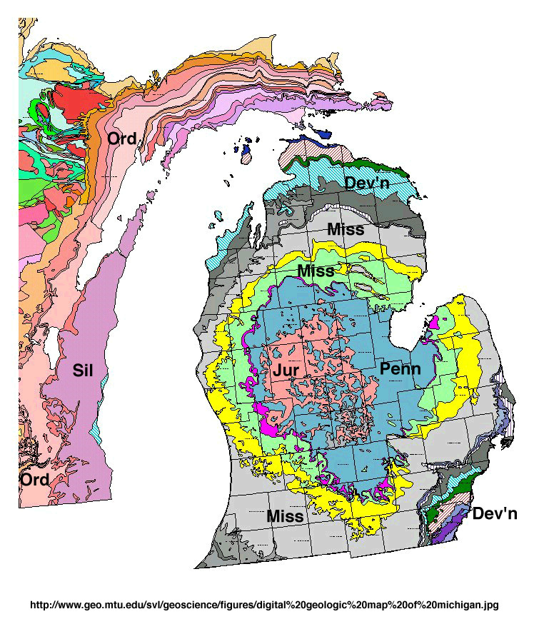
Geologic Maps
Show distribution and types of rocks
Layer one map on top of another
Rock units:
Geologic Unit
Color coded and abbreviated letters

Slide 12
Geologic Maps

Slide 14
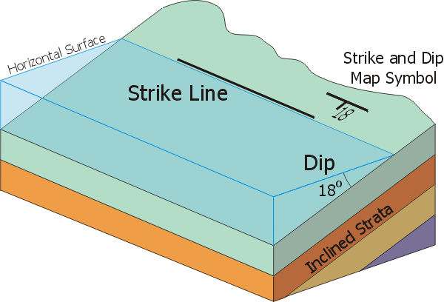
Other Structures
Contact Lines
Strike
Dip

Slide 16
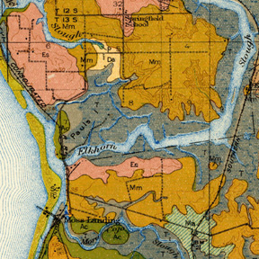
Soil Maps
Classify, map and describe soils
NRCS
Soil Surveys—3 Parts
Text-General info.
Maps-2 types
General Map
Detailed Map
Tables
Uses of Soil Maps—Who uses them?

Slide 19
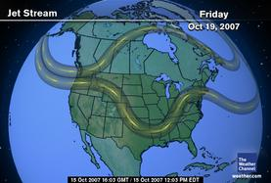
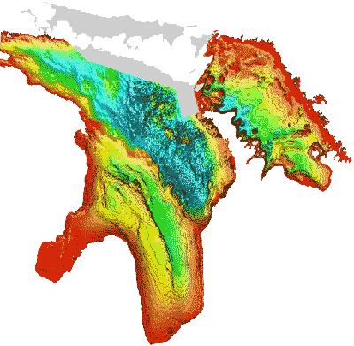
Other types
Maps to plot…
Water
Air movement
Temperatures

