Slide 1
Mapping Earth’s Surface
2

Slide 2
Making Maps
Map maker – cartographer
Collect data from an area and then plot onto a map

Slide 3
Remote sensing – gathering information without being there
GPS
Planes

Slide 5
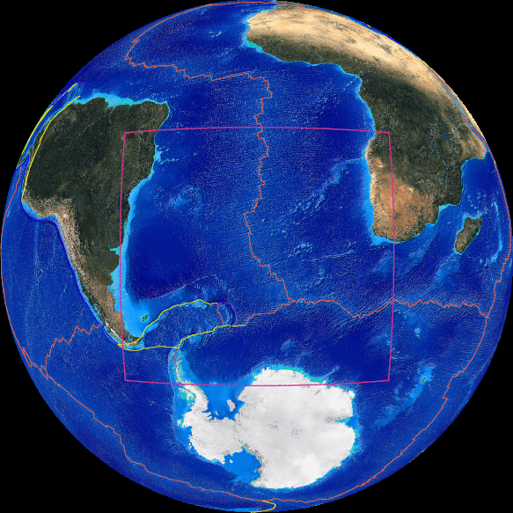
Map Projections
Map of entire Earth = large distortions
Small areas = less distortion
Hard to transfer curved lines onto a flat map

Slide 6
Map projection – flat map that represents a 3D image

Slide 7
Cylindrical Projection
Accurate near equator but not at poles
Shapes preserved

Slide 8
Azimuthal Projection
Distortion increases the farther from the point of contact
Good for air travel

Slide 9
Conic Projection
Areas near the parallel where the cone and globe are in contact are distorted the least

Slide 10
Reading a Map
Compass Rose
Cardinal Direction
North
South
East
West

Slide 11
Symbols
Legend – list of symbols and meanings

Slide 13
Scale
Scale – relationship between actual distance and distance shown on a map

Slide 14
Graphic Scale
Graphic Scale - Printed line similar to a ruler

Slide 15
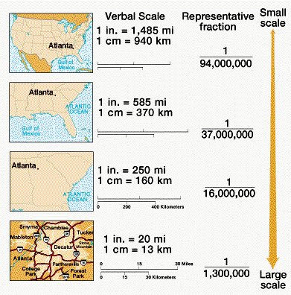
Fractional Scale
Fractional Scale - Ratio

Slide 16
Verbal Scale
Verbal Scale - Written in sentence form

Slide 17
Isogram
Iso – Greek for equal
Gram – means drawing
All locations in an isogram share the value that is being measured

Slide 18
Isobar

