Slide 1
27-4
The Koreas Today

Slide 2
South Korea
The Republic of Korea
President with other elected officials
US helped to create government after WWII

Slide 3
Strong economy
Major manufacturing country
Exports goods to many other countries

Slide 4
Daily Life
Seoul – Capital
Densely populated
Most people live near the west coast

Slide 5
Pollution from coal power plants
Housing is expensive
Most people are farmers

Slide 6
Challenges
Past – only a few families controlled much of the industry
Recent – less corruption

Slide 7
Demilitarized Zone
Empty buffer zone created to keep the two countries from fighting
Troops not allowed in
Patrol both sides

Slide 9
North Korea
Democratic People’s Republic of Korea
Not a democracy or republic
Totalitarian state – Communist Party controls everything

Slide 10
Government
Created after WWII
Kim Il Sung – dictator
Ruled with complete power

Slide 11
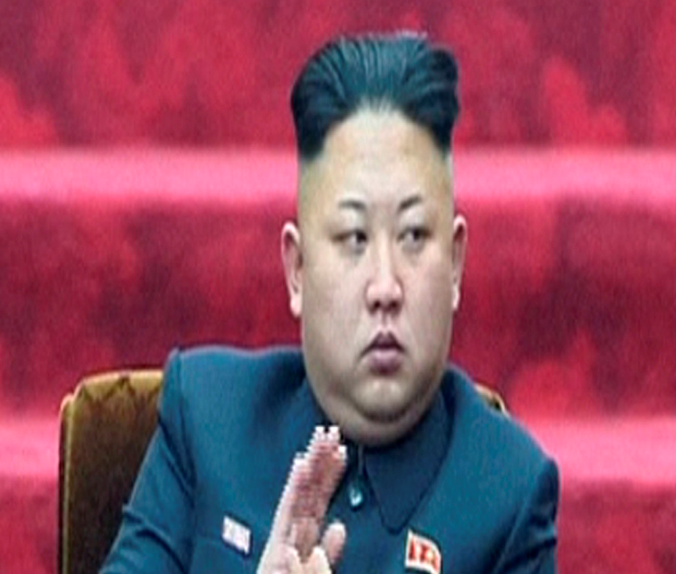
Kim Jong Il
Ruled after his fathers death in 1994
Kim Jong Un
Ruled after his father’s death 2011

Slide 12
Command economy
Rich in mineral resources
Factories make machinery and military surplus
Outdated technology
Poor

Slide 13
Must import food
Difficult due to relations with other countries

Slide 14
Daily Life
Pyongyang – capital
Only top officials can own cars
Wide spread electricity outages
Discourages religion of any kind

Slide 15
Challenges
Isolated from the world after the break up of the Soviet Union
Closed market – other countries can’t sell goods there

Slide 16
Have announced that they have the materials to build nuclear weapons
Tested weapons

Slide 17
Reunification
People from both sides have expressed interest in being reunited
Built a road between DMZ
Governmental issues

