Slide 1
27-3
Japan Today

Slide 2
Japanese Companies
Sony
Honda
Toyota
Mitsubishi
One of the world’s strongest economies

Slide 3
Government
Constitutional monarchy
Headed by a emperor
Head of state
Little power
Acts as a symbol of the people

Slide 4
Diet – elected legislature
Prime minister
Make laws and govern life

Slide 5
Economy
Not very strong until 1950’s
Strong today
Manufacturing
Electronics
Cars

Slide 6
Government works closely with business leaders
Well educated, highly trained
Strong work ethic
Belief that work in itself is worthwhile

Slide 7
Trade
Many goods are sent to China and US
Trade surplus – exports more goods than they import

Slide 8
Tariff – fee that a country charges on imports or exports
High tariffs were placed on good coming into country
People buy stuff made in Japan!

Slide 9
Resources
Not many natural resources
Imports raw materials
Little arable land
Must buy food other countries

Slide 10
Daily Life
Size of California
4 times as many people
Most people life in crowded cities

Slide 11
Tokyo
Capital
Banking and communications
Expensive real estate
Tall and narrow buildings

Slide 12
Underground shops and restaurants
Capsule hotels
“Pushers” on subways

Slide 15
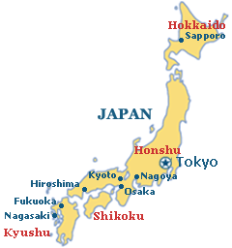
Osaka – 2nd largest city

Slide 16
Transportation
Shinkansen – bullet trains
160 mph
Very efficient

Slide 18
Rural Life
Most land is too rocky for farms
Average farm is 2.5 acres
Average farm in US is 175 times that size
Most can’t make a living farming

Slide 19
Challenges
Lack of space
Tall building need to be earthquake proof
China and South Korea are starting to take business away from them
Pollution – Kyoto Protocol (150) countries

