Slide 1
26-4
Mongolia and Taiwan

Slide 2
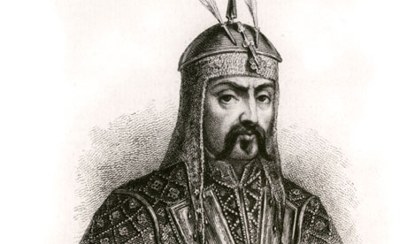
Mongolia’s History
700 years ago one of the greatest powers
Genghis Khan
Conquered much of Asia including China

Slide 3
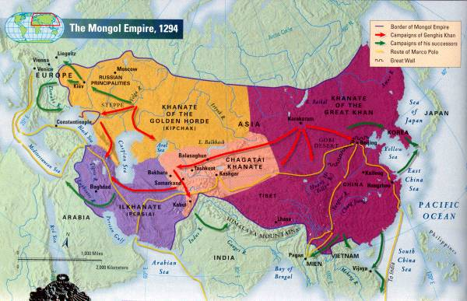

Slide 4
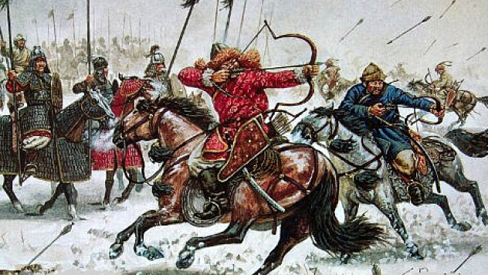
1600’s – China conquered Mongolia
Ruled for 200 years

Slide 5
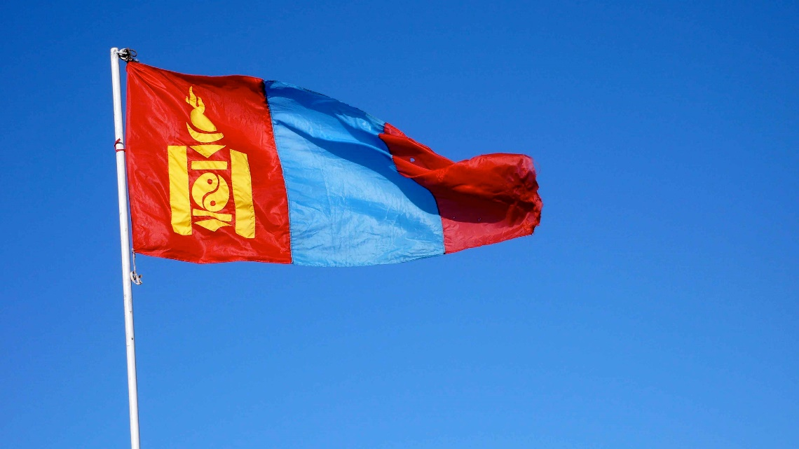
Mongolia declared independence in 1911
  Russia helped
Mongolian People’s Republic
  Communist run

Slide 6
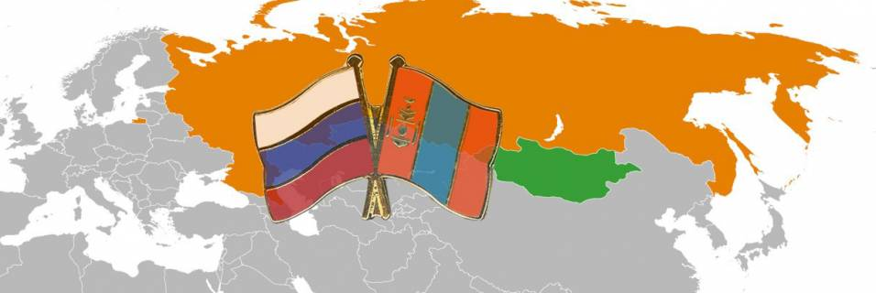
Russia was part of the Soviet Union
Gave Mongolia economic aide
Soviet Union collapsed
Mongolia today
  Democracy
  Free market

Slide 7
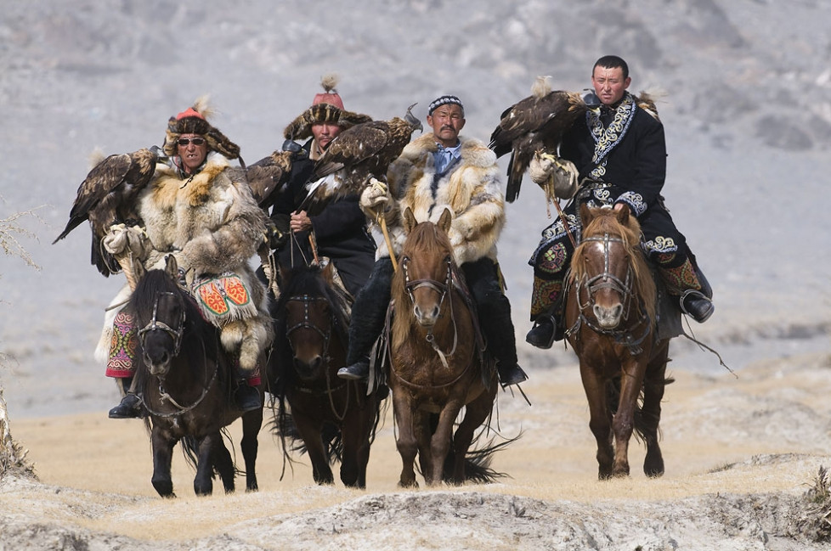
Culture
Nomads – ½ of population
Gers – large circular, felt tents
Horse are important

Slide 8
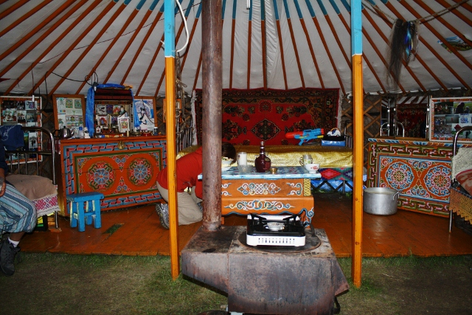
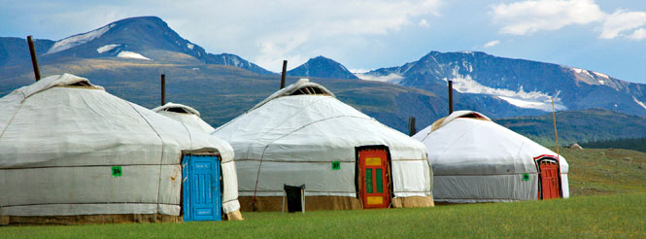

Slide 9
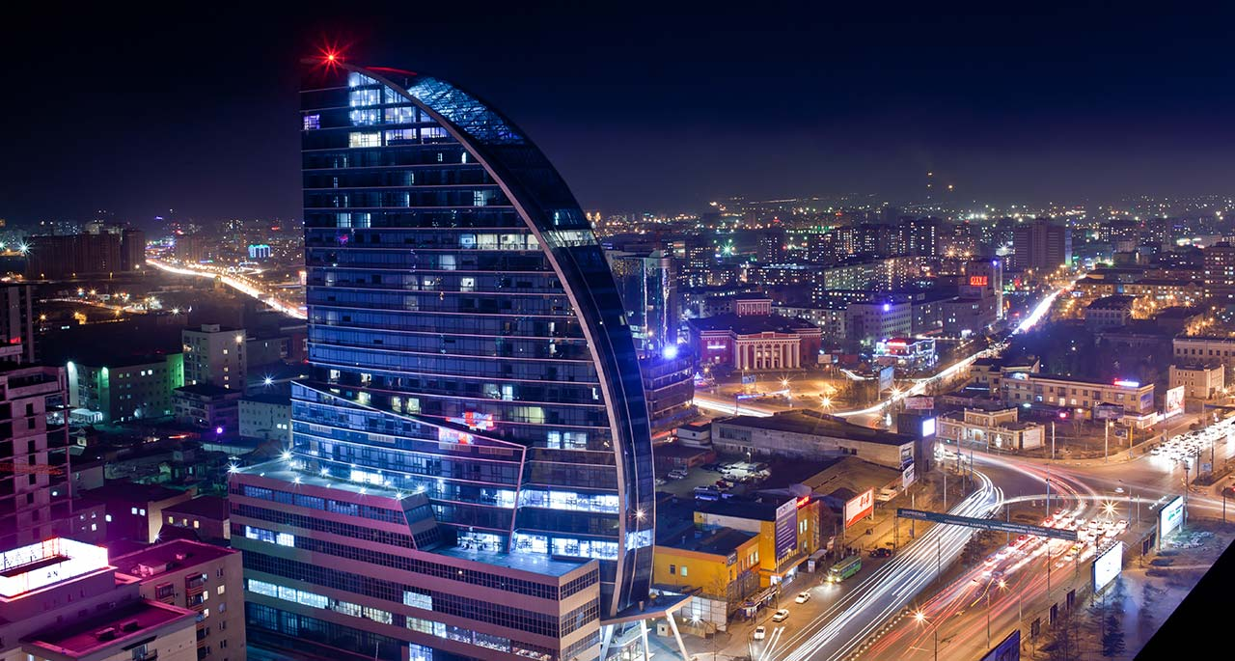
Mongolia Today
Ulaanbaatar – capital
Sparsely populated
Size of Alaska
  3 million people
Produces little food
  Food and water shortages

Slide 10
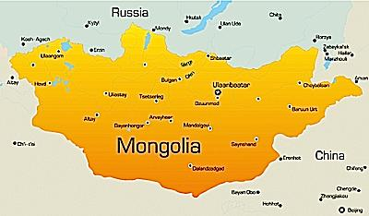

Slide 11
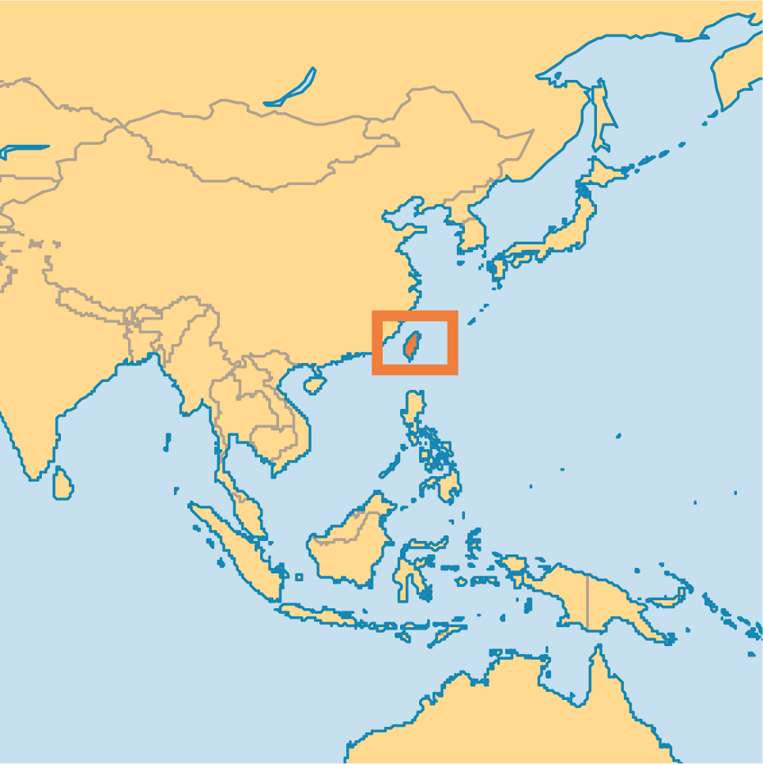
Taiwan’s History
China began settling in 600’s
China and Japan have both controlled the island

Slide 12
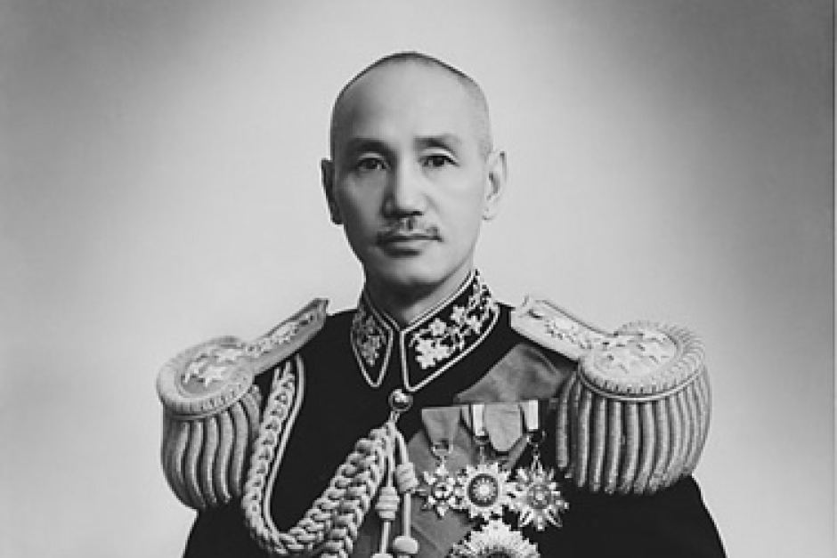
Chinese nationalist took over Taiwan
  Chiang Kai-shek
Ruled under martial law
  Military rule for 38 years
  Imposition of the highest-ranking military officer as the military governor or as the head of the government
Today - Democracy

Slide 13
Tensions
China says:
Taiwan is part of China
Threatens force if independence is declared
Officially recognized by US
Member of United Nations
Taiwan says:
Is China’s true government
Growing movement for independence
Unofficially recognized by US
Unable to regain membership in the UN

Slide 14
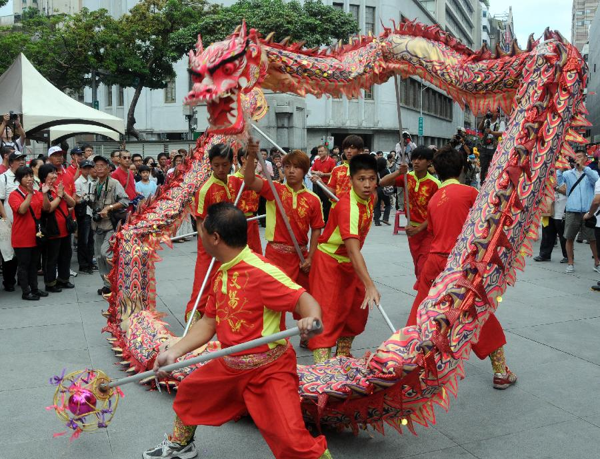
Taiwan’s Culture
85% native Taiwanese
Descendants of China
Japan influence
American and European Influence

Slide 15
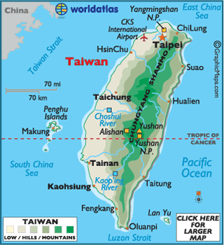
Taiwan Today
Modern country
23 million
Most live on west coast
Mountainous
Taipei – capital
Kao-hsiung - industry

