Slide 1
26-2
History and Culture

Slide 2
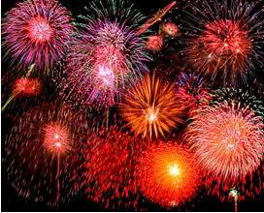
Early History
Invented:
Fireworks
Magnetic compass
Gunpowder
Paper
Printing Silk
4,000 old civilization

Slide 3
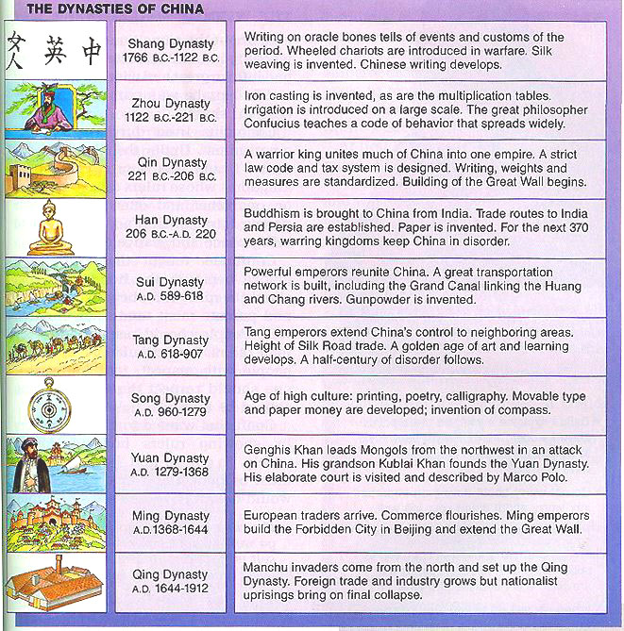
Dynasties
A series of rulers from the same family line
Emperors – rulers
Dynasties rose and fell
Chaotic periods with warlords

Slide 4
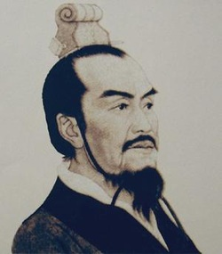
Qin or Ch’in
Unite China under one empire
Ruler – Shi Huangdi
Ordered the building of the Great Wall

Slide 5
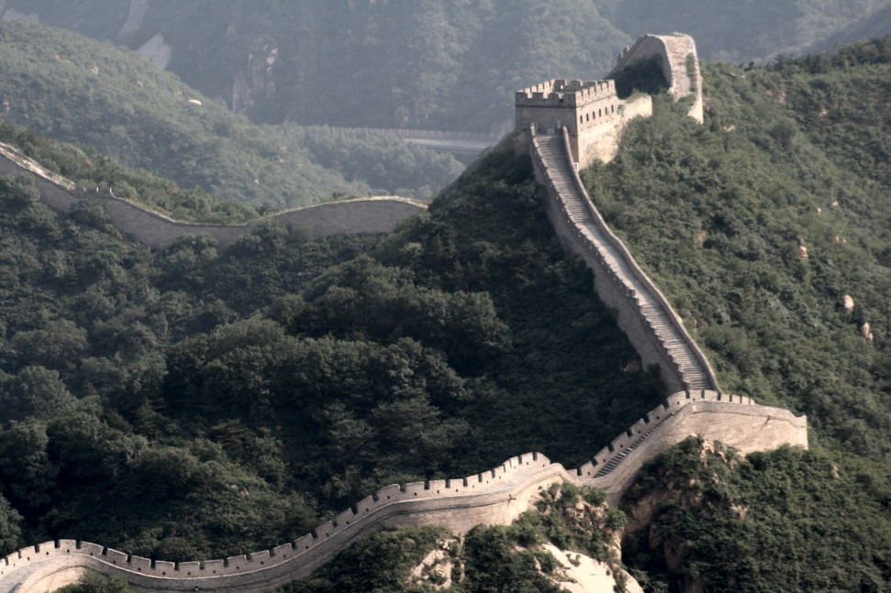
The Great Wall
Keep out invaders
Linked older walls in Northern China

Slide 6
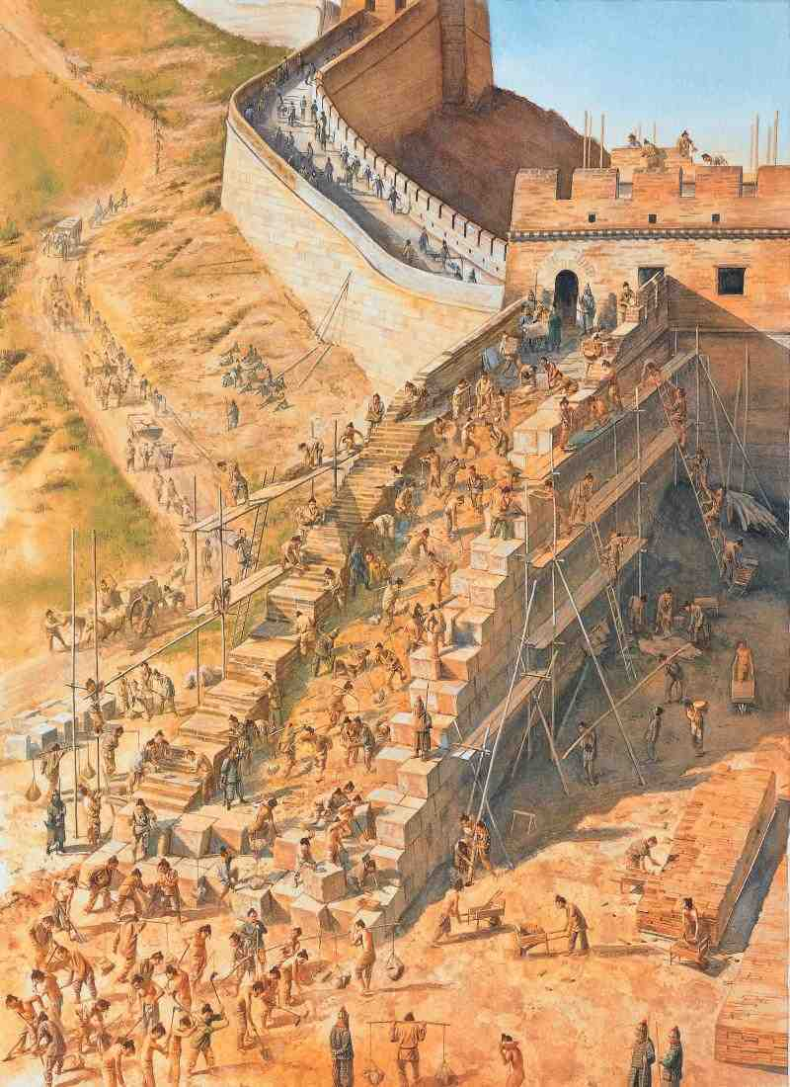
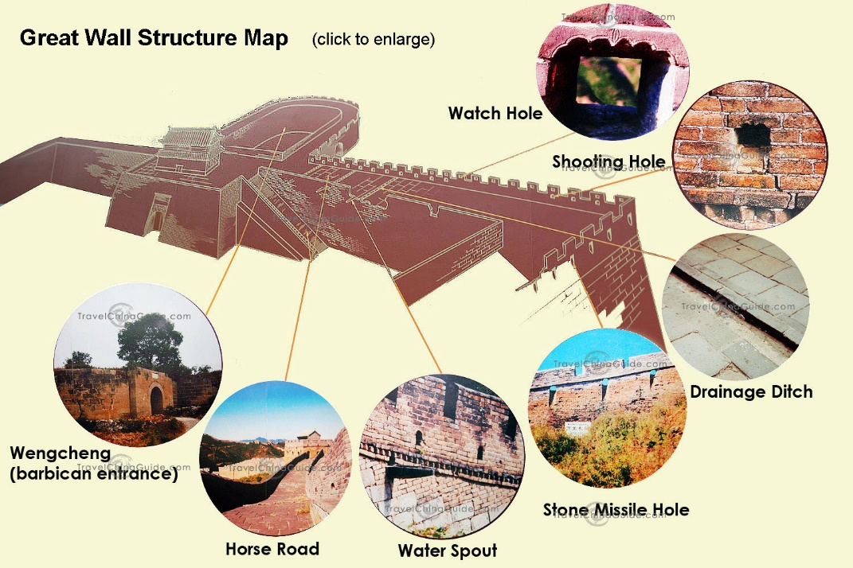

Slide 7
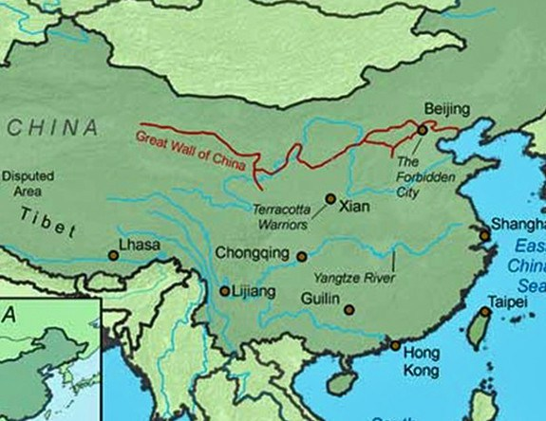

Slide 8
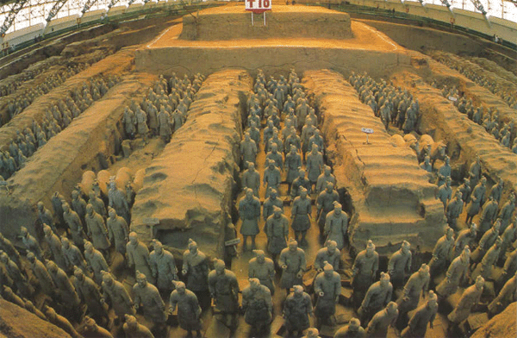
Shi Huangdi
1,000’s of terr-cotta warriors guarding his tomb
  Clay

Slide 9
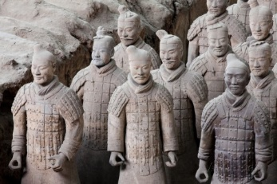

Slide 10
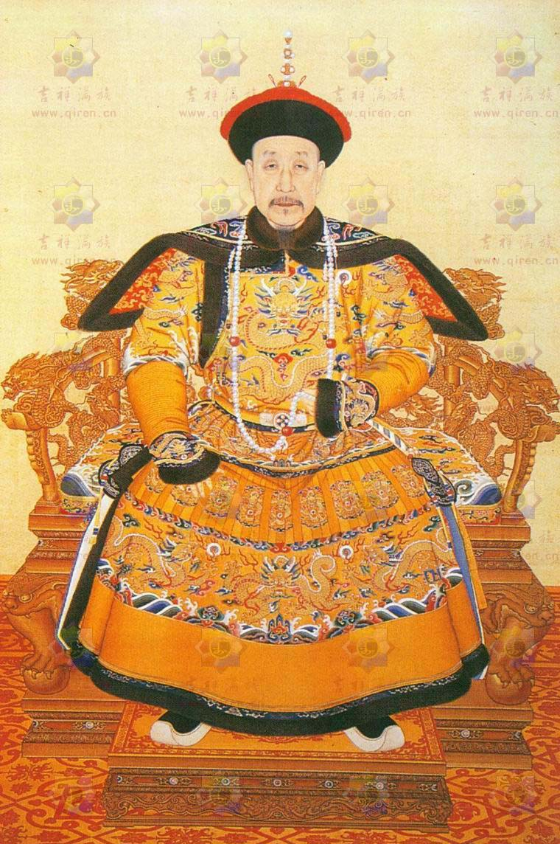
Qing
Last dynasty
Invaders called Manchu ruled dynasty in 1644

Slide 11
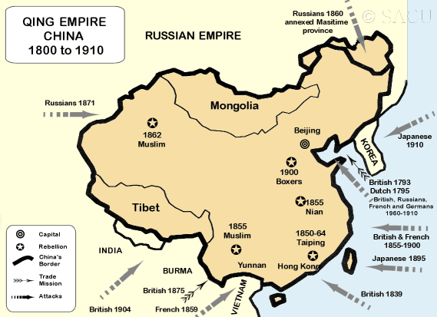
Outside Influences
Limited contact with outside world
Thought culture was superior
Natural barriers - mountains

Slide 12
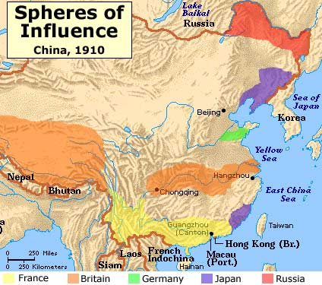
Europe
European powers forced trade
  Silk and tea
Took control of parts of the country
Chinese angry with emperor

Slide 13
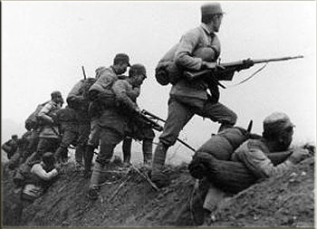
Revolution and Civil War
1911 – repels forced out last emperor
Republic
2 groups:
Nationalist – Chiang Kai-shek
Communist – Mao Zedong

Slide 14
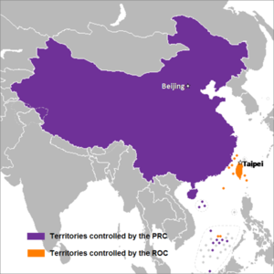
Civil War – Communists won
People’s Republic of China
Nationalist fled to Taiwan
  Republic of China

Slide 15
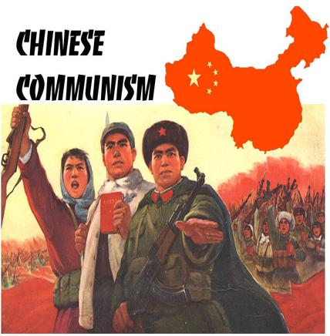
Communist China
Leader – Mao
Government:
Owns most business and land
Controls all areas of life

Slide 16
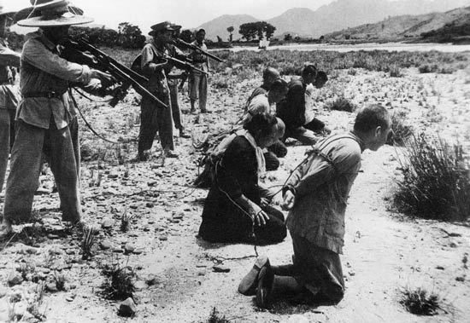
Seized all private farms and organized into large state run farms
Took over all business and factories

Slide 17
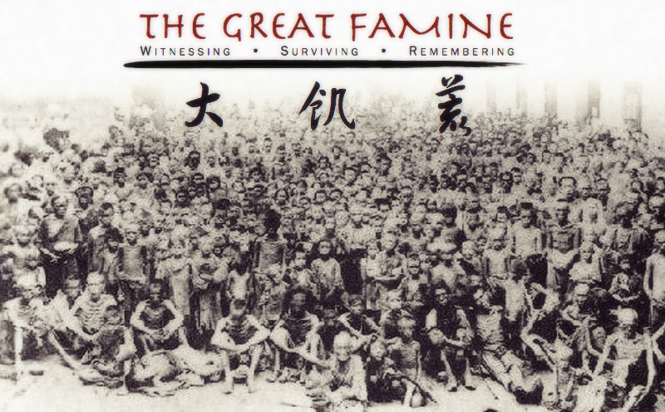
Women gained more rights
Limited freedoms
  Imprisoned people how criticized
Poor planning by government
  Famines

Slide 18
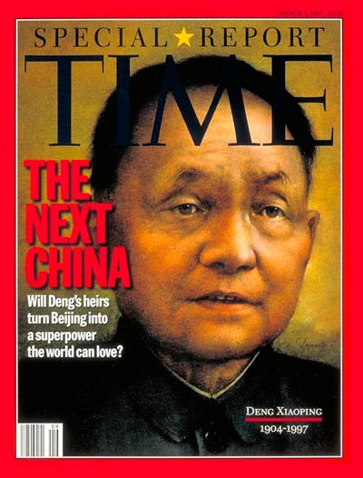
Deng Xiaoping – new leader
Modernized
Private business
Encouraged foreign investors

Slide 19
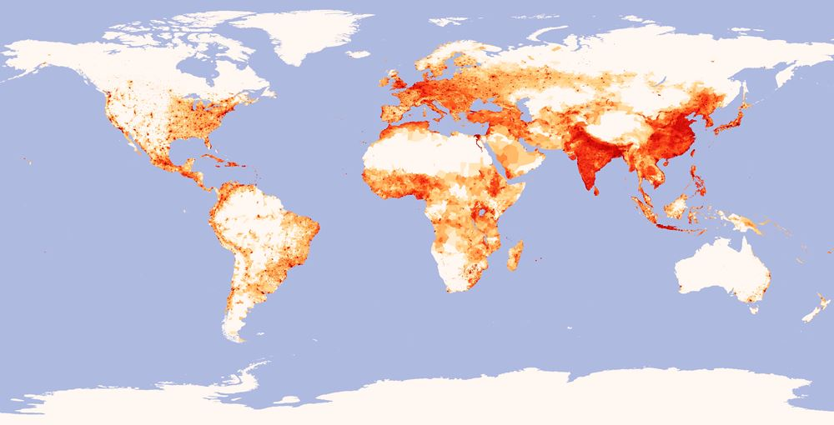
China’s People
1.3 billion
Largest population
More than Europe, Russia, and US combined

Slide 20
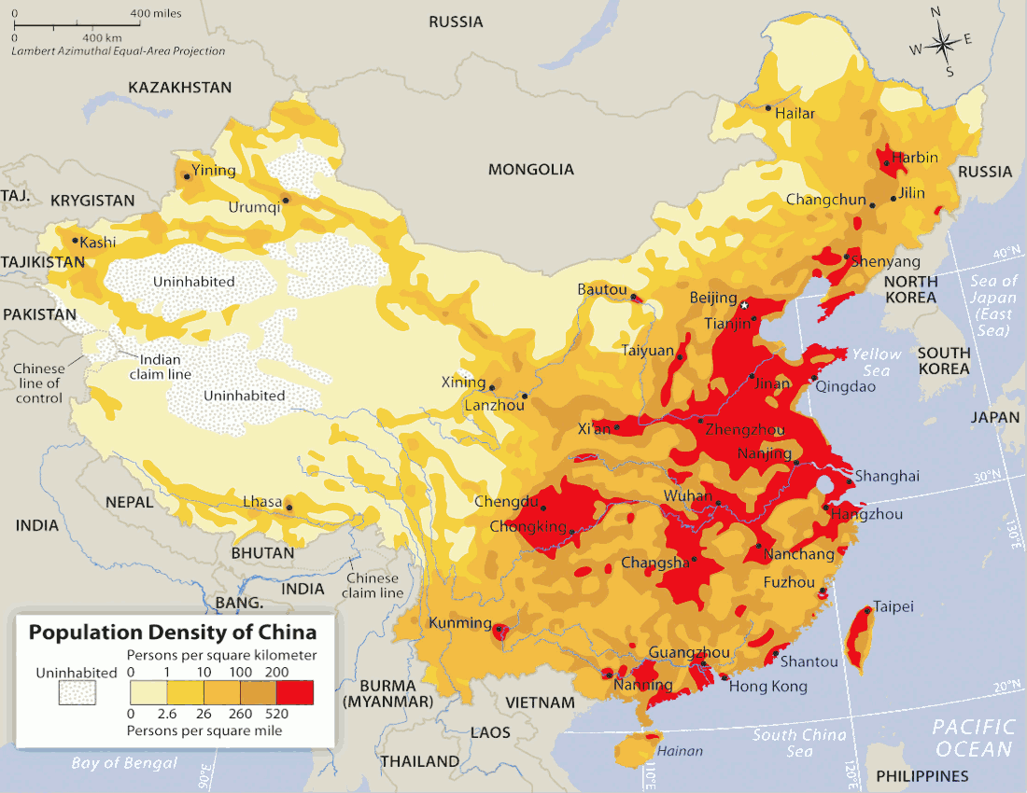
10% in west
90% in east
7 million new people a year
Tried to limit 1 child per family

Slide 21
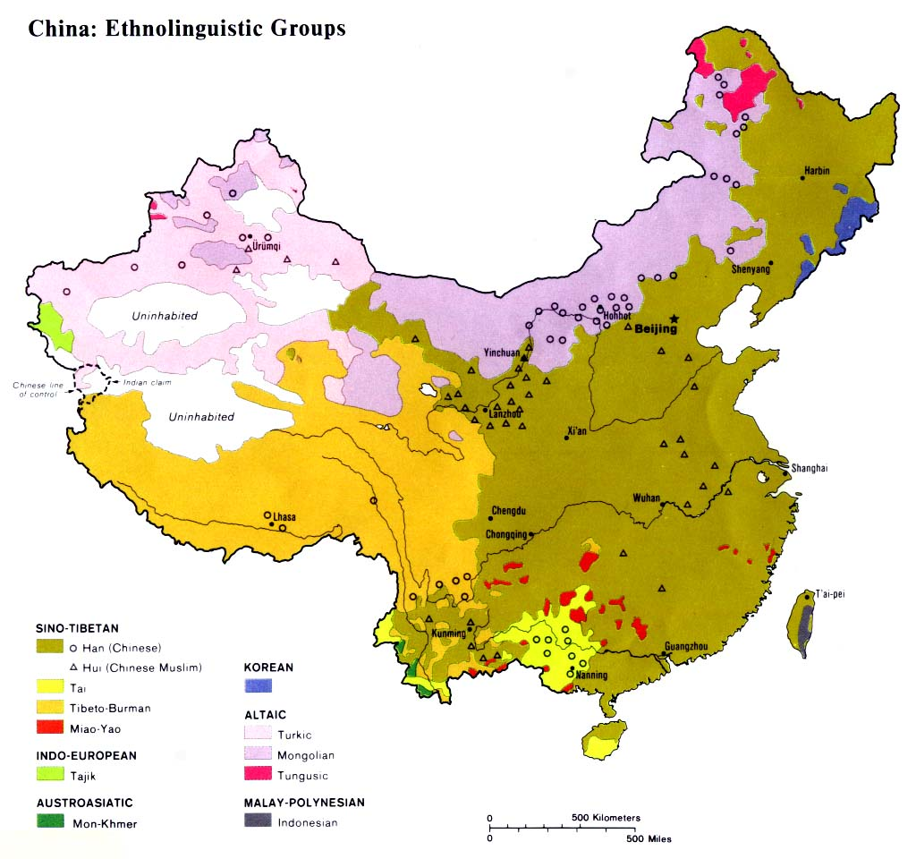
Ethnic Groups
Han Chinese - group
Mandarin – language
  Other dialects or variations

Slide 22
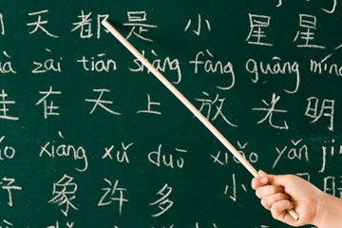

Slide 23
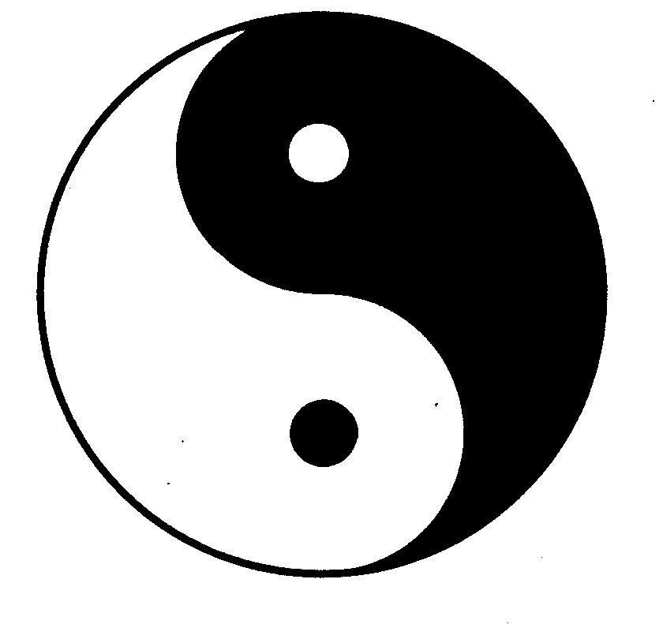
Religion
Daoism – living simply and in harmony with nature
  “The Way”
Buddhism

Slide 24
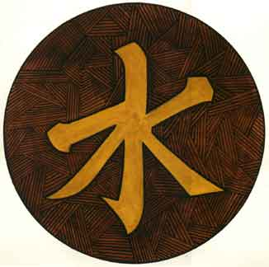
Confucianism – philosophy based on the ideas and teachings of Confucius
Family
Morals
Respect for elders

Slide 25
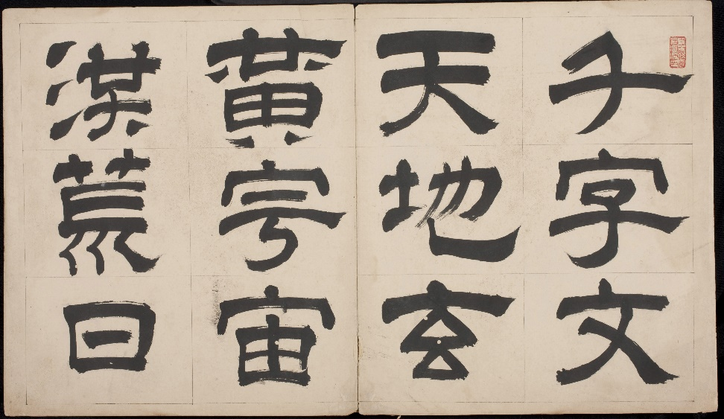
Arts
Chinese porcelain
Silk paintings
Calligraphy – decorative writing

Slide 26
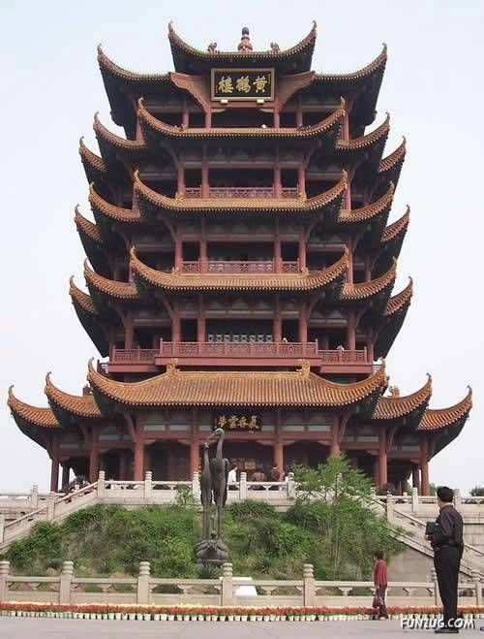
Pagodas – Buddhist temples
Multi-storied story towers
Upward curving roof at each floor

Slide 27
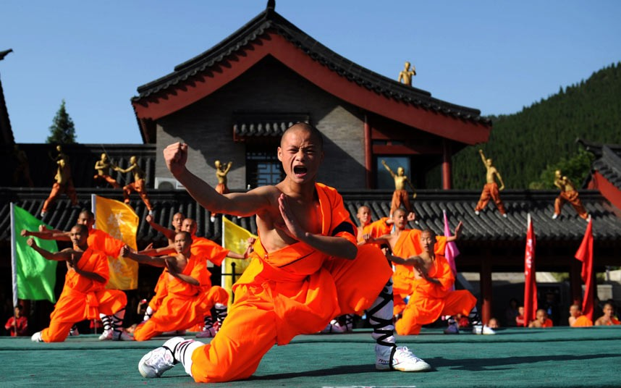
Martial arts
Table tennis
Karaoke

