Slide 1
25-4
India’s Neighbors

Slide 2
Countries
Pakistan
Bangladesh
Nepal
Bhutan
Sri Lanka

Slide 3
Sherpas
Ethnic group from mountains of Nepal
Himalaya guides

Slide 5
Tamil
Group from Sri Lanka
Came from India to work on plantations

Slide 6
Religion
Nepal – Hinduism
Bhutan and Sri Lanka - Buddhism

Slide 8
Pakistan
Lack of government stability
Established in 1947
2001 – Military coup rose to power
General Pervez Musharraf

Slide 9
2008 – Democracy
Elected Asif Ali Zardari

Slide 10
Rapid population growth
Struggles with resources and poverty
Kashmir – both India and Pakistan claim control
Armed troops – “Control line”

Slide 12
Aided the US on war on terrorism.
Many people believe there are terrorist still living there

Slide 13
Bangladesh
Size of Wisconsin
Population ½ of US
3018 people per square mile
Dhaka - capital

Slide 14
Flooding
Summer monsoons

Slide 15
Nepal
Population doubled in 30 years
Kathmandu – capital
One of the least developed nations
Deforestation – for farms

Slide 16
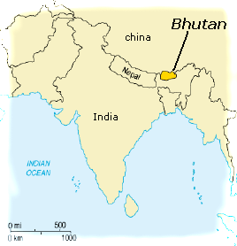
Bhutan
Very isolated – mountains
Established ties with Great Britain and India
Mid 1900’s ended isolation
Tourism

Slide 17
Sri Lanka
Island Country
20 miles from India
Tamil and Sinhalese – ethnic groups
Conflict

Slide 18
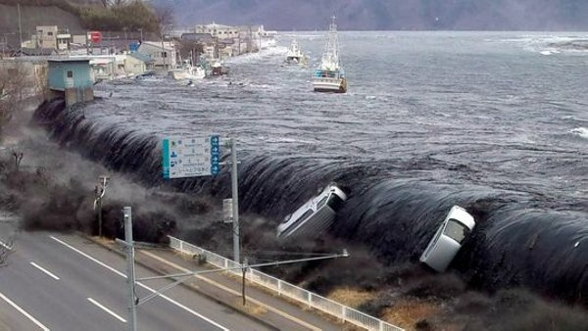
2004 tsunami
Thousands killed
500,000 homeless
Damaged industries

