Slide 1
25-3
India Today

Slide 2
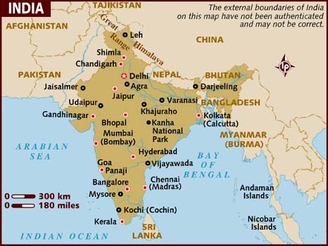
Daily Life
1.2 billion people
3 largest cities:
Mumbai (Bombay)
Delhi
Kolkata (Calcutta)

Slide 3
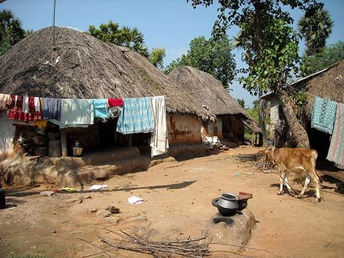
Villages
70% of population
Farming
Extended family
Simple homes

Slide 4
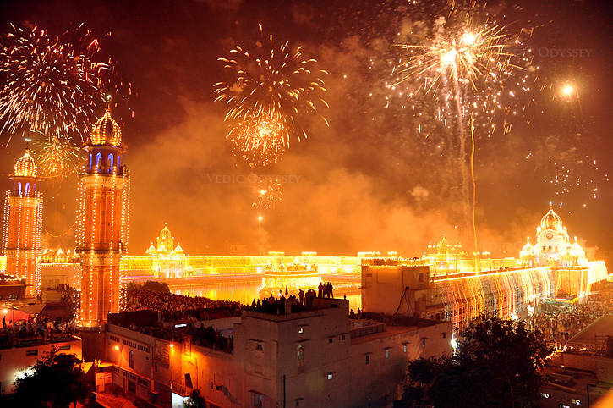
Religion
Hinduism
Native cultures: Sikhism and Jainism
Diwali – religious festival of lights

Slide 5
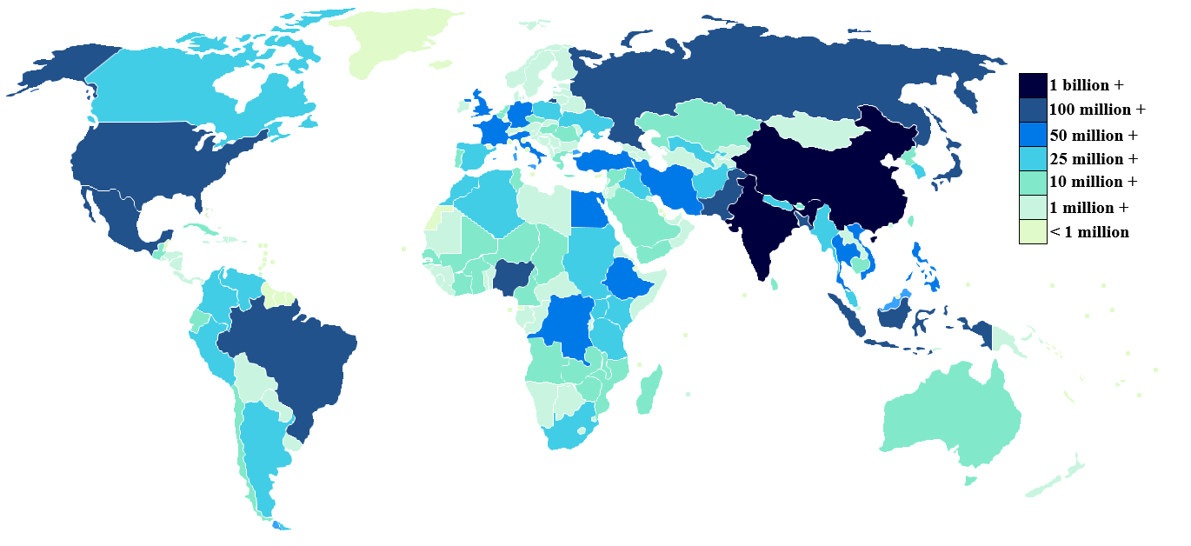
Challenges
Population – 2nd most populous country
China is #1
Strain on resources
Food
Homes
Schools

Slide 6
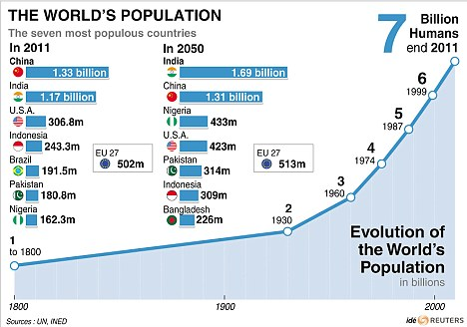

Slide 7
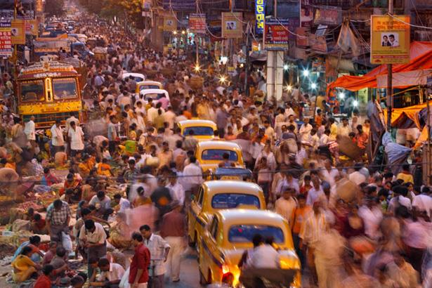
Urbanization – increase in the number of people who live in cities
Move into cities looking for jobs

Slide 8
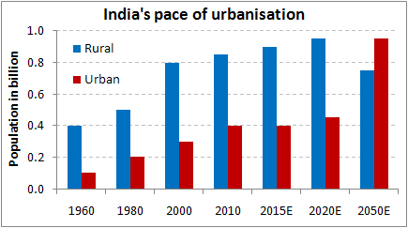

Slide 9
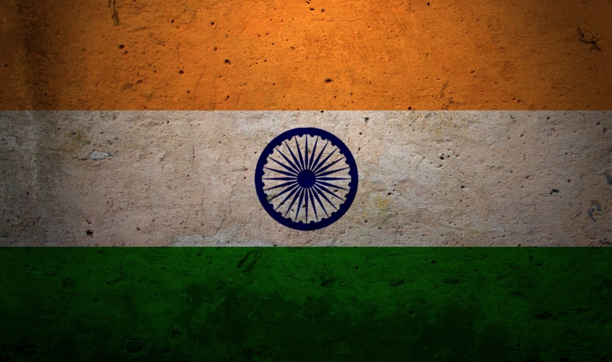
Government and Economy
Strengthened since independence
World’s largest democracy
One of the strongest nations in Asia

Slide 10
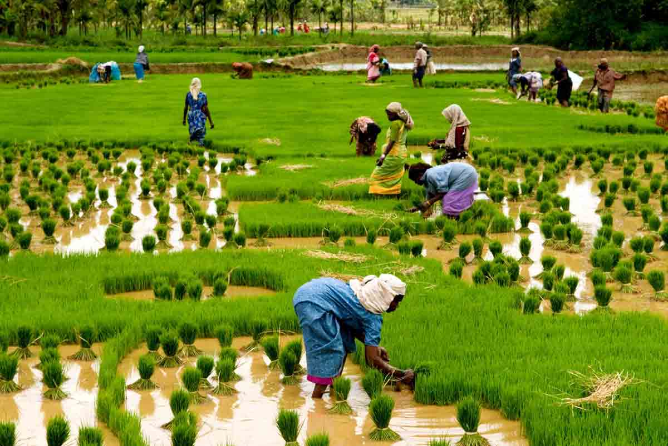
India and Pakistan have nuclear weapons
Conflicts
Lots of people still live in poverty
Green revolution – program that encouraged farmers to adopt modern agriculture methods

