Slide 1
25-2
History and Culture

Slide 2
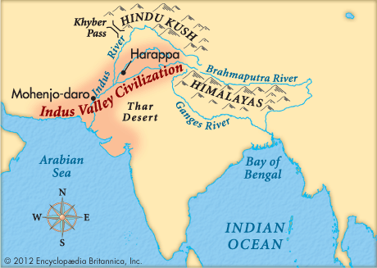
Ancient Civilizations
Indus River Valley (Pakistan)
Harappan
Invader or natural disasters lead to decline

Slide 3
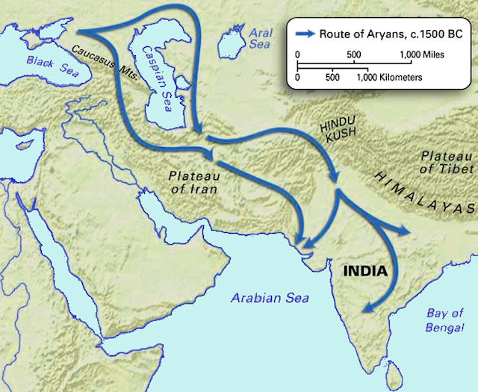
Aryans
Aryans – group from Central Asia
Powerful warriors
Settled fertile plains along Indus and Ganges rivers

Slide 4
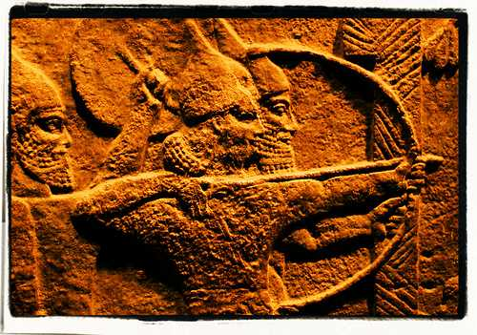
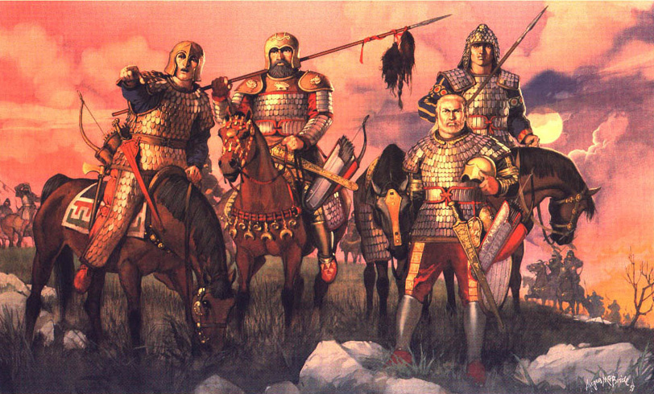

Slide 5
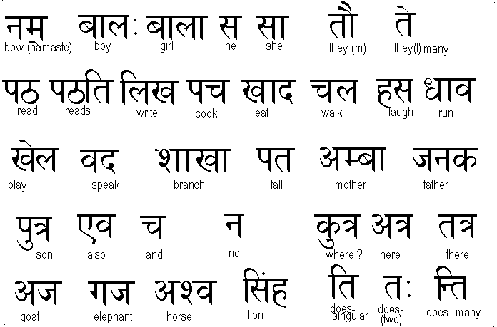
Aryans
Greatly influenced Indian culture.
Language – Sanskrit
  Basis for other languages (Hindi)
Social system
Hindu religion

Slide 6
Mauryan Empire
Mauryan Empire – conquered most of the subcontinent
Asoka – emperor
  Improved trade
  Expanded empire
  Encouraged - acceptance of other religions

Slide 7
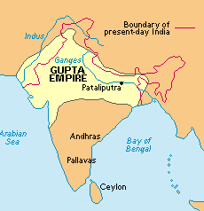
Splitting Up
India split into smaller kingdoms
Gupta Empire united Northern India
  Trade
  Culture – Scholars
    Math, medicine, astronomy
    Introduce the idea of 0

Slide 8
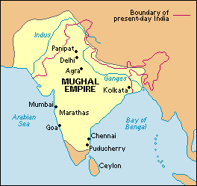
Mughal Empire
Muslim army invaded Indian Kingdoms
Lead by Babur
  Conquered much of India
Akbar – grandson
  Great leader

Slide 9
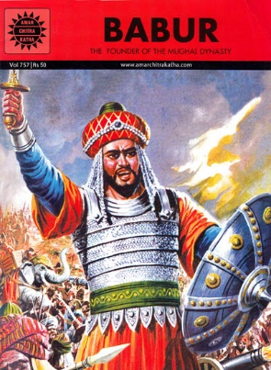
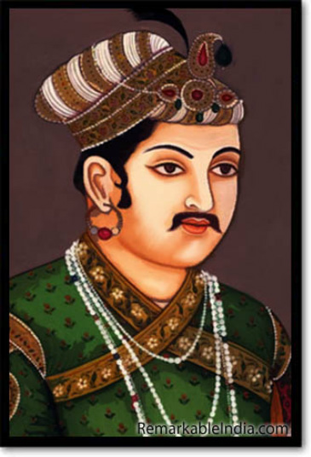

Slide 10
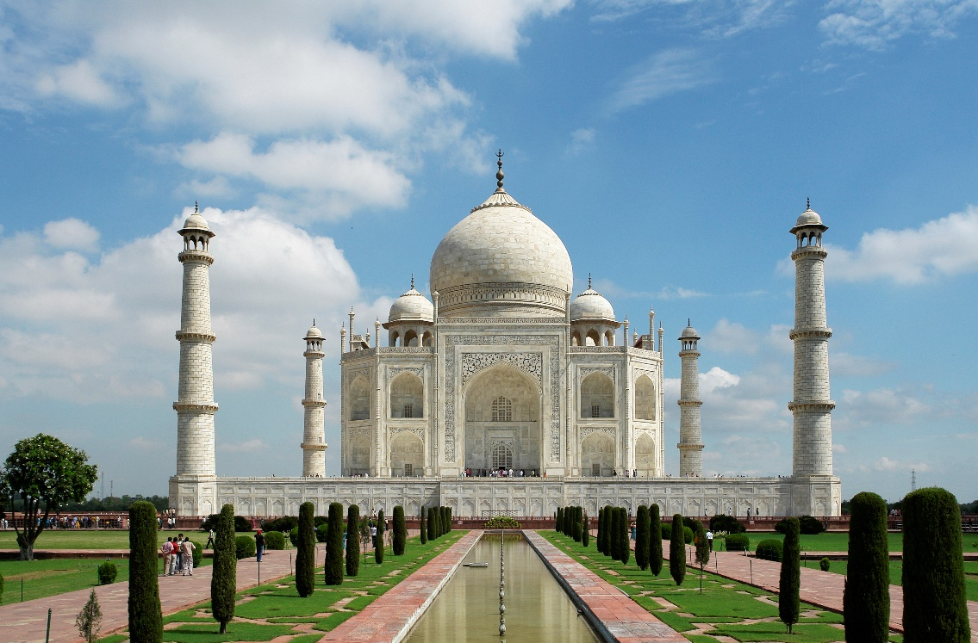
Religious freedom (Muslims and Hindus) – peace
Architecture – Taj Mahal built during this time

Slide 11
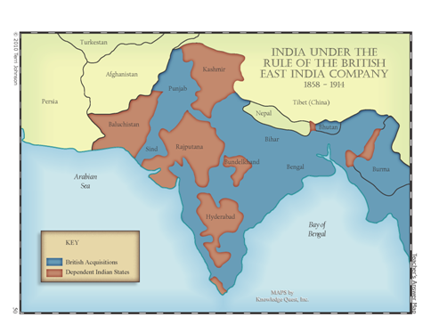
British Empire
England rose to power as Mughal empire declined
Rulers gave East India Company trading rights
  British company
  Eventually controlled ½ of India

Slide 12
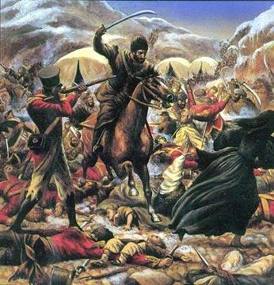
India became a British colony
  Territory controlled by a people from a foreign land
India rebelled
  British army crushed rebellion

Slide 13
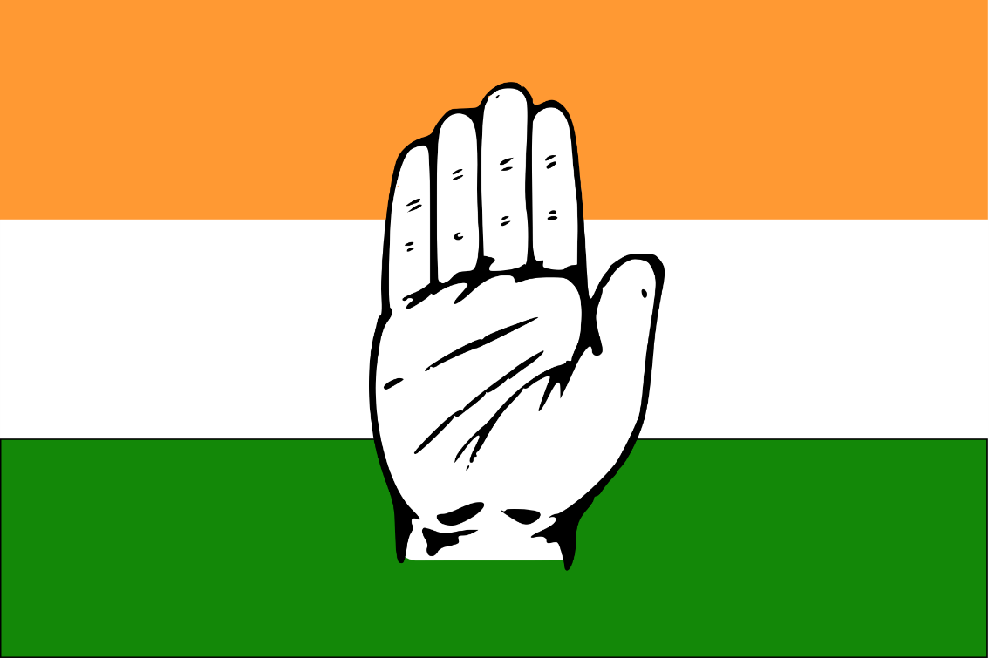
Independence
Indian National Congress – group created by Indians in order to gain more rights

Slide 14
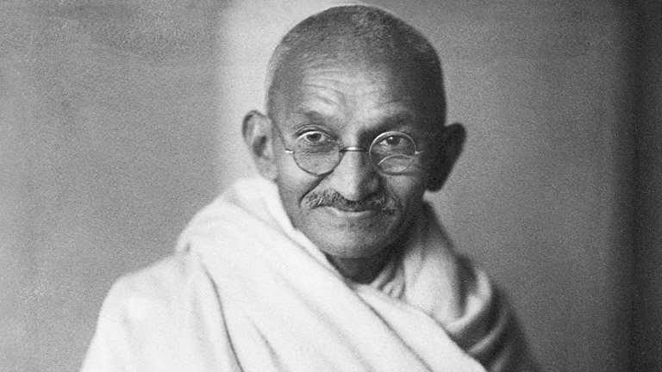
Mohandas Gandhi
Leader for Indian independence
Nonviolent protests
  Marches, boycotts
Independence was eventually granted
  Other countries followed soon after

Slide 15
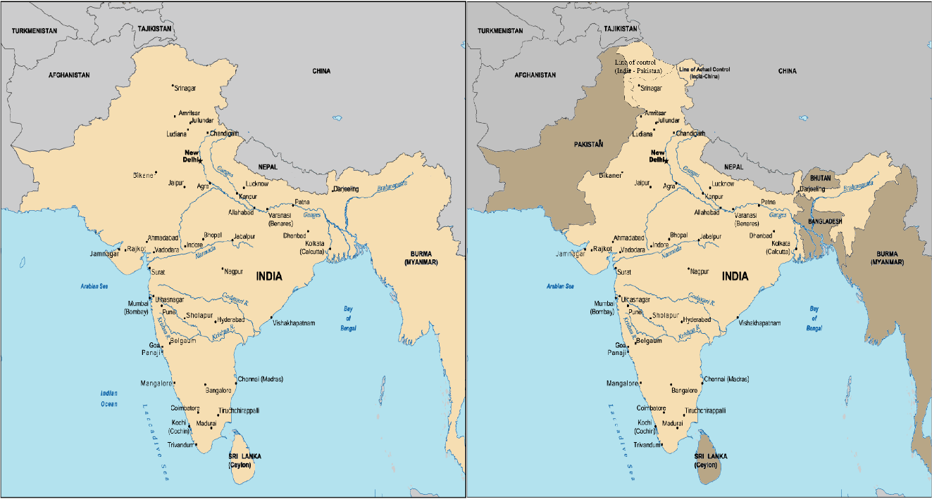
Partition
Division of India between Hindu and Muslim people
India – Hindu
Pakistan - Muslim

Slide 16
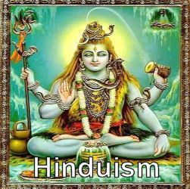
Hinduism
Very old religion
India
Everything in the universe is part of a single spirit – Brahman
Souls are reincarnated many times before you meet Brahman

Slide 17
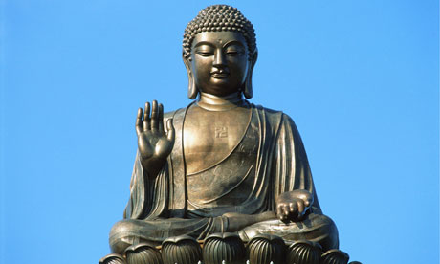
Buddhism
Teachings of Siddhartha Gautama – Buddha
Rise above need for material things
Nirvana – state of perfect peace where suffering and reincarnation end

Slide 18
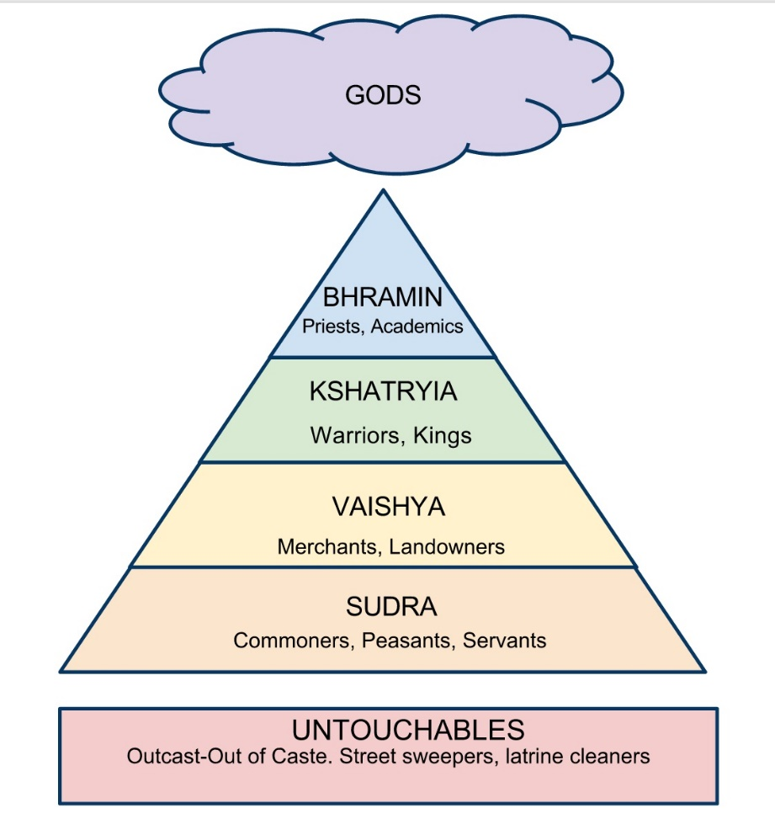
Caste System
Divided Indian society into groups based on birth or occupation
Rules against interacting with other castes

