Slide 1
25-1
Indian subcontinent
Physical geography

Slide 2
Subcontinent
A large landmass that is smaller than a continent
South Asia
7 countries:
Bangladesh, Bhutan, India, Maldives, Nepal, Pakistan, and Sri Lanka

Slide 3
Mountains
Hindu Kush – divide region from Central Asia
Eastern Ghats
Western Ghats
Low coastal mountains

Slide 4
Himalayas
1,500 miles
Tectonic collision
World’s highest mountains
Nepal and China

Slide 6
Mount Everest – highest mountain
29,035 ft
K2 – 2nd highest
Pakistan

Slide 9
Rivers
Ganges
Indus
Start in Himalayas
Floods leave fertile plains

Slide 10
Ganges – India and Bangladesh
Delta – formed at the mouth of a river from sediments deposition
Ganges Plain - farming

Slide 12
Indus River – river valley
Fertile plain
Home to early civilizations

Slide 13
Thar or Great Indian Desert
Tarai – Nepal
Topical jungles and fertile farmland

Slide 15
Climate
Climates vary through region

Slide 16
Monsoons
Seasonal winds that bring either moist or dry air
Summer – wet
Winter - dry

Slide 17
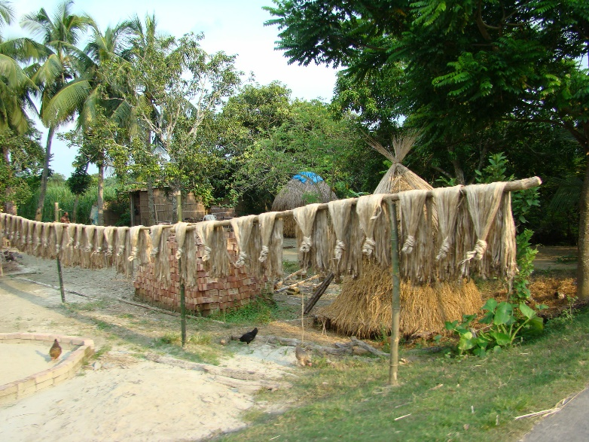
Natural Resources
Agricultural and mineral
Tea, rice, nuts, jute (rope material)
Irion ore, coal, natural gas

