Slide 1
23-1
Central Africa
Physical Geography

Slide 3
Landforms
Big soup bowl with a wide rim
Congo Basin – flat region surrounded by higher land

Slide 4
Western Rift Valley
Lake Nyasa (Lake Malawi)
Lake Tanganyika

Slide 6
Rivers
Congo River – drains the basin
Flows into Atlantic
Rapids and falls – stop travels to ocean

Slide 7
Zambezi River – flows into the Indian Ocean
Victoria Falls

Slide 9
Climate and Animals
Humid tropical
Warm, lots of rain
Rainforests

Slide 10
Okapis – short necked relative to giraffe
Gorillas, elephants, wild boars

Slide 11
Forests and animals are in danger from humans
North and south of the Congo Basin are tropical savanna

Slide 12
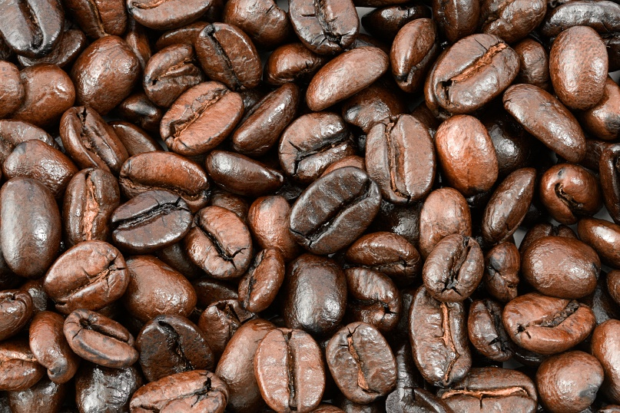
Resources
Subsistence farmers
Coffee, bananas, and corn

Slide 13
Periodic market – open-air trading market that is set up once or twice a week

Slide 14
Timber
Hydroelectric power
Oil, natural gas, coal

Slide 15
Copper belt – Northern Zambia and Southern Democratic of the Congo
Poor roads and political problems keep area from being fully developed

