Slide 1
22-2,3
East Africa
History and Culture

Slide 2
Christianity
Missionaries from Egypt spread religion to Ethiopia
Nubia – area of Egypt and Sudan

Slide 3
Christian emperor – Lalibela
Ethiopia
11 rock churches
City of Lalibela

Slide 5
Islam
Muslim Arabs from Egypt – spread religion
Mogadishu, Somalia
Mombasa, Kenya

Slide 6
Slave Trade
East Africans, Arabs, and Europeans
Shipped slaves to Islamic countries
Portuguese set up forts for slave trade

Slide 7
Zanzibar – slave trading center
Island

Slide 8
European Influence
European slavery ended in 1800’s
British wanted resources and more colonies

Slide 9
Imperialism – practice that tries to dominate other countries’ government, trade, and culture

Slide 10
1960’s – most gained independence
Ethiopia – never colonized
Mountains
Resistance by people

Slide 11
Language
Lots!
French, English - European
Swahilli – African
“On the coast”
Ethiopians – Amharic
Smolalians - Somali

Slide 12
Religion
Animist – natural spirits
Christianity
Islam

Slide 13
Tanzania and Kenya
Poor
Tourism and agriculture
Safari – wildlife viewing

Slide 14
Kenya
National park – can’t farm
Geothermal energy – heat from inside Earth

Slide 15
Modern cities
Dodoma – Tanzania capital
Moved from Dar es Salaam
Nairobi – Kenya capital
Industrial center

Slide 16
1998 – al Qaeda terrorist attack on US embassy
Kenya and Tanzania

Slide 17
Rwanda and Burundi
Densely populated
Tutsi and Hutu
Ethnic groups
Conflict
Genocide – intentional destruction of people
Hutu tried to wipe out Tutsi

Slide 19
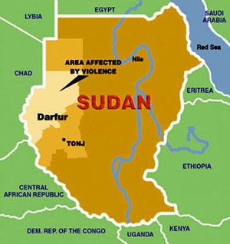
Sudan
Conflict between Christians and Muslims
Darfur – Sudanese killed by Arab militia
Thousands killed
Refugees fled
2011 - South Sudan gained independence

Slide 20
Uganda
Years of military dictatorship
Democracy
Slow to recover

Slide 21
The Horn of Africa

Slide 22
Ethiopia
Rich volcanic soil
Good agriculture
Drought – last 30 years
Rain recent

Slide 23
Eritrea
Broke away from Ethiopia after conflicts
Tourism – coral reefs

Slide 24
Somalia
Nomadic herders
Poor farmland
No central government
Clans fight over control of cities
Mogadishu

Slide 25
Pirates capture cargo ships

Slide 27
Djibouti
Port to sea is a major source of income
Civil War
Issa – close to Somalia
Afar - Ethiopia

